Slide 1
Empowering Self-Driving Networks
Patrick Kalmbach
Patrick.Kalmbach@tum.de
Johannes Zerwas
Péter Babarczi
Andreas Blenk
Wolfgang Kellerer
Stefan Schmid

Slide 2



Self-Driving Networks?
Analyze
Control
Measure
N. Feamster and J. Rexford, “Why (and How) Networks Should Run Themselves,” CoRR, vol. abs/1710.11583, 2017.
Notes:
What do we mean with self-driving networks? Especially with the driving? No Cars (I actually got that one a few times)
Its about continuously measure, analyze and control of a communication network. Allowing the operator to sit back and enjoy (I didn’t see that configuration coming)

Slide 3


Why Self-Driving Networks?
Cost
Control
?
Analyze
Measure
Control
Analyze
Measure
Complexity
Shortest Path Routing
Segment Routing
ECMP
Reconfigurable Networks
Notes:
At the moment its like this, operator measures, looks at the data and then makes control decisions. It worked and might even continue to do so – but at what cost?
Letting machines control networks
Unclear how exactly to do it
A lot of risk involved
High initial effort
Break-even point on the horizon? Ever more complex systems, mechanisms options.
High dynamicity
Large and high dimensional state space
Humans are not so good at this → Might machines be better suited to cope with upcoming challenges?
Autonomity to what degree?

Slide 4
Case Study: Reconfigurable Topologies
Each node can connect to any other node
Limited number of reconfigurable edges per node (degree limit)
Degree-Limit
Ring
One to many
Bulk transfer
M. Ghobadi et al., “ProjecToR: Agile Reconfigurable Data Center Interconnect,” in Proceedings of the 2016 ACM SIGCOMM Conference, New York, NY, USA
X. Jin et al., “Optimizing Bulk Transfers with Software-Defined Optical WAN,” in Proceedings of the 2016 ACM SIGCOMM Conference, New York, NY, USA
Notes:
Optimize no the routing to the network, optimize routing and topology jointly!
Many more degrees of freedom
State space explosion
How to leverage this newfound configurability?

Slide 5
Expectation to a Self-Driving Network
c
b
Configuration Space:
a
Request: a - b
+
Headroom
Use headroom intelligently!
Notes:
Requests must be satisfied, SLAs met
Cannot take seconds or minutes for a flow (as we have seen on tuesday, even milliseconds are too much)
Given this, there might be some headroom left, we expect from a self-driving network that it uses this headroom in an intelligent way
And no I did it, I said “intelligently”

Slide 6
“Intelligently” – A word simply said. But what does it mean?
“Everything else being equal, states are preferred that increase future possible options”
Potential for one request
Potential for three different requests
How to formalize this notion of preparedness?
A. S. Klyubin, D. Polani, and C. L. Nehaniv, “Empowerment: a universal agent-centric measure of control,” in 2005 IEEE Congress on Evolutionary Computation, 2005, vol. 1, pp. 128-135 Vol.1.
A. D. Wissner-Gross and C. E. Freer, “Causal Entropic Forces,” Phys. Rev. Lett., vol. 110, no. 16, p. 168702, Apr. 2013.
Notes:
What does “intelligence” mean? What does it reflect to?
I do not know this.
Some people, however, looked into the behavior of living organisms and derived a hypothesis.
This sounds very abstract, but this notion is successful in generating behavior that can be thought of as intelligent!
Also backed by novel theories from statistical physics.

Slide 7





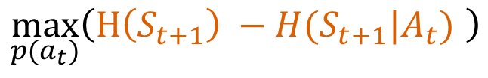


Empowerment
New request
Do Nothing
Environment
Leads to behavior that can be described as intelligent
$$R_{t−1}$$
$$R_{t}$$
$$R_{t+1}$$
$$S_{t−1}$$
$$A_{t−1}$$
$$S_{t}$$
$$A_{t}$$
Sensor
Actuator
$$\max_{p(a_{t})}\left(H\left(S_{t+1}\right) −H(S_{t+1}|A_{t}) \right)$$
Mutual Information
A. S. Klyubin, D. Polani, and C. L. Nehaniv, “Empowerment: a universal agent-centric measure of control,” in 2005 IEEE Congress on Evolutionary Computation, 2005, vol. 1, pp. 128-135 Vol.1.
Notes:
Gave rise to the notion of empowerment
Agent centric, information theoretic measure that quantifies how much influence an agent has on its environment.
How does it work:
Environment plus an agent equipped with actuators and sensors
Agent lives in environment and perceives it through its sensors
Not the whole environment, only what he can perceive!
Based on this he decides to act
Influences the environment
Additional changes and occurrences might also happen which are not in the control of the agent and he might not know about
Gets a new perception, makes new action…
Causal Bayesian Network! Actions have influence on future sensor states. Actor: sender, sensor: receiver, we want to maximize information transmitted between the two
Empowerment: Maximize mutual information between actions taken and sensors at later time step. That’s it.
Pretty abstract, but leads to behavior that can be described as intelligent

Slide 8
Empowerment – Strengths and Weaknesses
Agent Centric: Only information available to the agent is used.
Local: No complete world model needed.
Semantically unbiased: No external reward system is introduced.
Universal: Can be applied to arbitrary agent environment interactions.
BUT: Model needed that tells agent how actions influence the sensor to compute empowerment
Learn from data.
Use model free approaches.
Many Research Challenges for Networking!
Notes:
Does not need a complete world model, needs only to know how actions influence sensor values
Semantically unbiased: Makes it somewhat independt on the explicite environment (rain forest vs ocean, datacenter vs wide area)
BUT
Obtaining model for local dynamics (how actions affect sensors) also not known, but can be learned. Its not easy.

Slide 9
First Experiences
Actuator: Place edge, remove edge, do nothing
Sensor:
Number of routed flows (Simple)
Set of routed flows (Exact)
Notes:
- Figure is actually log scale (due to bits)

Slide 10
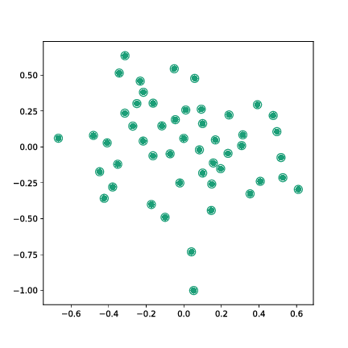
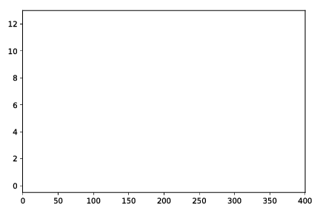
First Experiences
Actuator: Place edge, remove edge, do nothing
Sensor:
Number of routed flows (Simple)
Set of routed flows (Exact)
Empowerment [bits]
Time
Agent places edges at beginning to obtain sensor readings
Notes:
- Figure is actually log scale (due to bits)

Slide 11
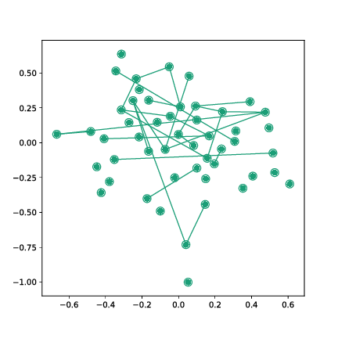
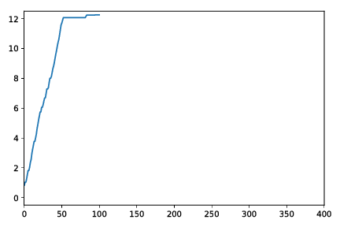
First Experiences
Actuator: Place edge, remove edge, do nothing
Sensor:
Number of routed flows (Simple)
Set of routed flows (Exact)
Empowerment [bits]
Time
Agent rearranges edges to further increase empowerment
Notes:
- Agent reached a configuration space with high empowerment, hops from more or less equivalent solutions to others → relation to sampling methods → basically generates an ensemble of graphs on which the agent has highest empowerment → How do those graphs look like?

Slide 12
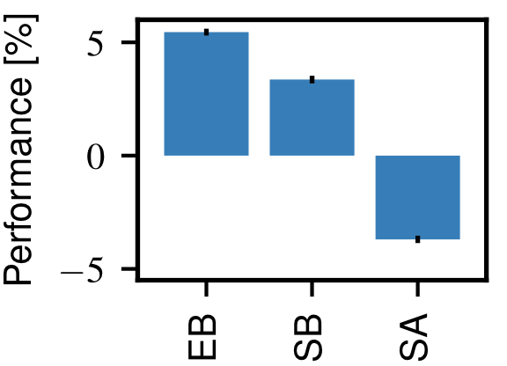
First Experiences
Exact
Simple
Simulated Annealing
Empowerment maximization prepares for more future requests
Notes:
→ For details see paper, Empowerment better than robust optimization and SA (but not always)

Slide 13
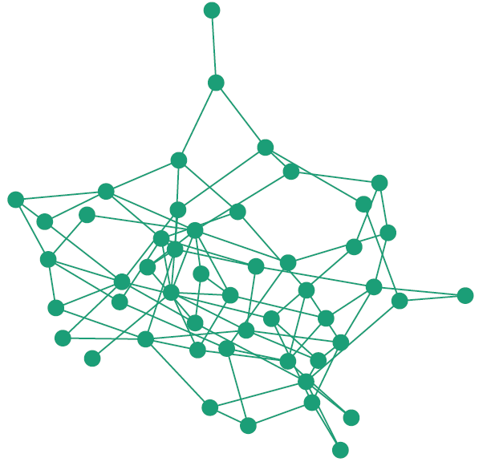
Summary, Lessons Learned and Outlook
Empowerment-driven agent builds a “good” network topology
Empowerment vs. extrinsic goals → Empowerment secondary
High dimensional sensor states make computation difficult
Actuator should be higher level actions
Empowerment as universal utility function? → Impact on performance metrics
Sensor evolution in communication networks
Unsupervised learning of control strategies

Slide 14
Thank You!

Slide 15
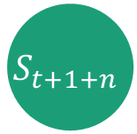
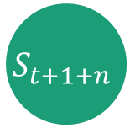
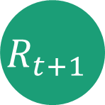
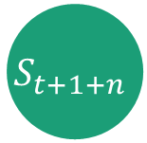






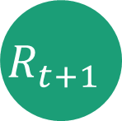
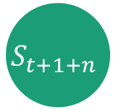
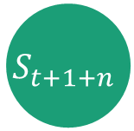

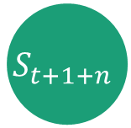

N-step empowerment
$$S_{t+1+n}$$
$$S_{t+1+n}$$
1000 random action sequences of length n
$$S_{t+1+n}$$
$$R_{t+1}$$
$$S_{t+1+n}$$
add edge
$$S_{t+1+n}$$
$$R_{t}$$
$$R_{t+1}$$
$$S_{t+1+n}$$
remove edge
1000 random action sequences of length n
$$S_{t+1+n}$$
$$S_{t+1+n}$$
do nothing
$$R_{t+1}$$
$$S_{t+1+n}$$
$$S_{t+1+n}$$
1000 random action sequences of length n
$$S_{t+1+n}$$
$$S_{t+1+n}$$

Slide 16
Obtaining Results
Possible Request Sets
Max num reconfigurations
Empowerment
Simulated Annealing
ILP
ILP
Final Topology

Slide 17
Self-DN tasks
Goals
Networks
Task and properties of system must be translated into a utility function
→ A big hassle!
Mitigate Congestion
Data Center
Minimize Latency
Wide Area
Increase throughput
Campus
Minimize Packet Drops Rate
Notes:
- Designing utility functions are a hassle

Slide 19
Today:
Traffic Engineering
Tomorrow:
Virtualization
Reconfigurable Topologies → our use-case

Slide 20



Case-Study: Reconfigurable Topologies
Reconfigurable
Network:
$$G=(𝒱, ℰ)$$
Degree constraint
Uncertain Demand:
$$𝓓_{RO}≔2^{𝒱×𝒱}$$
Set of routed requests
$$\max_{{D^{′}∈ 𝓓}_{RO}}\left(\min_{ℰ∈𝒱×𝒱 }\left|𝒟^{′}/ f(𝒟^{′}, ℰ)\right|\right)$$
→ Maximize number of routed requests
Objective:

Slide 21
Agent – Environment Framework
Actuators:
Sensors:
EQR: ExactRequests
NQR: NumRequests
EP: Edge-Placer
ER: Edge-Remover
IDL: Idler
3
Obtain Sensor Readings performing shortest path routing of requests
Embodiments:
Simple Builder (SB): NumRequests Sensor
Exact Builder (EB): ExactRequests Sensor

Slide 22
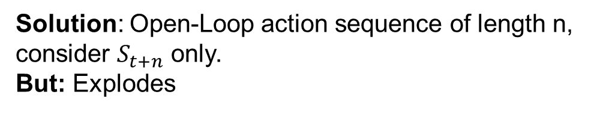
n-step Empowerment and Sparse Sampling
Action in t might not take effect immediately:
…
Solution: Open-Loop action sequence of length n, consider $S_{t+n}$ only.
But: Explodes
→ Sampling a fixed number of action sequences is enough

Slide 23
Self Adapting Networks
H1
{(H1, H4)}
H2
H4
{(H1, H4), (H2, H4)}
{(H2, H4)}
Increase number of future options!
Re-Route
Do Nothing
{(H2, H4)}
{(H2, H4)}
H3
{(H2, H4),
(H1, H3)}
{(H2, H4),
(H3, H4)}
{(H1, H4), (H2, H4)}
{}
{(H1, H4), (H2, H4)}
{}

Slide 24
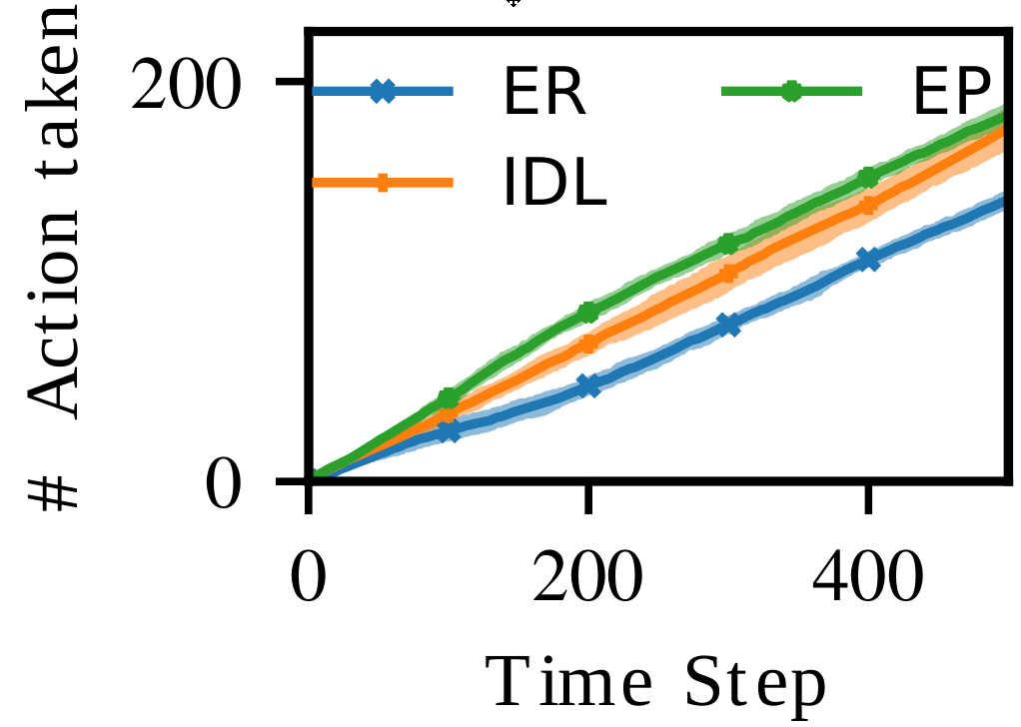
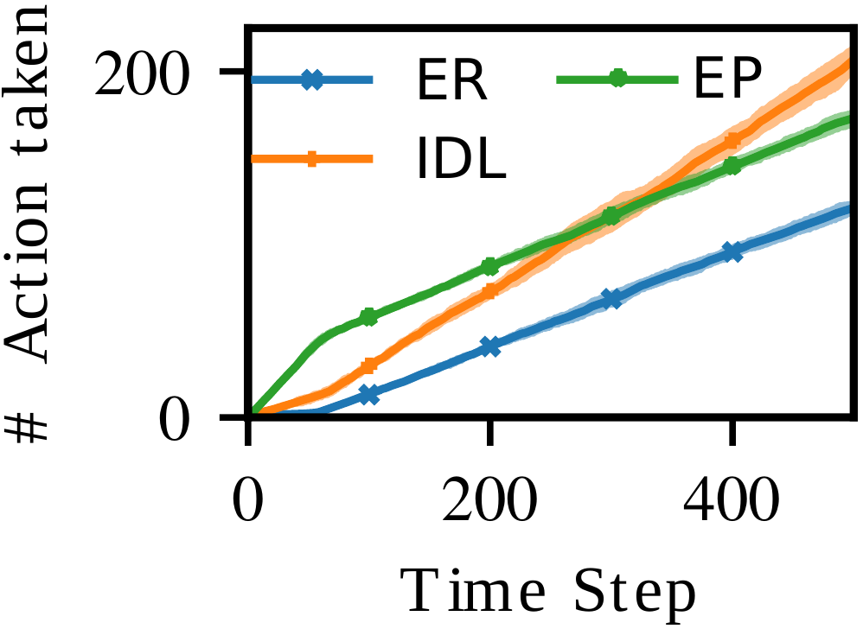
Agent Behavior
SimpleBuilder, Horizon 10
ExactBuilder, Horizon 10
→ Agent first places edges and then chooses to do nothing

Slide 25
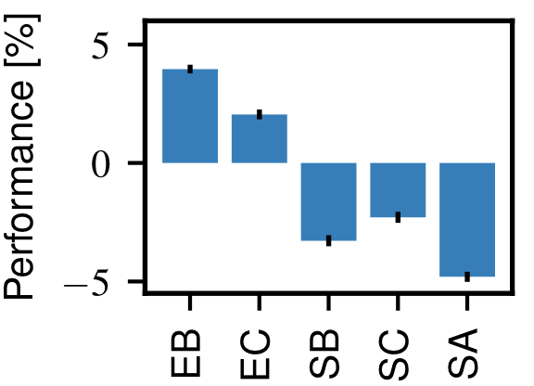
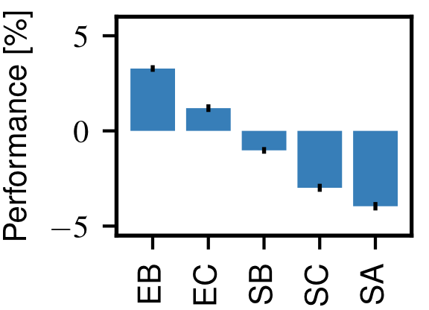
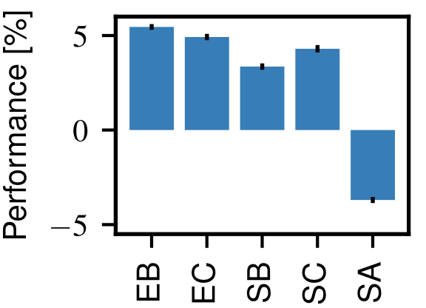
Performance Comparison
Horizon 5
Horizon 10
Horizon 15
Embodiments with Exact Sensor superior to Baselines
Increasing horizon increases this effect

Slide 26
Warum nicht robust optimization?
Warum nicht oblivious routing?
Warum brauchen wir empowerment?

Slide 27
The curse of Flexibility
Increasing complexity
Real time decisions
Notes:
Refer to Scott Shenker representation: Extract simplicity
Recent trends (Virtualization, SDN, P4) increase the capabilities that can be used in networks
Configurable Control Plane
Configurable Data Plane
Configurable Phyiscal Layer
Decision must be made in real-time and online

Slide 28
Why do we need data driven approaches?
Many components
Virtualization adds additional layers
What is the impact of, e.g. changing a flow on latency?
What happens inside a hypervisor with multiple tennants?
Notes:
Real time management requires the optimization of networking across a complex web of interacting protocols
Virtualization adds to the party:
What is the impact of a specific placement?
How does hardware or switch internal state impact things?
What is the impact of virtualization on QoS measures?
→ cannot be modeled close looped
→ ML and statistical learning is better suited for this type of task

Slide 29
Agent – Environment Framework
Actuators:
Sensors:
EQR: ExactRequests
NQR: NumRequests
EP: Edge-Placer
ER: Edge-Remover
RP: Request Placer
RR: Request Remover
IDL: Idler
3
Embodiments:
Simple Builder (SB): ({EP, ER, IDL}, {NQR})
Exact Builder (EB): ({EP, ER, IDL}, {EQR})

Slide 30

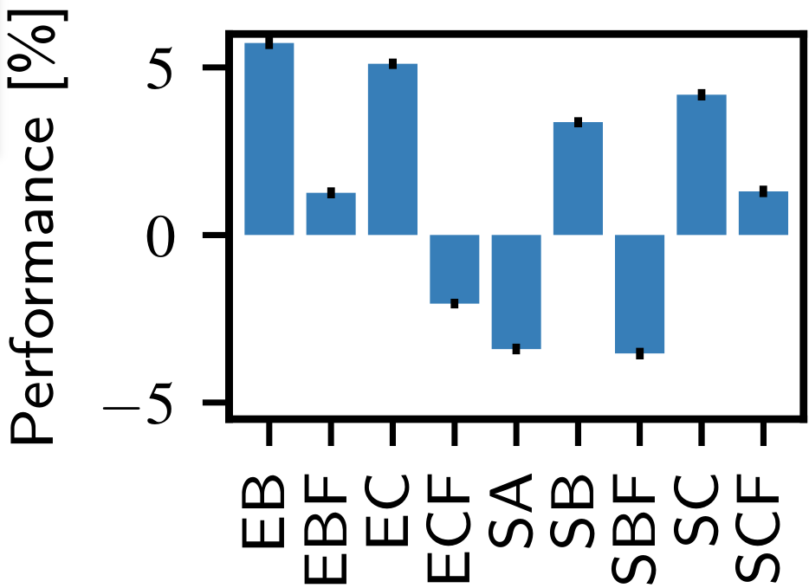
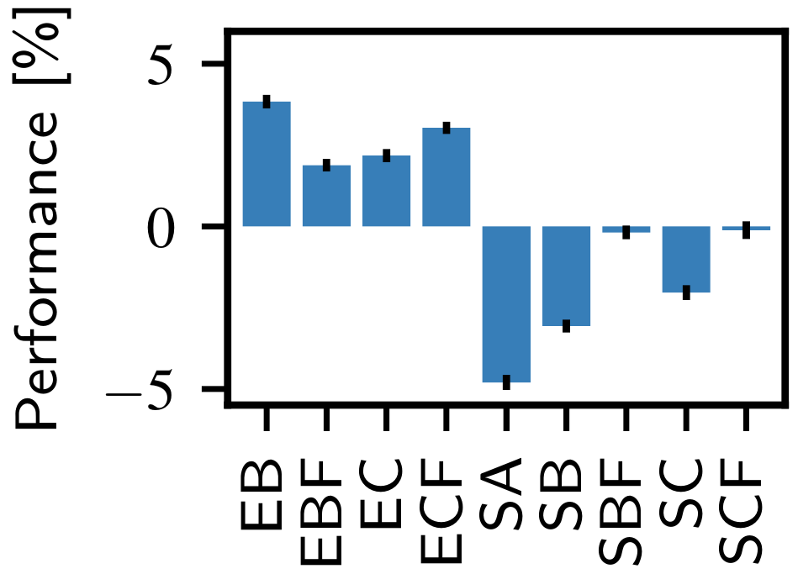


Performance Comparison
Embodiments with Exact Sensor superior to Baselines
Increasing horizon increases this effect

Slide 31
Survival of the fittest
What should a self-driving network strive for?
What should a self driving network optimize for?
→ Maximize future options
Notes:
But what should a self-driving network optimize for?
Data-Center Network is different from Campus Network is different from Wide Area Network, and each class has different types with different goals and requirements
One specific and optimized system for each use-case?
Might solve brittle solution since overengineered
Expensive
Different to port between systems
Is there a more general framework?
In the end we want to increase utilization by keeping certain constraints at the same time
What would be intelligent? → Actively adapt such that many future states can be reached → Prepare for the future

Slide 32
How can “preparedness” be quantified
Empowerment

Slide 33
Szenario

Slide 34
Results

