Slide 1



Chameleon: Scalable Adaptation of Video Analytics
Junchen Jiang, Ganesh Ananthanarayanan, Peter Bodik, Siddhartha Sen, Ion Stoica

Slide 2

Credit: Junchen Jiang
Postdoc at MSR NYC → Professor at U. Chicago

Slide 3
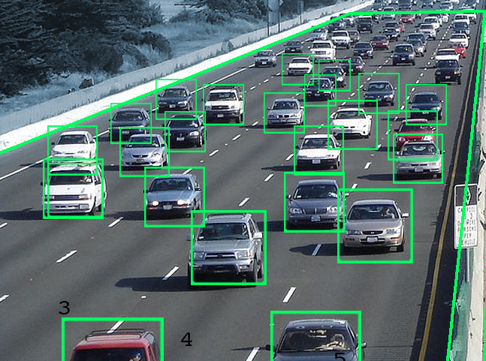
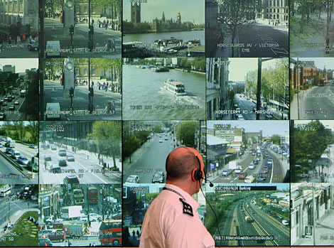
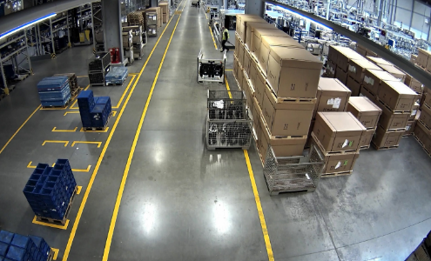
Cameras & video analysis apps are pervasive
Traffic control
Surveillance
Factory health/safety
This talk: Scalable adaptive video analytics

Slide 4
Current trends in video analytics
Trend #1:
Higher accuracy, higher cost

Slide 5
Current trends in video analytics
Trend #1:
Higher accuracy, higher cost
Trend #2:
More cameras, more content
High accuracy + low cost at scale?
Accuracy = Precision/Recall (F1 score)
Cost = GPU processing time

Slide 6
Prior work
Customize the video pipeline to the video content

Slide 7
Video analytics pipelines are configurable
Configurations:
Resolution
Frames rate
Object detector
(e.g., VideoStorm)
(e.g., NoScope)
480p
Resizing & Frame Selection
…
DNN Object Detection
(e.g., YOLO)
1280p

Slide 8
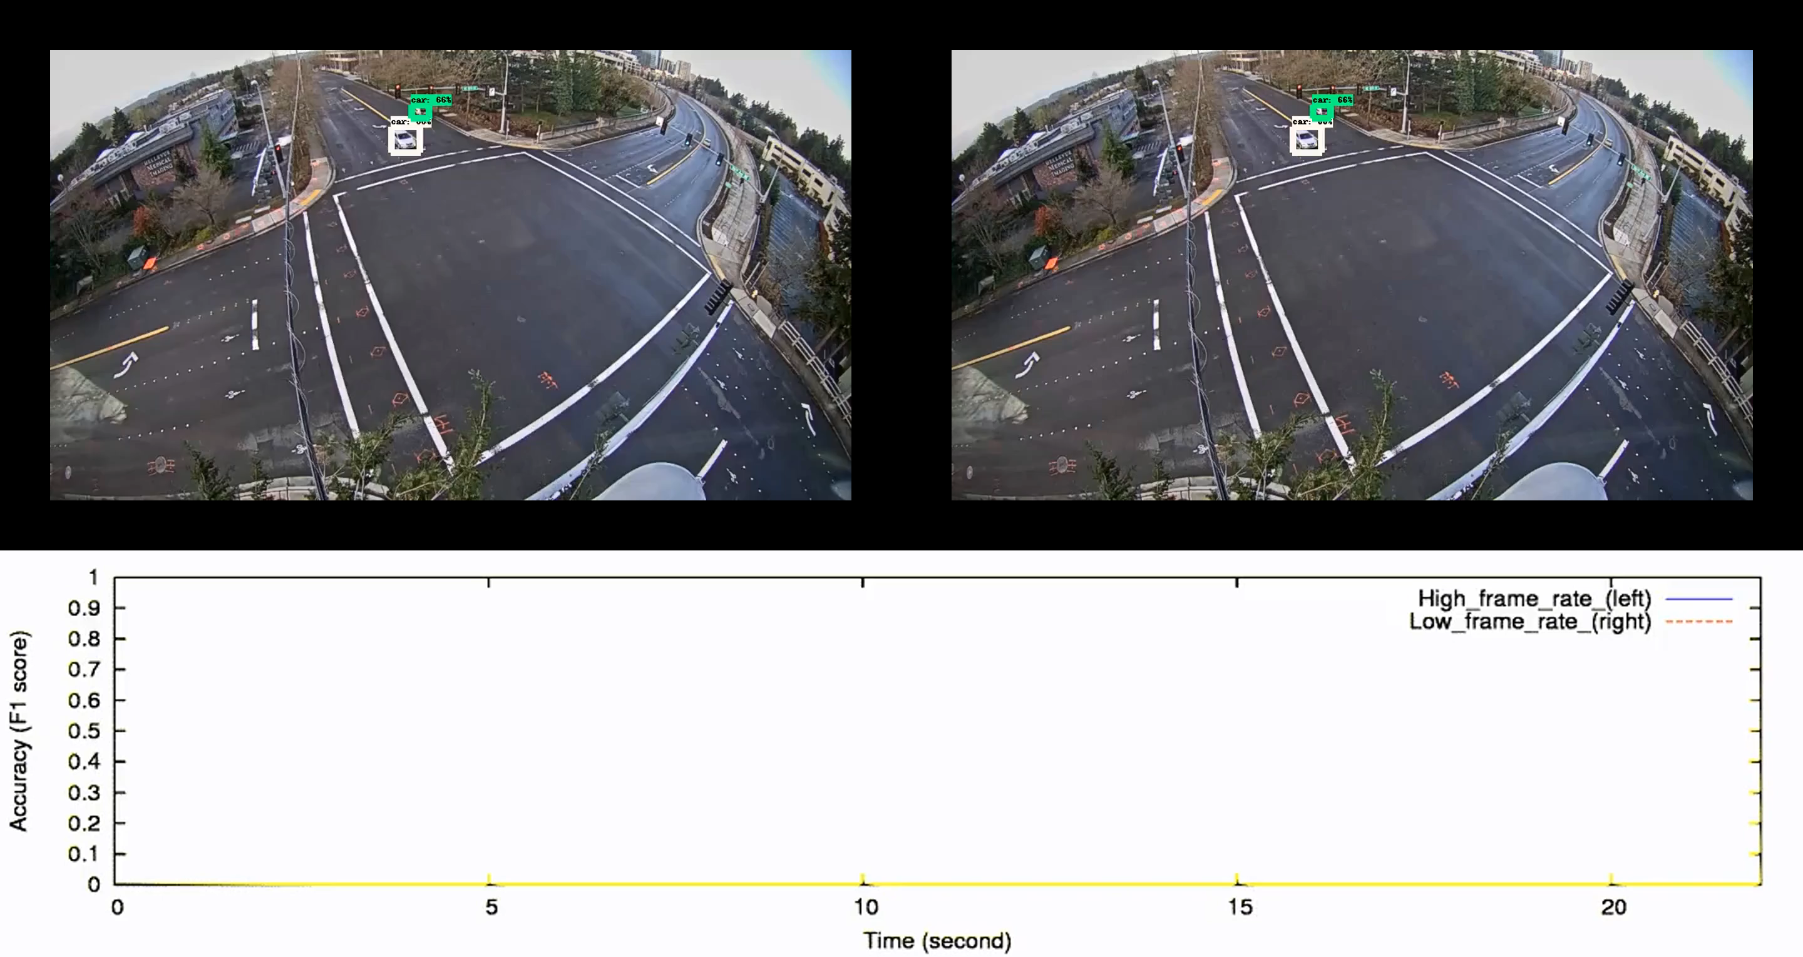
Example: Lower frame rate

Slide 9
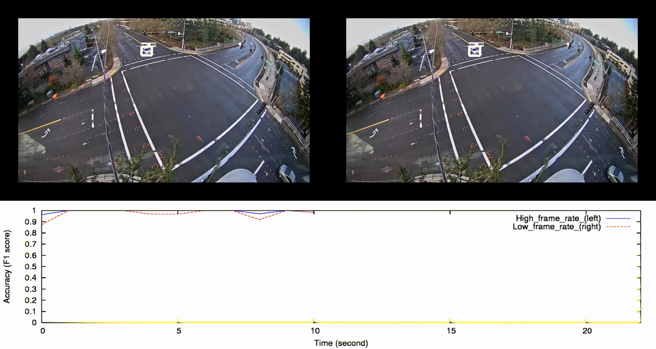
Problem: Best frame rate depends on content!

Slide 10
Key observation
Holds for other configuration knobs (resolution, NN classifier, etc.)
Prior work does one-time profiling at beginning
Video content varies over time
⇒ best configuration varies over time

Slide 11
Our approach: periodic reprofiling
Adapt
dynamic
Customize the video pipeline to the video content
>

Slide 12
Our approach: periodic reprofiling
Configurations:
Resolution
Frames rate
Object detector
480p
Resizing & Frame Selection
…
DNN Object Detection
(e.g., YOLO)
1280p

Slide 13
Our approach: periodic reprofiling
Configurations:
Resolution
Frames rate
Object detector
Chameleon:
Configuration Controller
480p
Resizing & Frame Selection
…
DNN Object Detection
(e.g., YOLO)
1280p

Slide 14
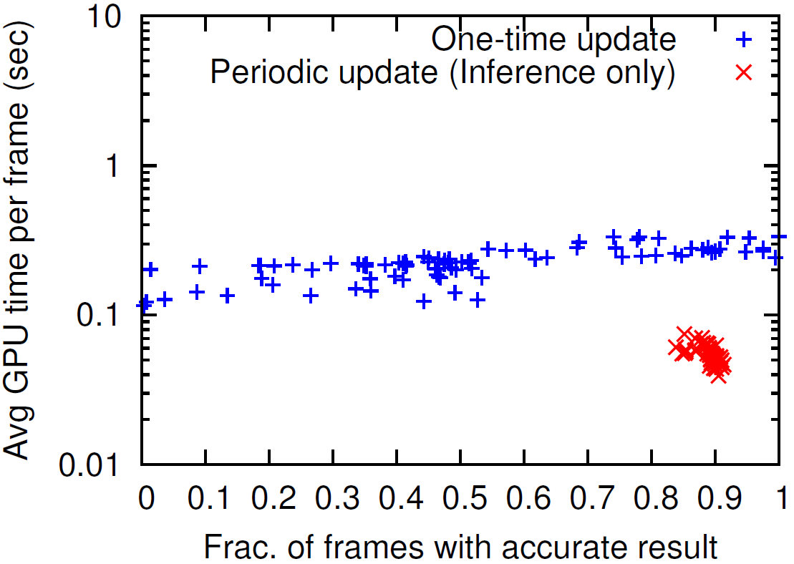
Potential win…

Slide 15
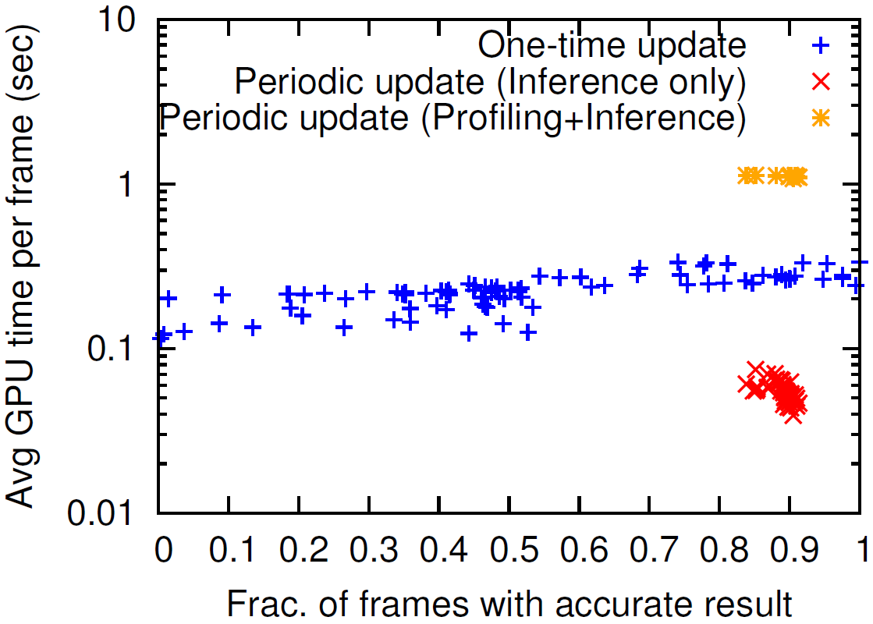
Potential win… but at what cost?
Key challenge:
Reduce the profiling cost!

Slide 16
Our approach:
Customize the video pipeline to the video content
Adapt
dynamic
>
Key challenge:
Reduce the profiling cost!
    Idea #1: Temporal correlation
    Idea #2: Spatial (cross-camera) correlation
    Idea #3: Independence of configurations

Slide 17
Idea #1: Temporal correlation
Insight: Underlying characteristics of video remain stable for short periods of time
  E.g.: size/class of objects, viewing angle
  Good configurations tend to remain good, bad tend to remain bad

Slide 18

Idea #1: Temporal correlation

Slide 19
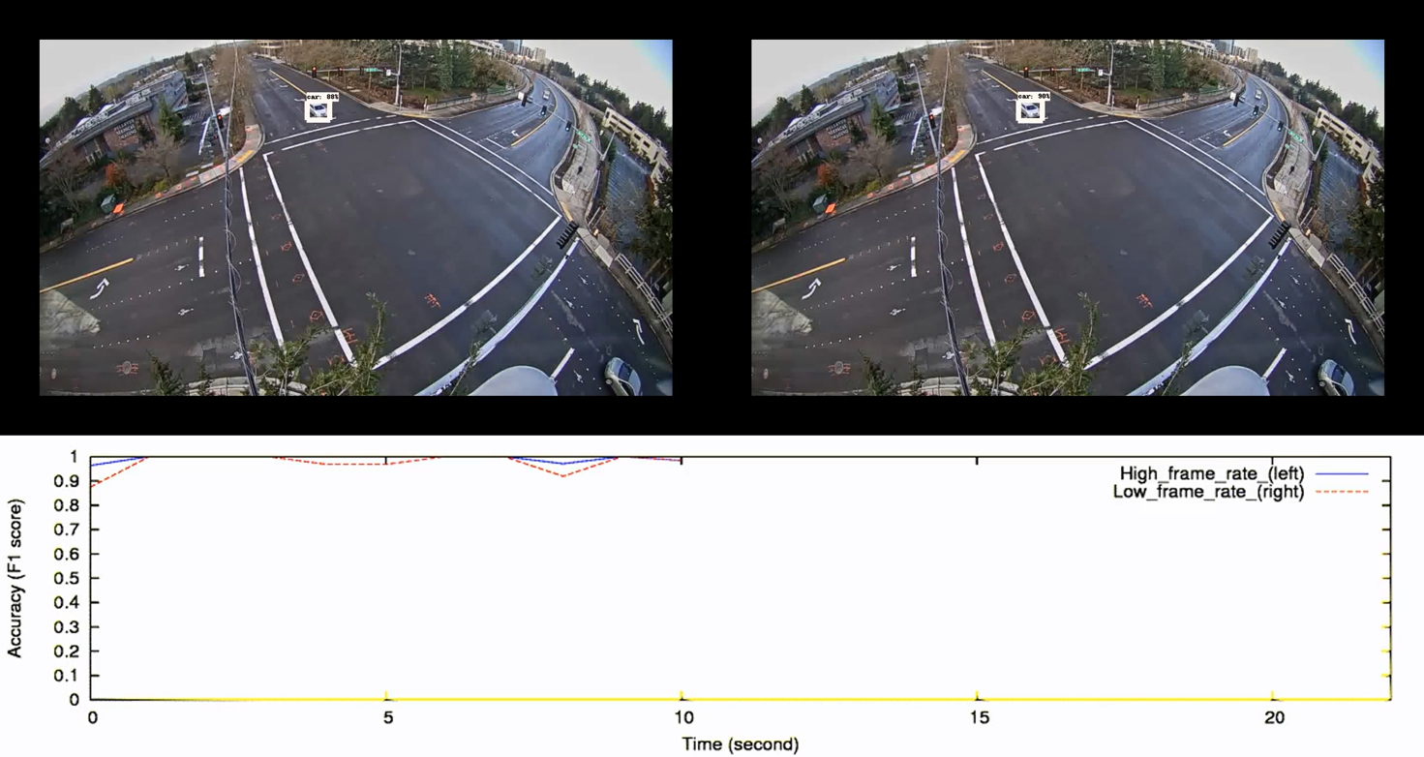
Idea #1: Temporal correlation

Slide 20
Idea #2: Cross-camera correlation
Insight: Many cameras feeds share similar characteristics
  E.g.: traffic cameras in a city see similar vehicles, weather, and viewing angles (thanks to uniform installation policies)
  Good/bad configurations for one camera tend to be good/bad for others
How to find groups of similar cameras?
  Current solution: very simple offline clustering (see paper)

Slide 21
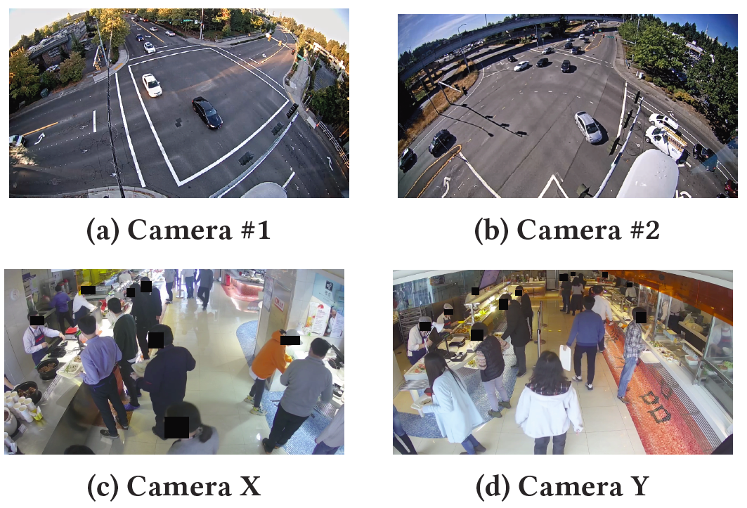
Idea #2: Cross-camera correlation

Slide 22
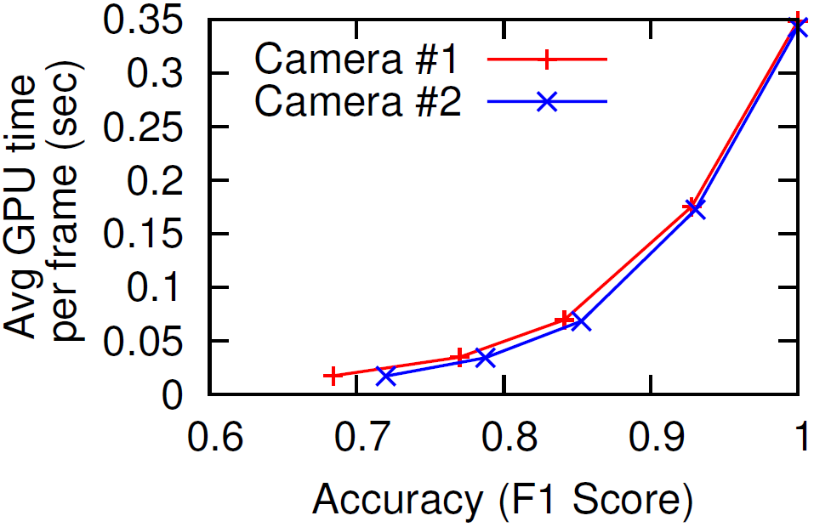
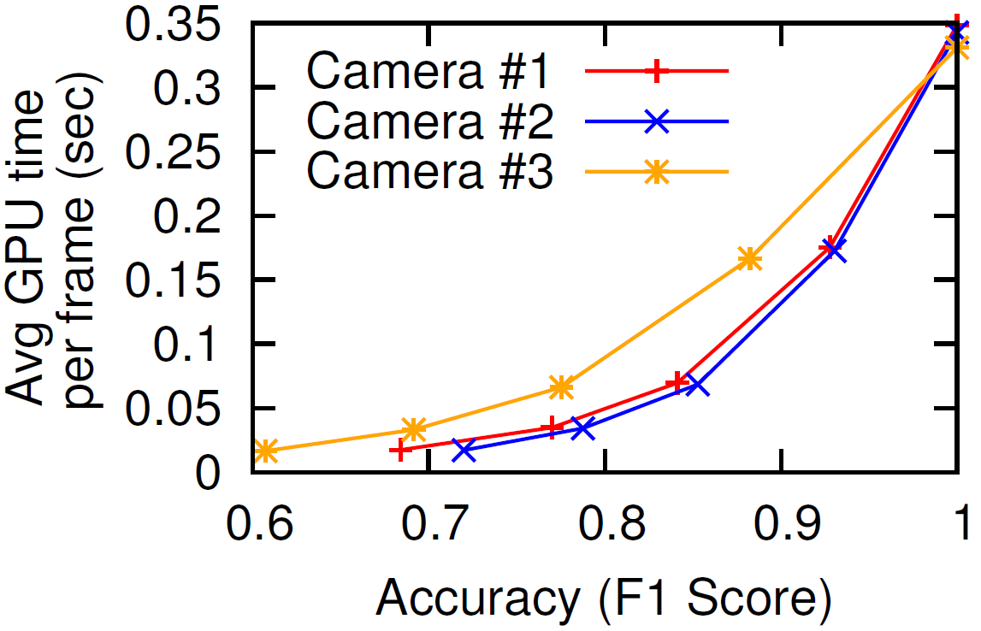
Idea #2: Cross-camera correlation

Slide 23
Some caveats
Applying the single best configuration temporally/spatially is unstable
  But top-k configurations are more stable
Correlations do not hold indefinitely
  Must periodically explore the full configuration space

Slide 24
Putting them together (Chameleon)
leader
follower 1
follower 2

Slide 25
Putting them together (Chameleon)
…
…
profiling window
leader
follower 1
follower 2

Slide 26
Putting them together (Chameleon)
…
…
profiling window
leader
follower 1
follower 2
segments 1 - 4

Slide 27
Putting them together (Chameleon)
…
…
profiling window
leader
top-k configs
follower 1
follower 2
segments 1 - 4

Slide 28
Putting them together (Chameleon)
…
…
profiling window
leader
top-k configs
follower 1
follower 2
segments 1 - 4

Slide 29
Putting them together (Chameleon)
…
…
profiling window
leader
top-k configs
follower 1
follower 2
segments 1 - 4

Slide 30
Putting them together (Chameleon)
…
…
profiling window
leader
top-k configs
follower 1
follower 2
segments 1 - 4

Slide 31
Idea #3: Independence of configurations
Reduce cost of a single profiling event (including ground truth estimation via “golden configuration”)
  Leverage independence of knobs, monotonicity of knob value performance reduce search cost from exponential to linear (see paper)

Slide 32
Evaluation
2 datasets
  5 traffic video cameras at different intersections in Bellevue, WA (120 video clips across 24 hours)
  10 cameras in indoor cafeteria (90 video clips across 3 days)
2 pipelines
  Raw frames → sampling/resizing → object detection model
  Raw frames → regions of interest → NN classifier
2 accuracy metrics
  Label-based: any object with same label matches
  Bounding box-based: object with same label and location matches

Slide 33
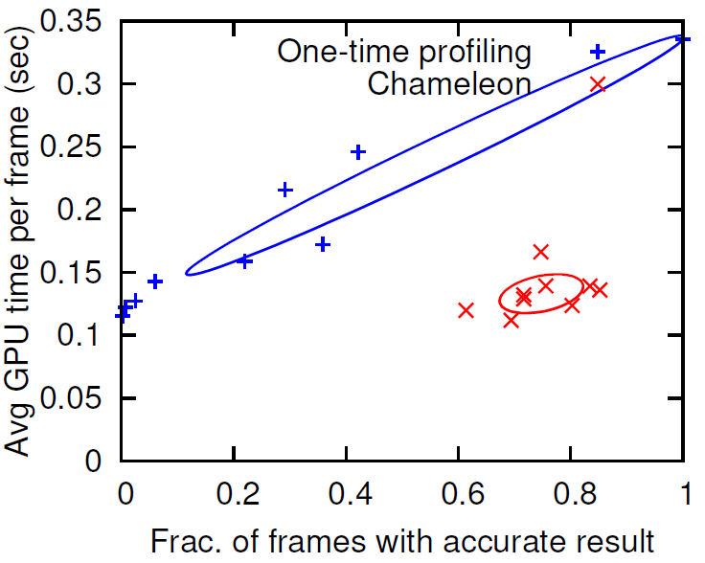
Chameleon improves accuracy + cost (traffic)
20-50% higher accuracy at same cost, or same accuracy at 30-50% of the cost (2-3× speedup)

Slide 34
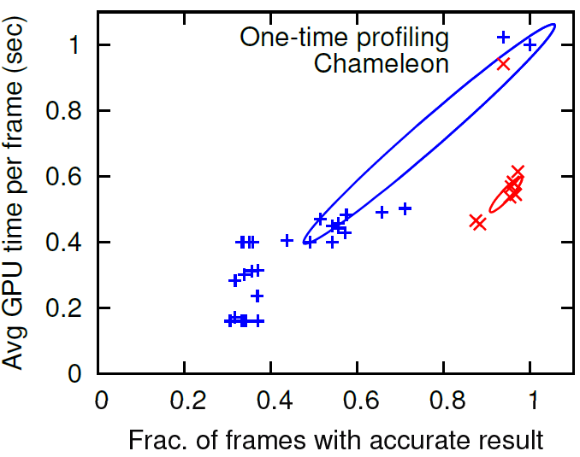
Generalizes to different pipeline

Slide 35
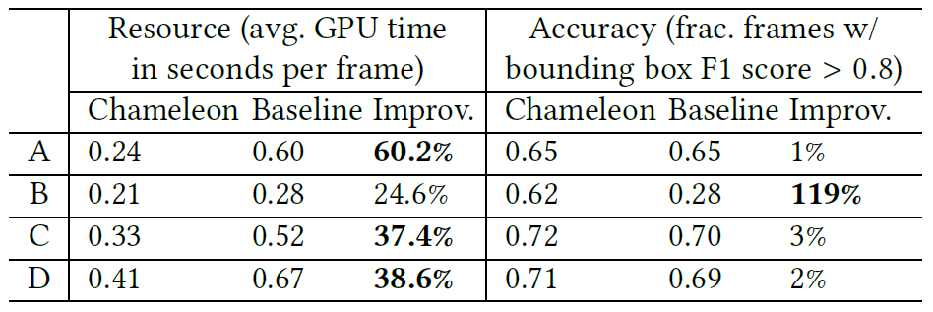
Generalizes to different dataset (cafeteria)

Slide 36
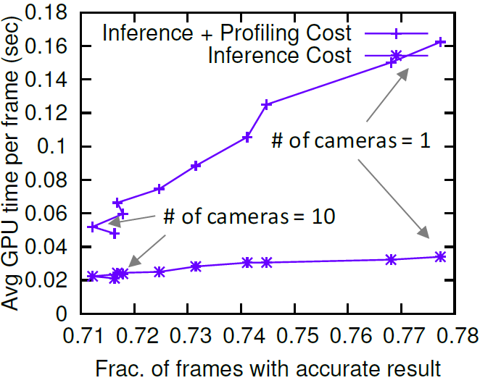
Benefit of similar cameras

Slide 37
Benefit of similar cameras
Grouping algorithm needs work

Slide 38
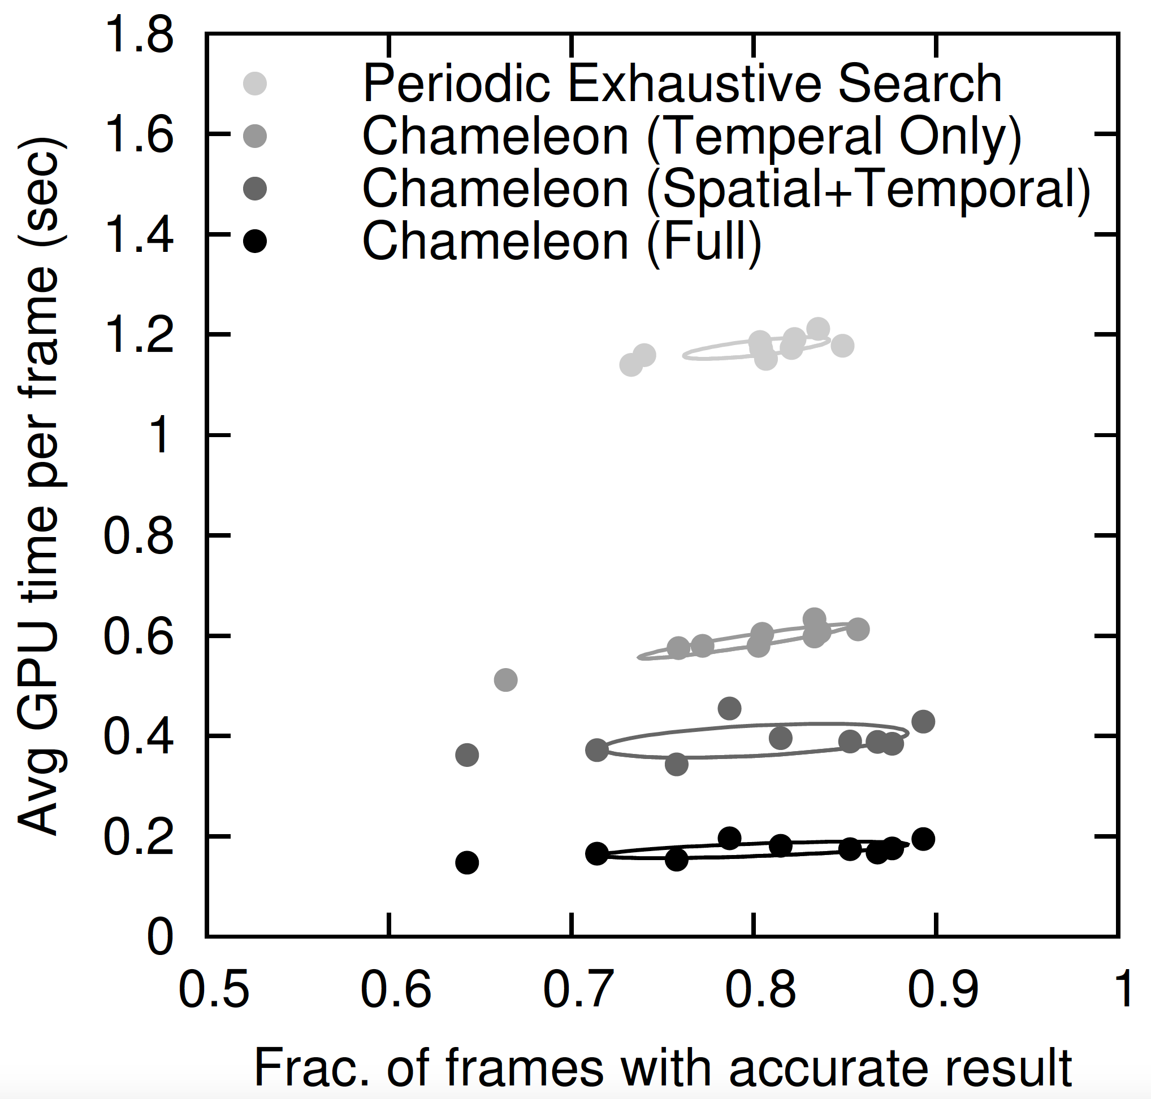
Contribution of each idea

Slide 39
Contribution of each idea

Slide 40
Contribution of each idea

Slide 41
Contribution of each idea

Slide 42
Conclusion
Proliferation of cameras and video analysis apps ⇒ need video analytics systems that scale
Key observation: Video analytics pipelines must adapt over time
Key insight: Videos exhibits temporal/cross-camera correlations
Technical contribution: Suite of techniques for cutting profiling cost
Results: Substantially better accuracy (cost) at similar cost (accuracy)

