Slide 1

NetAI 2018, Budapest, Hungary
IFS-RL: An Intelligent Forwarding Strategy Based on Reinforcement Learning in Named-Data Networking
Yi Zhang¹, Bo Bai², Kuai Xu³, Kai Lei^{1,*}
¹ICNLAB, SECE, Peking University
²Future Network Theory Lab, 2012 Labs, Huawei
³Arizona State University
Notes:
Hello, everyone, I’m Bo Bai, from Future Network Theory Lab, Huawei Hong Kong. On behalf of my collaborators, I will present our joint work IFS-RL: An Integllignet Forwarding Strategy Based on Reinforcement Learning in Named-Data Networking.
Although I am the presenter and the second author of this work, actually I have to say I’m not a fan of NDN. My collaborator, Prof. Lei is a strong supporter of NDN, he has worked in this area for many years. He believes NDN will be the future and change the architecture of the network. But I really doubt his point. We have a long discussion on this problem. Because in NDN, the smart thing is we separate content with its source server. P2P and CDN also use the similar idea, but they work in application layer. In NDN, it is supposed to work in IP layer. We need to name each piece data, so that the receiver can locate them. In my opinion, the amount of data could be thousand times of nodes in networks. So how to find the interested data is a very very challenging issue. Prof. Lei agreed with me on this point, but he believed that maybe machine learning approach could help us out from this problem. That’s why we came out with this work. This is only very preliminary attempt to this very challenging problem.

Slide 2
Outline
Introduction
Methodology
  Basic Training Algorithm
  Learning Granularity
  Enhancement for Topology Change
Preliminary Experiments
Conclusions
Named-Data Networking (NDN)
Intelligent Forwarding Strategy
Reinforcement Learning (RL)
Notes:
In this work, we focus on the packet forwarding in Name Data Network and introduce an intelligent forwarding strategy based on the powful framework of reinforcement learning.
My presentation consist of these 4 parts.

Slide 3
NetAI 2018, Budapest, Hungary
Introduction

Slide 4
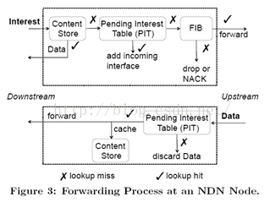
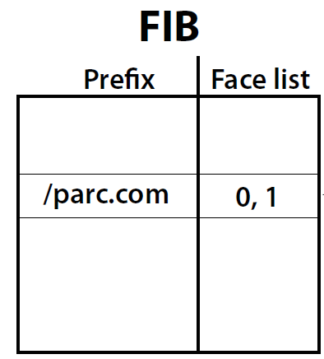
Introduction
Named-Data Networking (NDN)
  An Information Centric Network (ICN) architecture
  Pull-based data delivery process
    Triggered by user requests, i.e., Interest Pkt.
  Request forwarding is driven by forwarding engines
  Reachability information about different content items
    Forwarding Information Base (FIB)
Notes:
The named-data networking is an information centric network architrave. From my personal point of view, the key of NDN or even ICN is the separation of information and its source. Because in many situation, the need of the users are information stored in some servers in the network, not the servers themselves. Based on this fundamental observation, there are different designs for ICN. NDN may be the most disruptive one. In NDN, we need to forget IP and TCP, the data is located by its name, and will be delivered in a pull-based manner which is triggered by users' requests.
In NDN, if a user want to get some information, it will send out an interest packet to the network. When a NDN router receives this interest, it will check its cache. If this data is in its cache, the router will send data to this user directly. If the answer is no, the router will check pending interest table. If it is in PIT, we just to need to add the incoming interface for this interest. If it is not in PIT, we need the FIB to decide the next hop for this interest packet.
Of course, it is not possible to store the location information of each piece of data in the FIB. So it is very challenging to design FIB with high hit ratio and limited size.
According to the NDN architecture, the request forwarding process is driven by forwarding engines with the data sturcture of forwarding inforamtion base.
Typically, the FIB provides the reachabiltiy information of different content items in the network.

Slide 5
Introduction (Cont)
Interest Forwarding Process in NDN
  The forwarding plane enables each router to
    Utilize multiple alternative interfaces
    Measure the performance of each path
Forwarding Strategy
  For each Interest Pkt., select the optimal interface from multiple alternative interfaces
interface 1
forward
interface 2
…
interface k
Notes:
Let me explain the interest forwarding process in more details. Whatever the forwarding strategy is, the forwarding plane will use multiple alternative interfaces, and measure the performance of each path. For each forwarding strategy, the FIB will determine the optimal interface of forwarding in some sense.
It can be seen that the routers rely on the carefully designed forwarding strategies to select the interface from multiple alternative interfaces for each interest packet with some kind of optimality.

Slide 6
Introduction (Cont)
Existing forwarding strategies
  Fixed control rules
  Simplified models of the deployed environment
Fail to achieve optimal performance across a broad set of network conditions & application demands
Propose IFS-RL:
An intelligent forwarding strategy based on RL
Determine a self-adaptive learning granularity
Enhance the basic model to handle topology changes
Notes:
However, most of the existing forwarding strategies use fixed control rules based on simplified models of the network. As a result, it is very difficult for these existing schemes to achieve optimal performance across a broad set of network conditions and application demands.
To deal with this problem, this work propose a machine learning based intelligent forward strategy. We use the reinforcement learning here, which has shown its power in many challenging tasks. Our RL method can generate the forwarding decision of each router accoding to observations of each feedback. Then, we also enhance the basic model with two aspects: a self-adaptive learning granularity and handle the topolgy changes in the network.

Slide 7
NetAI 2018, Budapest, Hungary
Methodology

Slide 8
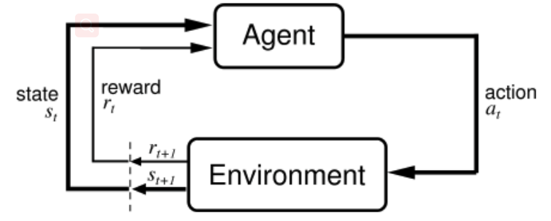
Basic Training Algorithm
Reinforcement Learning (RL) Framework
  Consist of Agent & Environment
  For a certain time step t
Observe state s_{t}
Choose action a_{t}
Receive reward r_{t}
Transit state s_{t}→s_{t+1}
The goal
  Maximize the expected cumulative discounted reward
Notes:
Our basic method is a standard reinforcement learning framework, which consists of the the agent and environment. For a certain a time step t, the agent observes the state s_t from the environment and choose an action a_t. The enviroment then transit its state while the agent will then receive a reward r_t. Based on the observed state of this time step, the goal of this RL framework is to choose an action a_t so as to maximize the expected cumulative disctounted reward of all the time steps,. The setting is pretty standard.

Slide 9
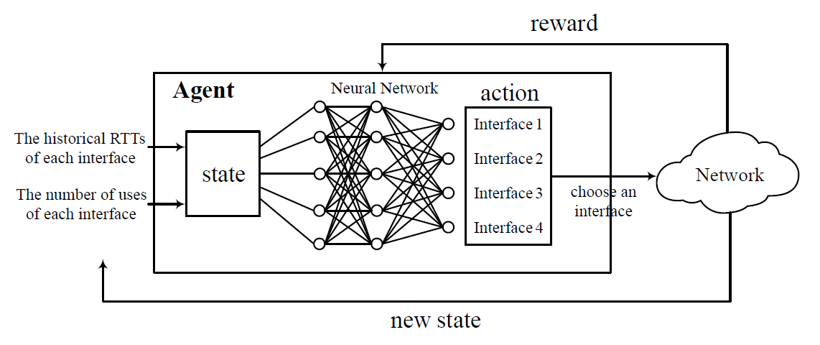
Basic Training Algorithm (Cont)
The IFS-RL Model
  Agent - Router
    Implemented by Neural Networks (NNs)
    Observe the network state (e.g., RTT & # Pkt for each interface)
    Determine the optimal forwarding interface
    Use reward information to train the NNs
  Environment - Network
Notes:
In our IFS-RL model, the agent is embedded in each router and is implemented by neural networks, while the network condistions forms the environment. In each time step, the agent observe the network state such as the RTT and number of forwarded packets of each interface, and then determine the optimal interface to forward the interest packets. Finally, the agent use the reward information provided by the environment to train the neual networks.

Slide 10
Basic Training Algorithm (Cont)
The IFS-RL Model (Cont)
  State: s_{t} = (D_{t}, N_{t}) (Average Delay, # of Interest Pkt.)
    D_{t} = (d₁, d₂, …, d_{K});
      d_{i}: Avg. delay of interface i (Approximated by RTT)
    N_{t} = (n₁, n₂, …, n_{K});
      n_{i}: # of Interest Pkt. forwarded by interface i
D_{t}
N_{t}
Notes:
In our model, the avergae delay and the number of forwarded packets are used as the states observed by the agent. It is easy to understand we will choose the one with small delay. Also, it an interface forwards the most number of interest packet, the hit ratio of this interface could be high. We use the vector D_t to represent the delay of different avaible interfaces in a router. Here, we use Round-trip Time as the approximated metric of delay. The vector N_t is used to describe the number of packets forwarded by different interface during a certain time step.

Slide 11
Basic Training Algorithm (Cont)
The IFS-RL Model (Cont)
  Action
    Choose an interface based on the learned policy μ
  Reward
    Negative Average RTTs of all packets between two continuous actions
Notes:
In our RL model, the action of the agent is quite clearly, i.e., choose an intetface based on the policy learned by the neural network. For simplicity, the reward here is the negative average RTT of all the packets forwarded by a router between two continuous actions.

Slide 12
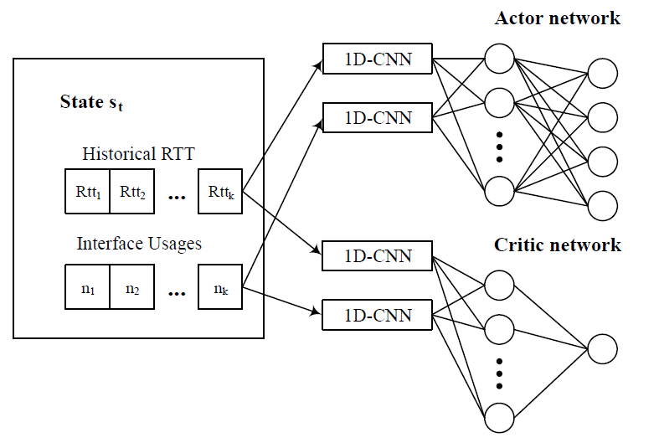
Basic Training Algorithm(Cont)
The IFS-RL Model (Cont)
  Policy π(s_{t}, a_{t}) (continuous domain)
    Deep Deterministic Policy Gradient (DDPG) [Timothy P. et al. '15]
    Actor-critic method
1-D Conv. Layer
Dense Hid. Layer
Output Layer
Actor Net.
Critic Net.
Notes:
As the RTT state observed by the agent is in a continuous domain, we dopt the DDPG algorithm solve this continuous reforcement learning problem. DDPG is an actor-critic method, which includes an actor network and a critic network. For both neural networks in our model, there is one convolutional layer, one full-connected hidden layer and one output layer. The actor network will generate the policy to determine the agent's acton, while the cirtic network is used to obtain the action-value function.

Slide 13
Learning Granularity
Setting of learning granularity
  Massive packets to be processed
  Let calculation keep up with pkt. arrival
  Put the learning granularity as a part of action space
    Use the combination of Selected interface & Num. of time intervals
Action (Interface, #Time intervals)
Notes:
Besides the standard setting we discussed before, there is another important issues which should be considered, which is the learning granularity. In other words, we need to decide how much time do we need to observe until we take a new action. We consider this issue, because the router need to process massive number of packets in every second. We should let the calculation of the model keep up with the packet arrival.
To enable the model to automatically determine the learning granularity, we try to put it as a part of the action space. In this case, the action of the agent becomes the combination of the selected forwarding interface and the time intervals for current training process.

Slide 14
Learning Granularity (Cont)
IFS-RL Algorithm (Consider the learning Granularity)
  Observe state information s_{t} = (D_{t}, N_{t})
  Take action a_{t} according to the learned policy μ
    Selected interface i
    Learning granularity T_{lg}
  During the period of time T_{lg}
  Forward all the Interest Pkt. through interface i
  Calculate reward r_{t}
  Update the NNs’ parameters according to (s_{t}, a_{t}, r_{t})
  Start the next round of learning
Notes:
With the learning granularity, the overall algorithm can be summarized as follow.
First, the agent observe the state information of delay and number packets, and take action according to the policy generated by the actor network.
Note that the action includes the selection of the optimal interface i and determination of the learn granularity T_lg.
Then, during the period of time determined by the learning granularity T_lg, all the interest packets are forwarded through the selected interface i.
After the time of T_lg, the agent receive the reward and update the parameters of the neural networks according to the state, action as well as reward,and a new learning process will start.

Slide 15
Enhancement for Topo. Change
Network Topology Changes
  Lead to dimensional changes of s_{t} and a_{t}
  Set input and output formats span the max. # of interface
    E.g., ordinary routers with max. # of interfaces of 48
  Zero out unavailable interfaces
  Interpretation of actor network’s output
    Apply a mask to the (softmax) actor net.'s output layer
      0-1 vector [m₁, m₂, …, m_{k}]
      p_{i}: normalized probability for action i
Notes:
The network topolgy changes is also another important problem. For the NDN router, the change of the topology may lead to the dimensional changes of the state and action. For example, if there is one router is added, the interface of its neighbor should be added by one. Of course, if one router is down, some router will need to decrease the number of interface. In this case, a simple way can be used to handle this problem. Specifically, we set the canonical input and output formats of the model to span the maximum number of interface in a router in practice, such as 48 for ordinary routers. Then, we can zero out the unavailable interfaces according to current network topology.
Moreover, for the actor network's output, we should also consider this modification. So we can then apply a 0-1 value mask to the softmax output layer of the actor network. Then, we normalize the probability based on this mask.
Undr such circumstance, the standard back propagation of the gradient in the NN still holds, so the original training process can be dircetly applied without other modification

Slide 16
NetAI 2018, Budapest, Hungary
Preliminary Experiments

Slide 17
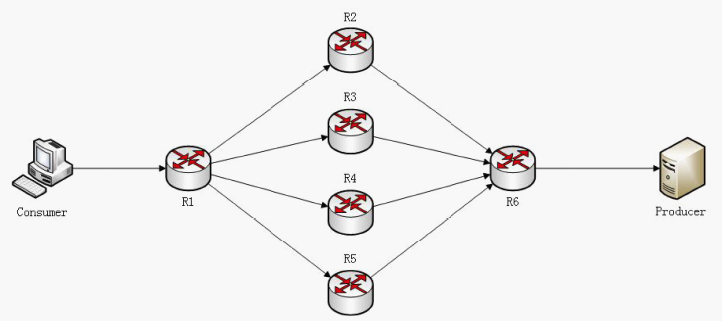
Experiment Results
Experiment setting
  Simulation experiments in NDNSim
  Throughput & Drop rate
  Comp. with BestRoute [A. Afana et al.'12] & EPF [K. Lei et al.'15]
  Simulation topology:
R2
Bandwidth
4 Mbps
7 Mbps
R3
Consumer
R1
R6
Producer
4 Mbps
7 Mbps
10 Mbps
4 Mbps
R4
10 Mbps
7 Mbps
4 Mbps
7 Mbps
R5
Notes:
We also conduct simulation experiments in NDNsim, where we adopted the throughput as well as drop rate as the metrics and use two state-of-the-art approach BestRoute and EPF as the comparative methods.
The simulaton topolgy is as follow.
There are 4 alternative links between the consumer and the producer, and we set the bandwidth of all the alternative links to be the same.
BestRoute: It uses three colors to mark the status of the interfaces. Green marks that the interface can bring data back, Yellow marks that whether data can be accessed through this interface is unknown, and Red means data cannot be found through this interface.
EPF: entropy-based probabilistic forwarding (EPF) strategy to calculate the probability of each interface. EPF counts the probability of each interface every time when an Interest is forwarded, thus leading to high time complexity

Slide 18
Experiment Results (Cont)
Simulation experiment
  Simulation topology
  Pkt Size
    Interest Pkt: 40 bytes
    Data Pkt: 1024 bytes
4 links between consumer & producer
With 1 link having smaller delay
  R1-R3-R6
R2
Delay
40 ms
R3
7 ms
Consumer
R1
R6
Producer
10 ms
7 ms
40 ms
R4
7 ms
40 ms
7 ms
R5
Notes:
On the other hand, we set the link R1-R2-R6 to have smaller delay while we set the rest three links to have the same larger delay.

Slide 19
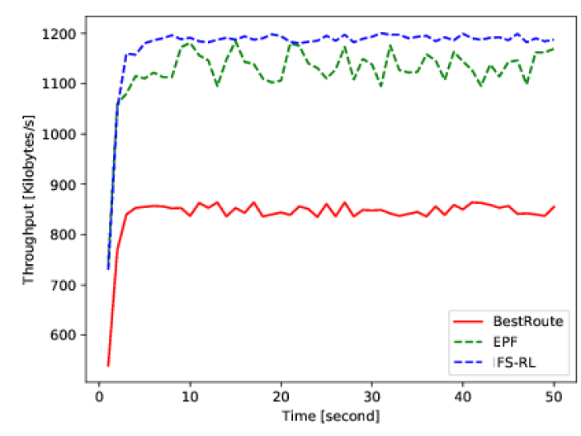
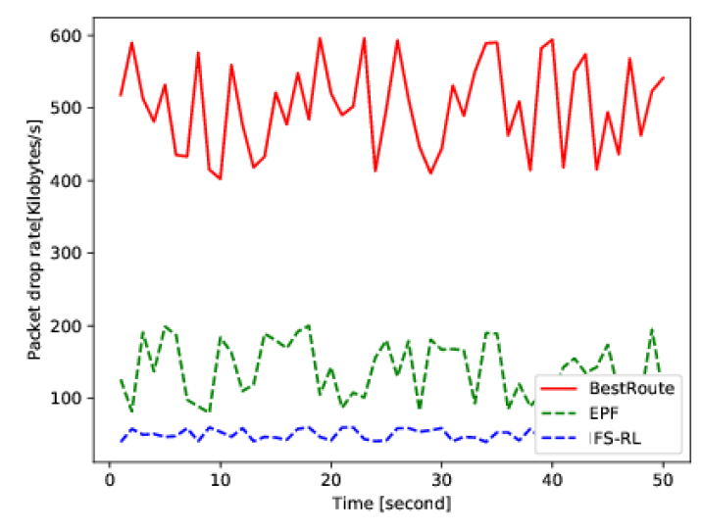
Experiment Results (Cont)
Experimental Results
  Consumer sends Interest Pkt. at a constant rate of 1500 Pkt./sec for 50 Sec
Throughput
IFS-RL
Drop Rate
IFS-RL
Notes:
In the experiment, the consumer continuously sends interest packet at a constant rate of 1500 packets per second for totally 50 seconds.
The evaluation result is as follow.
As we can see from these two figures, the proposed forwarding strategy IFS-RL significantly has the best performance for both the metic of throughput and packet drop rate.

Slide 20
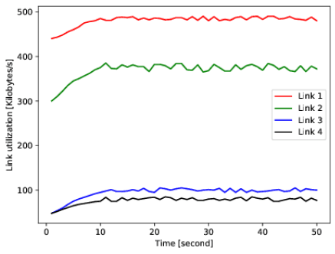
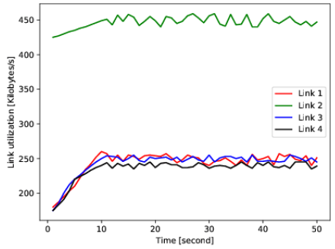
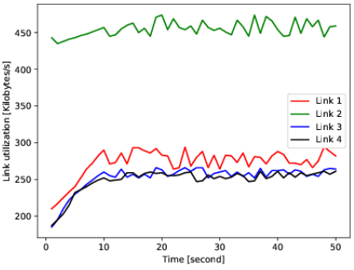
Experiment Results (Cont)
Link Utilization
Load balance of IFS-RL is not the best
  Maximize throughput & minimize Pkt. drop rate
  Tend to choose the interface with minimum RTT
Link utilization
BestRoute
EPF
IFS-RL
Notes:
Furthermore, we also explore the link utilization of the three methods being evaluated.
However, the load balance of the IFS-RL is not the best according to our results. This is because the goal of the proposed model is to maximize the throughput and minimize the packet drop rate, so the router may tend to choose the interferce with minimal RTT, which may result in worse load balance.
And we intend to consider the load balance factor in our future work.

Slide 21
NetAI 2018, Budapest, Hungary
Conclusion

Slide 22
Conclusion
IFS-RL
  An intelligent forwarding strategy
    Deep Reinforcement Learning (DRL)
    Deep Deterministic Policy Gradient (DDPG)
  Learning granularity
    Incorporate learning granularity into the action space
  Network topology changes
    Set input and output formats span the max. # interface
    Introduce a softmax mask
  Simulation experiment
    Achieve higher throughput & lower drop rate
    Need improvement in load balancing
Notes:
Here is the conclusion of this work.
We propose an intelligent forwarding strategy based on deep reinforcement leraning and adopt the DDPG framework to implement the neural networks.
Furthermore, we also modifiy the basic model to enable the proposed approach to adaptively determine the learning granularity and handel the network topology changes.
Simulation experiment results show that the proposed model can significantly achieve higher throughput and lower drop rate compared to other state-of-the-arts methods.

Slide 23
NetAI 2018, Budapest, Hungary
Thank You!
Q&A
For implementation details, please contact Yi Zhang
(1601214039@sz.pku.edu.cn)
Notes:
This is the end of my presentation, and I will try my best to answer your questions. For implementation details, please contact Yi Zhang.

