Slide 1
NDN-ABS: Attribute-Based Signature Scheme for
Sanjeev Kaushik Ramani, Alexander Afanasyev (FIU)
Reza Tourani (SLU)
George Torres, Jay Misra (NMSU)
ACM Conference on Information Centric Networking
Macau, China
September 26, 2019

Slide 2
Overview
Motivation
Attribute Based System
NDN-ABS Design
Evaluation
Challenges
Conclusion

Slide 3
Motivation: Current scenario
Mobile Health
Connected & Autonomous Vehicles
Smart Cities and Buildings

Slide 4
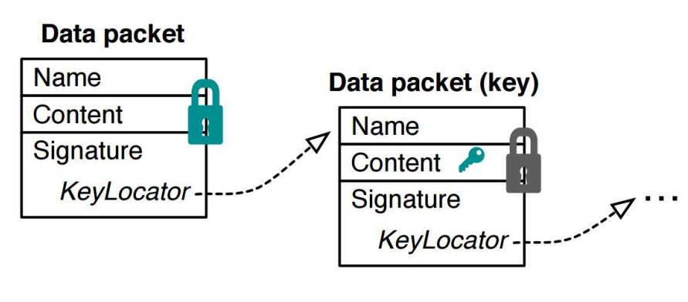
Issue I – Fetch multiple certificates
Can signatures be verified successfully without additional information like keys in certification chain?

Slide 5
Issue II – Signature tied to public key
Can a system provide configurable privacy, i.e., control over the amount of details a signature reveals about a data publisher?

Slide 6




NDN-ABS to the rescue!
Producer Anonymity
Ease of verification without
dependence on network

Slide 7
Attribute Based Signatures
Signature generated using attribute secret signing keys
Attribute – String
Secret signing key – crypto material associated with the attribute
Generated by authority for the signer
Signature is associated with a “Policy”
Set of attributes combined with boolean operators

Slide 8



NDN-ABS Design: Authority Setup
Setup
Input:
/UnivMacau/edu/
Attribute Authority
Output:
Authority Private key (ask) = (a₀,a,b).
Authority Public key (pk) = (g, h₀,··· , h_{tmax} , A₀,··· ,A_{tmax} ,B₁,··· ,B_{tmax} , C).
Design data packet of Public parameters:
/UnivMacau/edu/ABS/42=pp/v_25
Bootstrap
Signer / Producer
Bootstrap
Consumer / Verifier

Slide 9



NDN-ABS Design: Signer Setup
Bootstrap public parameters of authority
Install pub params
Request for
Attribute signing keys
Attribute Authority
/UnivMacau/edu/ABS/prod1/<attrs>*/ENCRYPTED-BY
[user-RSA-key-or-ABE-policy]
Producers

Slide 10


NDN-ABS Design: Signing Process
Define Policy requirements
{Researcher; ICNGuest; UnivMacau; NDN}
Select
Generate
Policy
ICNGuest;
UnivMacau;
RegID;
Alice;
Researcher;
NDN;
Editor;
ICNPC;
…
Alice@um.edu;
Alice
(ICNGuest & NDN) | (UnivMacau & Researcher & NDN)
Policy +
Public Params
Content name
MetaInfo
Content
Signature
Signed NDN data packet
Signature Info
Keylocator: /campus/edu/ABS/42=pp/(ICNGuest & NDN) | (UnivMacau & Researcher & NDN)

Slide 11
NDN-ABS Design: Verification Process
Bootstrap public parameters of authority
install pub params
Signature Verification:
Signed NDN data packet
Retrive the signature info
Extract the policy
Generate required crypto material
Verify the signature
Consumers
From KeyLocator info:
/campus/edu/ABS/42=pp/(ICNGuest & NDN) | (UnivMacau & Researcher & NDN)
Authority
Policy

Slide 12









Advantage I : Signer Privacy
Signature does not reveal
identity of the signer
Signed by ?
Policy:
‘Vehicle’ & ‘NH1’ & ‘34Mile’ …
Vehicle = Truck (but which one)
Policy:
‘Truck’ & ‘NH1’ & ‘34Mile’ …
Verifiers
(LBS)
Producer Pool

Slide 13
Advantage II : Direct verification
Verification does not require all entities to be online
Nothing needs to be fetched specific to the signature (only public parameters of the ABS authority)

Slide 14
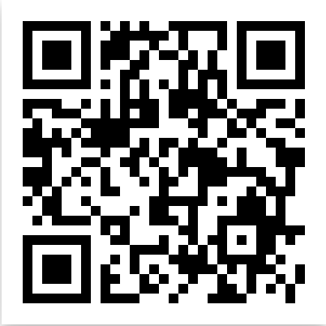
NDN-ABS Prototype Implementation
To the best of our knowledge we designed the first comprehensive prototype implementation of ABS
Python library called PyNDNABS is available in https://github.com/sanjeevr93/PyNDNABS

Slide 15
Code Snippets from PyNDNABS
def authSetup():
apk = {}
ask = {}
tmax = n
apk['g'] = group.random(G1)
for i in range(tmax + 1):
apk['h{}'.format(i)] = group.random(G2)
#Authority Private key
a0,a,b = group.random(ZR), group.random(ZR), group.random(ZR)
ask['a0'] = a0
ask['a'] = a
ask['b'] = b
#Authority Public Parameters
apk['A0'] = apk['h0'] ** a0
for i in range(1, tmax + 1):
apk['A{}'.format(i)] = apk['h{}'.format(i)] ** a
for i in range(1,tmax+1):
apk['B{}'.format(i)] = apk['h{}'.format(i)] ** b
apk['C'] = apk['g'] ** group.random(ZR)
return apk, ask
def generateattributes(ask, attributes):
ska = {}
Kbase = group.random(G1)
ska['Kbase'] = Kbase
ska['K0'] = Kbase ** (1 / ask['a0’])
#Attribute Secret key generation
ska['attributes'] = attributes
for i in attributes:
u = group.hash(i)
ska['K{}'.format(u)] = Kbase ** (1 / (ask['a'] + u * ask['b']))
Attribute Authority setup
Attribute creation
Manipulating Policy to be used in signing & Verification
def getMsp(message, attributes):
#Monotone span program built using attributes in policy
M = M[len(attributes)]
u = [group.hash(i) for i in attributes]
mu = group.hash(message + b' AND '.join(attributes))
return M, u, mu

Slide 16
Code Snippets from PyNDNABS (contd.)
def sign(pk, ska, message, attributes):
signature = {}
M, u, mu = getMsp(message, attributes)
r = []
for i in range(len(M) + 1):
r.append(group.random(ZR))
signature['Y'] = ska['Kbase'] ** r[0]
signature['W'] = ska['K0'] ** r[0]
for i in range(1, len(M) + 1):
end = 0
multi = ((pk['C'] * (pk['g'] ** mu)) ** r[i])
try:
end = multi * (ska['K{}'.format(u[i-1])] ** r[0])
for j in range(1,len(M[0])+1):
end = 0
for i in range(1,len(M)+1):
base = pk['A{}'.format(j)] * (pk['B{}'.format(j)] ** u[i-1])
exp = M[i-1][j-1] * r[i]
end = end * (base ** exp)
signature['P{}'.format(j)] = end
return signature
def verify(self, pk, sign, message, attributes):
M, u, mu = getMsp(message, attributes)
if sign['Y']==0 or pair(sign['Y'], pk['h0']) != pair(sign['W'], pk['A0']):
return False
else:
sentence = True
for j in range(1,len(M[0])+1):
multi = 0
for i in range(1,len(M)+1):
a = sign['S{}'.format(i)]
b = (pk['A{}'.format(j)] * (pk['B{}'.format(j)] ** u[i-1])) ** M[i-1][j-1]
multi = multi * pair(a,b)
after = pair(pk['C'] * pk['g'] ** mu, sign['P{}'.format(j)])
pre = pair(sign['Y'], pk['h{}'.format(j)])
if j == 1:
if multi != (pre * after):
sentence = False
else:
if multi != (after):
sentence = False
return sentence
Generating Signature
Verifying Signature

Slide 17
Experimental Setup
Check the feasibility of NDN-ABS
Identify performance of NDN-ABS compared to traditional signature schemes
Evaluated metrics - Impact of policy size
Signing and verification times
Signature size
Recorded performance on different platforms
Server
Intel i7 4.00GHz, 62.8 GB RAM
MacBook Pro
Intel i9 2.9GHz, 32 GB RAM
Laptop
Intel T2300 1.66GHz, 2.4 GB RAM
Raspberry Pi 3
Raspbian, ARM v7 1.4GHz, 0.9 GB RAM

Slide 18
Evaluation (For every data packet)
Costly but feasible when data generated slowly.
Substantial cost on limited resource platforms like the Raspberry Pi 3.
Signing/verification is at least two orders of magnitude slower than using RSA.
Improve efficiency by
Limited policy size (2-3 attributes)
Aggregated signing
Implementation optimizations,

Slide 19



Signing Optimizations
Signing hash of every data packet - not be a practical choice
Aggregate hashes of several packets into a manifest
Variable number of packet hashes.
Experiments were run on MacBook Pro (Intel i9 2.9GHz, 32 GB RAM) with10MB input files
Hash
Sign
Hash
Hash
Sign
Hash
…
…
Hash

Slide 20
Evaluation (Optimized Signing and Verification)
Manifests can effectively manage signing time
Optimization factors:
Hash group size
Policy size
2 attribute policy in graph
Implementation

Slide 21
Evaluation (Implementation Optimization)
Lack of a reference ABS implementation to compare the NDN-ABS performance.
As a proxy, the performance of existing CP-ABE libraries was evaluated
The underlying computations of ABS and ABE are similar even though the specific constructs differ
CP-ABE libraries compared:
OpenABE (C++): https://github.com/zeutro/openabe
FAME (Python): https://github.com/sagrawal87/ABE/blob/master/ac17.py
Bethencourt CPABE (C): http://acsc.cs.utexas.edu/cpabe/
BSWABE (Python): https://github.com/sagrawal87/ABE/blob/master/bsw07.py
BSWABE (Java): https://github.com/junwei-wang/cpabe/

Slide 22
Challenges to deployment
Revocation
revoking compromised attribute secret keys
revoking expired users’ attributes
Scalability
multiple attribute authorities
manipulate and update policies when the number of attributes is variable with frequent new additions
Performance
hardware acceleration

Slide 23
Conclusion
ABS and NDN-ABS in the NDN context
provides producer (signer) anonymity
reduces network overhead
ABS has high computational cost
but can be optimized
Ease of packaging/retrieving using NDN naming conventions
public params
attribute secret signing keys
signed data packets with embedded policies

Slide 24
Acknowledgements

Slide 25
Thank you

