Slide 1

Pano: Optimizing 360 Video Streaming with a Better Understanding of Quality Perception
Yu Guan
Yu Guan, Chengyuan Zheng, Xinggong Zhang, Zongming Guo, Junchen Jiang
Notes:
I am Yu Guan from Peking University.
I believe most people sitting here have watched 360 videos at least once. Now, it‘s obvious that streaming 360 videos can take a lot of bandwidth. in this talk, we will present a system to dramatically cut the bandwidth needed for 360 videos *without hurting user experience*!
This is a joint work of Peking University and the University of Chicago.

Slide 2
One-Minute Overview
Streaming 360 videos consumes huge bandwidth
Users have limited span of attention
Sending much less data to save the bandwidth while keeping the user’s perceived quality ➔ Pano
Notes:
Before diving into the details, lets have a one-minute overview of the key points!
[click]
Many content providers offer 360 video streaming. But streaming 360 videos needs *much* more bandwidth than traditional videos.
[click]
But we argue that user’s attention does NOT grow with the screen size. In fact, it is limited, so if we accurately track the user’s attention, we can dramatically cut the bandwidth need of 360 videos.
[click]
To put it in practice, we present Pano, a 360 video streaming system which lowers the quality of the contents where the user is not sensitive. Pano can reduce bandwidth need of 360 videos by 46% without hurting user experience.

Slide 3
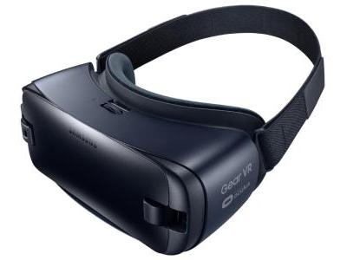
Popularity of 360 Video Streaming
36.9 million 360 video users in US
(10% US population)
55 million 360 video headsets in US
Most video providers support 360 videos
Notes:
First of all, why do we care about 360 videos?
[click]
Over 10% of US population has watched 360 videos.
[click]
The 360 video headsets will be as many as Netflix members in the US in 2022.
[click]
And most video content providers offer 360 video streaming services on various platforms.

Slide 4
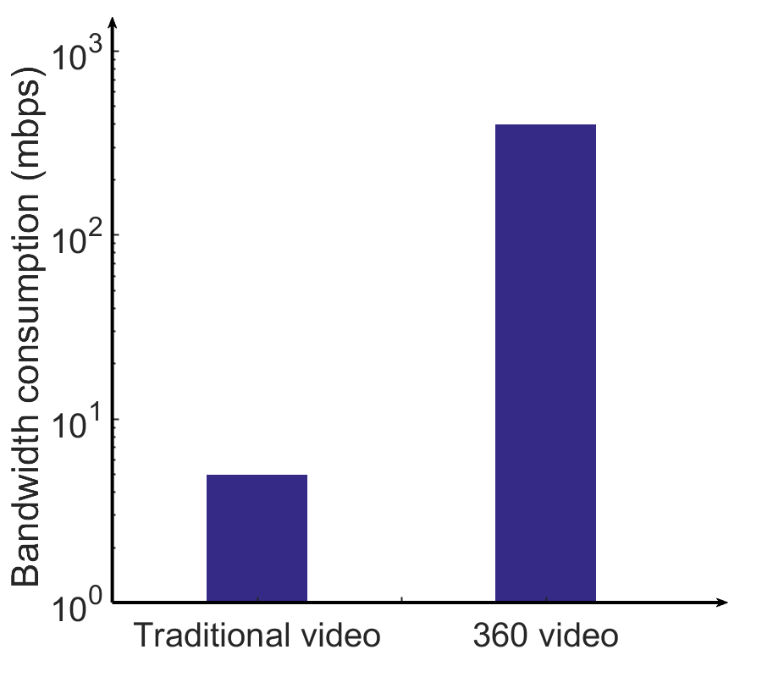

Essential challenge of 360 video streaming: bandwidth consumption
360°
110°
30°
Problem: Still costs much higher bandwidth!
15°
80°
180°
5Mbps
400Mbps
Viewport-driven
Notes:
However, streaming 360 videos in high quality is challenging.
A 360° video must be streamed with a large sphere, in high resolution and without any stall.
[click]
To put it into perspective, a traditional full-HD video displayed on a desktop screen takes 5 Mbps to stream.
[click]
Now, to keep the same quality level, a 360 video will take *400* Mbps, which is *80* times higher
[click]
Now, prior work reduces the bandwidth by streaming only the viewport region.
[click]
Suppose here is the viewport region, then the client will request the high quality content *ONLY* in the viewport, which significantly reduces the bandwidth consumption,
[click]
However, this scheme still needs 2 to 4 times more bandwidth than traditional videos.
[click]

Slide 5
Conventional wisdom
Users pay equal attention to all pixels in the viewport
Notes:
Among all the existing solutions, the conventional wisdom is that, when watching 360 videos, users pay *equal attention* to *all* pixels in the viewport.
However, we found this is actually a myth, and sticking to it will miss many opportunities to save bandwidth!

Slide 6
Key observation
Due to the viewpoint movement, users have different span of attention to different pixels in the viewport
Watching a traditional video
Watching a 360 video
Notes:
What we found is that 360 video viewers pay attention to different pixels differently, even in the viewport. This is because users can *freely* move their viewpoints during the video playback.
[click]

Slide 7
Key observation
Example:
Users lose attention to static background when tracking a moving object
Notes:
Here is an example. Imagine you are tracking a person running in front of a static tree. Then you will pay less attention to the tree in the background *even if* the tree is also in the viewport! This is because, as you track the person, the tree now has a high relative speed with your viewpoint. and intuitively, the faster an object moves, you pay less attention to it. So, people will *less* likely to notice quality degradation on the tree than on the person.
From now on, we call object speed relative to the viewpoint as *relative object moving speed*.

Slide 8

Key observation
Notes:
Now, let’s see this effect in action.
Here are two videos. Both of them are the user’s viewport cropped from the whole 360 video. Let’s now watch them side by side. After that, I will ask if you can tell any quality difference between them. [Hold for 1-2 seconds. Before playing]
Now, can you see the quality difference? [Hold for 2-3 seconds before moving on!]
Well it seems most of the audience doesn’t see a big difference between them.
However, the right one is only 50% the size of the left one.
Why??
Well, the left video allocates the same quality to all pixels in the user’s viewport, while the right video allocates much lower quality to the background.
Now, the video stopped at the last frame.
[click]
Take a closer look, the quality of background in the right video is much lower than that in the left video.
But why you didn’t find this difference when the video is playing? Because when you focus on the moving athlete, the background have a high relative speed with your viewpoint. So you didn’t’ pay attention to it.
So how often you can save bandwidth by reducing the quality of a relatively fast moving areas?

Slide 9
Potential gains
In ≥ 35% time, viewpoint is moving faster than 10 deg/second
Users can tolerant 50% more distortion
Opportunity to stream lower quality video without hurting users’ experience
Notes:
To answer that, we use a dataset of 48 users watching 20 videos.
[click]
In more than 35 percent of time, the user’s viewpoint is moving faster than 10 degree per second.
[click]
In this case, users can tolerant 50% more distortion on the static background.
[click]
This provides us an opportunity to stream lower quality video to users, without hurting users’ experience.

Slide 10
User sensitivity also depends on...
Scene luminance changes
Depth-of-Field difference between objects
Notes:
Now this is not just about relative object moving speed.
[click]
When the user’s viewpoint moves, the scene may change from dark to light or from light to dark,
[click]
or move across several objects with different depth of field. They can also lower the user’s sensitivity to quality degradation.
So how to *use* these observations to reduce bandwidth consumption of 360 video streaming?

Slide 11
Our approach
Identify where the user’s attention is
Drop the quality of areas the user doesn’t pay attention to
Notes:
Well, at a high level, the idea is very straightforward:
[click]
First, we identify where the user’s attention is in 360 video streaming.
[click]
Then we drop the quality for areas the user doesn’t pay attention to.
But realizing these benefits in practice is by no means trivial!

Slide 12
How to achieve this in a real system?
Challenge 1: How to build the perceived quantify model?
Video Source
Scene luminance changes
Relative object moving speed
Depth-of-Field difference
Perceived quality model
Tiling & encoding
Video Server
CDN
Client-side bit-rate adaptation
Notes:
To understand why, let’s first look at how 360-degree videos are streamed today.
[click]
First a 360 video is generated from the video source.
[click]
Then the video is spatially split into tiles, encoded to a certain format, and stored in the video server.
[click]
Finally, the video is delivered to end users via Content Delivery Network. The end user runs a bit-rate adaptation logic to adjust the video quality in real-time.
[click]
Now, remember our approach is to save bandwidth while maintaining *perceived* quality. So how do we do it? Well, there are three key challenges.
First, we need a perceived quality model that *systematically* takes consideration of relative object moving speed, luminance change and depth-of-field difference.
[click]
This model is the basis of attention-driven video encoding and bit-rate adaptation.

Slide 13
Challenge #1: How to build the perceived quality model?
Perceived quality
?
?
?
Relative object moving Speed
Scene Luminance change
Depth of Feild difference
Notes:
Perceived video quality has been studied for many years, prior work focuses on the impact of the static *video content* on the perceived quality, such as content luminance, content texture.
But as we have seen that, user’s perceived quality in 360 video display also highly depends on *viewport movement*. Their sensitivity is related to some new factors, such as
[click]
relative object moving Speed,
Scene luminance change, and
Depth of field difference.
However, none of the existing user quality model captures *any* of the three new factors. So first, we need to build a new quality model, to measure the video quality *under user actions*.

Slide 14
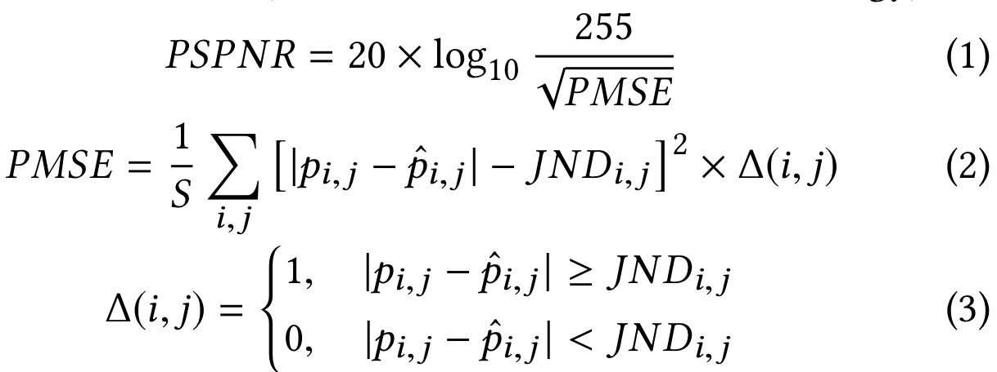
Solution #1: Quality model for 360 video
P_{i,j}: Pixel (i,j) in the original video
P_{i,j}: Pixel (i,j) in the compressed video
JND_{i,j}: Just Noticeable Difference of pixel (i, j)
Notes:
We build our model on PSPNR, a widely used video quality metric. You don’t need to understand all the details. But here is the key points.
[click]
To compute PSPNR, we need to compute the pixel-level difference between the original video and the compressed video. The larger the difference, the lower the perceived quality of the compressed video.
[click]
However, there is an important missing part, JND, just noticeable difference. It represents the user’s sensitivity to this pixel.
[click]
As shown in this formula, only when the pixel-level difference exceeds this threshold, the user can detect the quality degradation. So, the larger the JND, the more tolerant the user is.
As we have stated, the value of JND depends on many new factors. So how to compute JND is a problem.

Slide 15
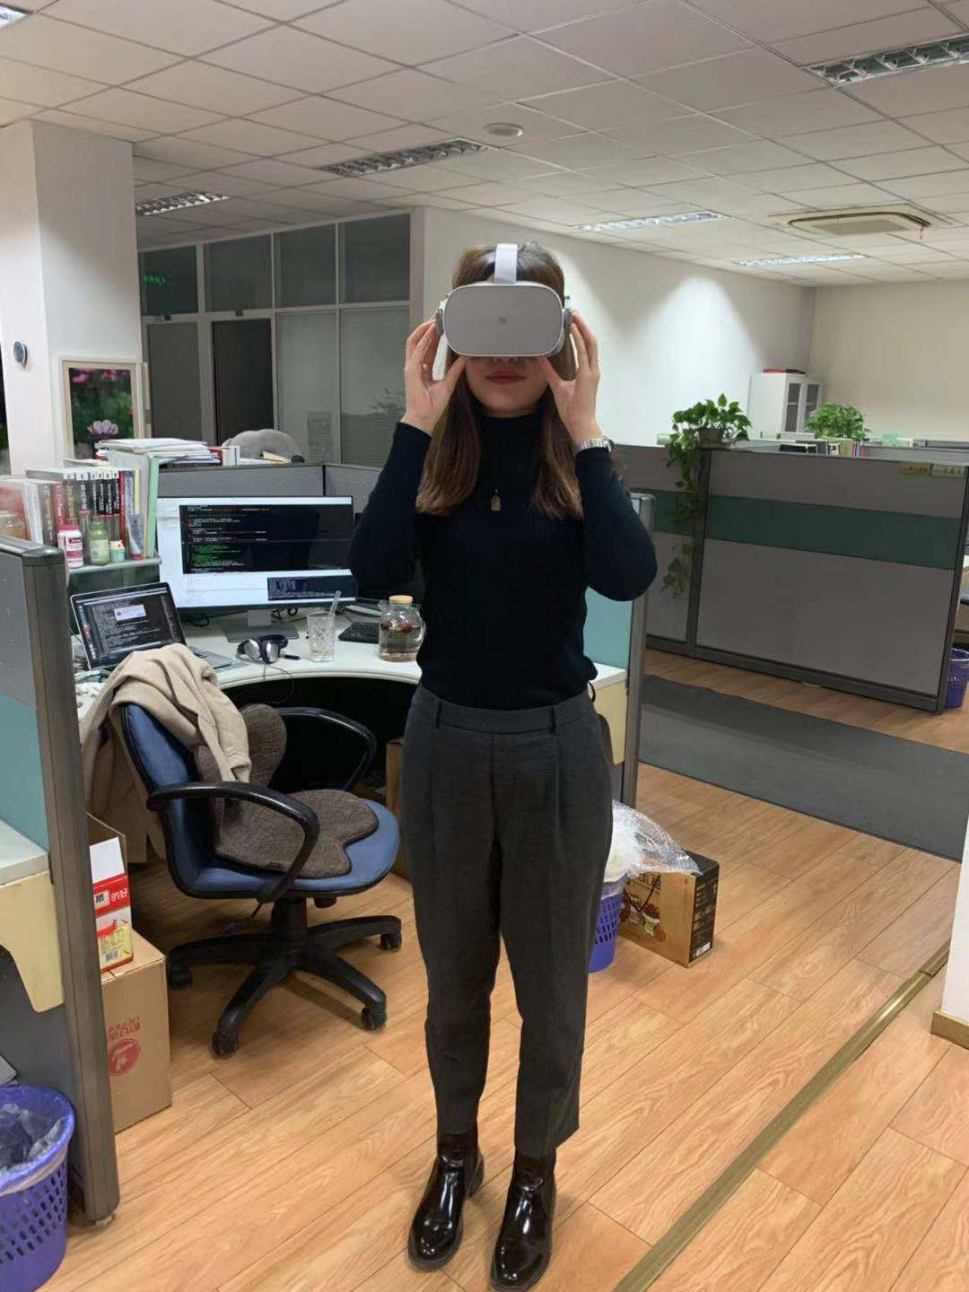
Solution #1: Quality model for 360 video
Notes:
We did a real-world user study to find the relationship between each factor and JND.
Here is an example of relative object moving speed.
Look at the figure on the right. The X axis represents the viewpoint’s relative speed with the video object, and Y axis represents the value of JND. We can see that the faster the speed, the more tolerance they have on quality distortion.
We also do the same user study on luminance change and depth of field difference. And we get the similar result.

Slide 16
How to achieve this in a real system?
Video Source
Perceived quality model
Challenge 2: How to encode 360 videos based on user perceive quality?
Tiling & encoding
Video Server
CDN
Client-side bit-rate adaptation
16
Notes:
Now that we have a more accurate user-perceived quality metric.
[click]
The second challenge is how to *encode* 360-degree videos based on how users perceive the video quality.

Slide 17
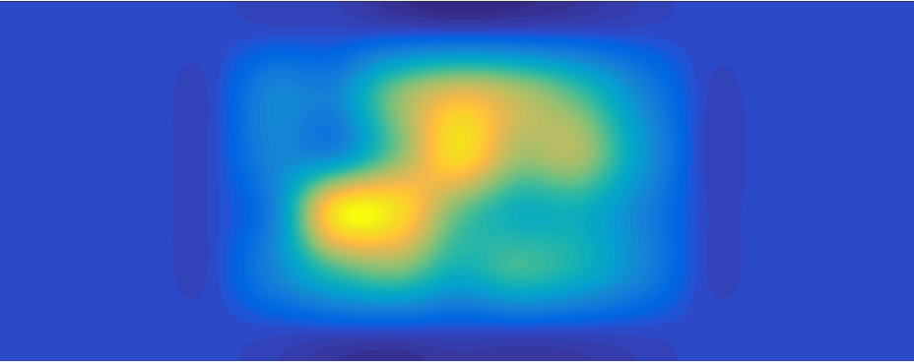
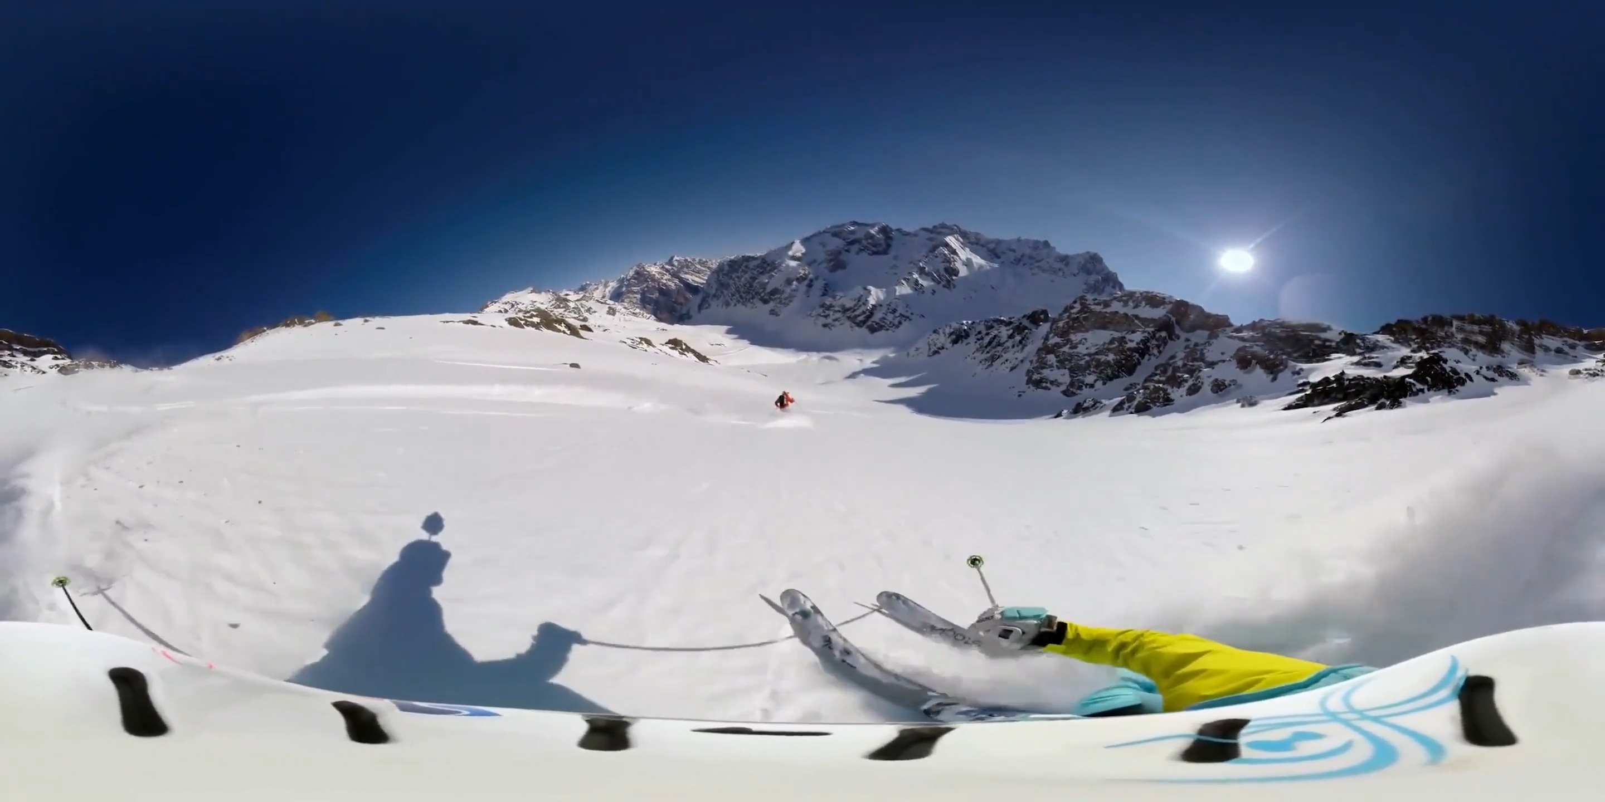

Challenge #2: How to encode 360 videos based on user perceive quality?
Notes:
[click]
In a 360 video, many different objects may appear in one video chunk.
[click]
In traditional viewport driven 360 video streaming, it is assumed that the user pays equal attention to all pixels in the viewport.
[click]
Once we realize that the user’s attention depends on more factors as we introduced before, a user’s attention to each pixel is highly different.
To optimize the user’s perceived quality in constrain bandwidth, we need to allocate different quality to each spatial region.
[click]
To achieve this, each video chunk is spatially split into many small tiles which can be encoded independently. Then a user can request different quality levels for different tiles.
[click]
However, spatially splitting a video into tiles will increase the video size in video encoding. For example, when we split the video with 12 times 24 granularity, the size of the whole video increases by almost 200%.
So how to allocate different qualities to different regions without leading to serious encoding efficiency problem is a challenge.

Slide 18
Solution #2: Video tiling based on perceived quality
1 | 1 | 1 | 1 | 1 | 5 | 5 | 1
1 | 3 | 3 | 1 | 1 | 5 | 5 | 1
1 | 3 | 3 | 1 | 1 | 1 | 1 | 1
1 | 3 | 3 | 1 | 1 | 1 | 1 | 1
1 | 1 | 1 | 1 | 1 | 5 | 5 | 1
1 | 3 | 3 | 1 | 1 | 5 | 5 | 1
1 | 3 | 3 | 1 | 1 | 1 | 1 | 1
1 | 3 | 3 | 1 | 1 | 1 | 1 | 1
Merge tiles with similar scores
Calculate efficiency score
Notes:
[click]
To solve the problem, we compute an efficiency score for each spatial area of the video chunk, which is defined by how fast the perceived quality grows with the quality level.
Our intuition is that the areas with similar efficiency scores tend to be assigned with similar quality levels.
[click]
So we group the areas with similar efficiency score to one tile, without losing the flexibility of quality allocation.
In this way, the area with different quality efficiency can be still allocated with different quality levels. But we only split the video into 7 spatial tiles.

Slide 19
How to achieve this in a real system?
Video Source
Perceived quality model
Challenge 3: How to select bitrate for each tile in real-time to optimize perceived quality?
Tiling & encoding
Video Server
CDN
Client-side bit-rate adaptation
19
Notes:
The final challenge is how to select bitrate for each tile in real time to optimize perceived quality.

Slide 20
Challenge #3: How to select bitrate for each tile in real time to optimize perceived quality?
Bandwidth throughput
Buffer level
Quality
User action
Perceived video quality
Time
Video content
Client-side bit-rate adaptation logic
Notes:
The 360 video adaptive streaming scheme relies on the client-side bit-rate adaptation logic. It takes
[click]
Bandwidth throughput,
[click]
Buffer level,
[click]
Perceived video quality as inputs, and then
[click]
it can decide the quality level of the incoming video chunk in real-time.
[click]
However, as we has stated that, user perceived quality of a 360 video depends on *both* video content and user action.
[click]
But the client is only aware of the user’s action. It knows nothing about the video content before it is actually downloaded.
[click]
So how to enable the client-side bit-rate adaptation logic compute the perceived video quality is a problem.

Slide 21
Solution #3: Client-side perceived quality look up
Scene luminance changes
Depth-of-Field difference
Viewpoint moving speed
Manifest File
Video Server
Client
Video Playback
Notes:
To solve this challenge, our intuition is that the user’s perceived quality can be precomputed on the server-side offline.
For each spatial tile of a 360 video,
[click]
based on the quality model we built, the video server precomputes the user perceived quality under each possible user action.
[click]
[click]
Then it includes this lookup table to the manifest file, a necessary file for all video streaming including some basic video information.
[click]
The manifest file will be downloaded to the client-side before the video start to play.
[click]
During the video playback,
[click]
the client-side logic monitors the user’s viewpoint, and
[click]
looks up this table to be aware of the perceived quality before the video chunk is downloaded.

Slide 22
Evaluation
Datasets
18 360 videos (12000 seconds)
Each video with 48 real viewpoint trajectories
Two evaluations
User survey based evaluation (20 real users)
Trace driven simulation
Notes:
Now, let’s see how well Pano works on real videos and real users.
We use 18 360° videos to evaluate Pano and the viewport driven baseline. The videos are in 7 different genres and they are 200 minutes in total.
We did two evaluations in this work. The first one is user survey based evaluation. We stream 360 videos to 20 real users. After video display, they are asked to give us their opinion score for the video quality, from 1 to 5.
The second one is trace driven simulation. We apply PSPNR, a well-known quality metric to quantify the user perceived quality.

Slide 23
Mean Opinion Scores under the same bandwidth
1
¹Viewport-driven: Flare: Practical Viewport-Adaptive 360-Degree Video Streaming for Mobile Devices. Feng Qian et. al. MobiCom 2018
Notes:
Here is our user survey based evaluation result.
In this figure, the x axis represents the video genres, and the y axis represents the mean opinion score from 20 users. The higher the mean opinion score is, the better the quality.
We see that under the same bandwidth, Pano receives a much higher user rating, with 25-142% improvement.

Slide 24
Quality-rebuffering trade-off under the same bandwidth
Notes:
In the trace driven simulation, we implement Pano base on a 360 video streaming system.
In this figure, x axis represents the rebuffering ratio, and the y axis represents the user perceived quality. A good streaming system should provide a good video quality with a low rebuffering ratio. So the top-left direction is better.
The result shows that Pano can significantly improve the quality-rebuffering trade-off.

Slide 25
Robustness against viewpoint prediction error
Notes:
It is well known that, video streaming logic is always streaming the video chunk for the user’s future view. So both Pano and viewport-driven baseline rely on a viewpoint prediction algorithm. One main concern is that, any prediction error can lead to the quality degradation.
So we create a noisier viewpoint trajectory based on real viewpoint. The higher the noise level, the higher the prediction error.
In this figure, the x axis represents the noise level and the y axis represents the user perceived quality.
The result shows that Pano performs better than the baseline when the viewpoint noise increases, although the improvement becomes smaller.

Slide 26
Conclusion
Existing works assume users pay equally high attention to all pixels in the viewport ⇒ Huge bandwidth consumption
Key observation: Users have limited span of attention
Our approach: Optimizing users perceived quality considering users’ attention
Results: Substantially higher users perceived quality under the same bandwidth consumption
Notes:
To sum up, existing works assume that in 360 video streaming, users pay equal attention to all pixels in the viewport. Since the viewport in 360 video is much larger than that in traditional videos, streaming 360 videos needs huge bandwidth consumption.
Our observation is that although 360 video has a much larger viewport, users still have limited span of attention, even in the viewport.
So we present Pano, a 360 video streaming system that optimizes users perceived quality considering users’ attention.
Evaluation results show that Pano significantly improves users perceived quality under the same bandwidth consumption.
Thank you.

