Slide 1


NitroSketch: Robust and General Sketch-based Monitoring in Software Switches
Alan (Zaoxing) Liu
Joint work with Ran Ben-Basat, Gil Einziger, Yaron Kassner,
Vladimir Braverman, Roy Friedman, and Vyas Sekar

Slide 2
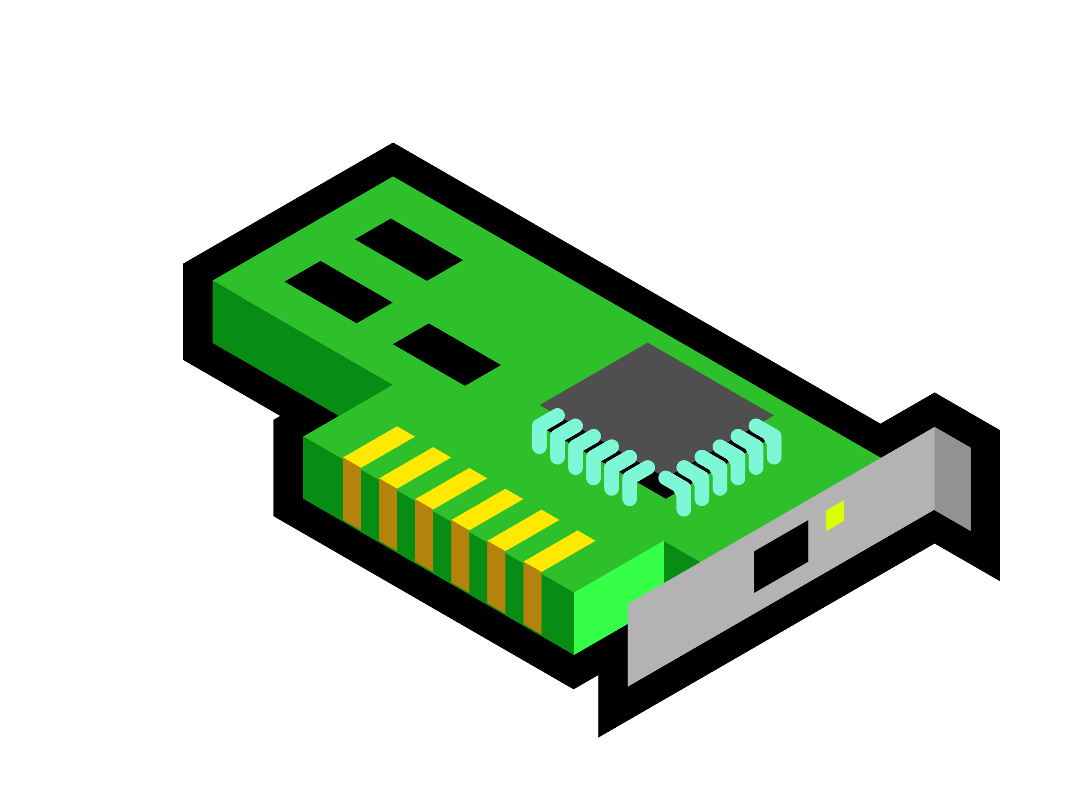



Need for network telemetry in software switches
Where: Virtual switches, White-box switches, DPDK, FD.io,…
DPDK
Virtual SW
Apps
A
A
A
A
BESS
VM
VM
VM

Slide 3
Need for network telemetry in software switches
Where: Virtual switches, White-box switches, DPDK, FD.io ……
Traffic Engineering
Anomaly Detection
“Flow Size Distribution”
“Entropy”, “Traffic Changes”
Worm Detection
Accounting
“SuperSpreaders”
“Heavy Hitters”
Requirements: Performance, Accuracy

Slide 4
Sketches appear to be a promising alternative
Flow key k
5
+1
7
9
11
3
H₁(k)
Keep
flow
keys
Packet
3
4
6
+1
10
H₂(k)
.
.
.
7
d arrays of
counters
+1
9
6
11
8
4
H_{d} (k)
7
9
5
10
3
+1
r counters per array
Require small memory with bounded error rates.
Guaranteed fidelity with arbitrary workloads.

Slide 5
Reality: Sketches in software switches not performant!
  Single core 100% CPU.
  Cannot meet high line-rates: < 10Gbps

Slide 6
Existing proposals to speed up sketches?
SketchVisor [SIGCOMM’17]:
Elastic Sketch [SIGCOMM’18]:
R-HHH [SIGCOMM’17]:
✔ Performance increase (still < 10 Mpps)
            X Not robust on arbitrary workloads.
✔ Performance increase (> 14.8 Mpps)
            X Not robust on arbitrary workloads.
✔ Performance increase (up to 14.8 Mpps)
            X Not general towards many tasks.

Slide 7
NitroSketch in a nutshell
A software-switch based sketching framework that simultaneously has:
Performance: line-rate (40G) with minimal CPU and memory.
Generality: support a variety of measurement tasks.
Robustness: accuracy guarantees for any workload.

Slide 8
NitroSketch Approach
Systematically analyze the performance bottlenecks.
Learn key insights from strawman solutions (sampling, one-level hash).
Reformulate sketching for software from first principles
- Tradeoff slight memory increase, Novel counter sampling rather than packet.

Slide 9
Outline for this talk
Motivation
Understanding bottlenecks
Design Insights
  Strawman ideas
  Our proposals
Evaluation
Conclusions and future work

Slide 10
Outline for this talk
Motivation
Understanding bottlenecks
Design Insights
  Strawman ideas
  Our proposals
Evaluation
Conclusions and future work

Slide 11
Bottleneck Analysis
- Performance benchmarks using Intel VTune Amplifier.
- Hotspots for UnivMon [SIGCOMM’16].

Slide 12

Bottleneck B1: Many hash computations per packet
+1
hashing
Top
keys
Packet
+1
d arrays of
counters
+1
+1
r counters per array
B1: Many (independent) hash computations per packet (~37% CPU)

Slide 13
Bottleneck B2: Many counter updates per packet
+1
hashing
Top
keys
Packet
+1
d arrays of
counters
+1
+1
r counters per array
B2: Many counter updates (~15% CPU)

Slide 14
Bottleneck B3: Tracking keys is also expensive
+1
hashing
Top
keys
Packet
+1
d arrays of
counters
+1
+1
r counters per array
B3: Expensive flow key data structure operations
(e.g., heap (~10% CPU))

Slide 15
Outline for this talk
Motivation
Understanding bottlenecks
Design Insights
  Strawman ideas
  Our proposals
Evaluation
Conclusions and future work

Slide 16
Outline for this talk
Motivation
Understanding bottlenecks
Design Insights
  Strawman ideas
  Our proposals
Evaluation
Conclusions and future work

Slide 17
Strawman 1: Reduce hashes by using single array?
Traditional
Single larger hash array
+1
H1
H2
….
+1
+
+1
Hd
+1
CPU cache
DRAM
Pros: Simple idea to reduce hash computations.
Cons:
- Memory increase may cause cache misses.
- Even one lightweight hash per packet may be high!

Slide 18
Strawman 2: Reduce updates by packet sampling?
Sampled Packet
+
+1
+
Flip a coin:
with p
+
+
Pros: Simple idea to reduce hash/counter updates.
Cons:
- Memory increase may cause cache misses.
- Even one coin flip per packet may be high!
- Incurs accuracy-convergence tradeoff.

Slide 19
Key lessons from strawman solutions
Can tradeoff memory for CPU reduction
But need to ensure cache residency
Sampling is promising
But need to manage per-packet ops and convergence

Slide 20
How do we tackle this?
We trade memory for CPU reduction
while ensuring cache residency
Sampling is promising
But need to manage per-packet ops and convergence

Slide 21
Key Idea: Sample counter updates not packets!
Sketch
1
Sampled Packet
+
Uniform
Packet
Sampling
2
+1
3
+
4
+
5
+
6
Rethinking the way of doing sampling with sketches
1
Each Packet
2
+1
3
+
Uniform
Counter
Sampling
4
5
6
Notes:
Our key idea is Sampling counter updates not packets.
We sample counters updates not packets that achieve better tradeoff between memory and CPU reduction.
What it means is the following:
Considering we have uniformly sampled packets as in the strawman, each sampled packet will update the counters in all sketch arrays. To achieve the same accuracy guarantee, memory needs to increase by some polynomial in (1/p) in order to offset the accuracy loss from the sampling.
What we do is different, we are not sampling packets but the counters to update. For each packet we sampled the counters to be updated.
The high-level intuition why this way can achieve higher memory efficiency is the following:

Slide 22
Key Idea: Sample counter updates not packets!
Multiple independent hashes key for memory efficiency
Coin flips
with p
+1
Packet
+1
+1
+1
+1
- Per-packet hash/counter updates can be reduced to less than one.
- Memory increase by O(1/p): Much better than uniform packet sampling.
Notes:
By adopting this key idea, we can significant reduce the hash computation overhead to less than one per packet. And achieves much better memory efficiency than uniform packet sampling.
However, you may notice that there are two issues here:
(1) Still incur many per-packet coin flips
(2) Require some amount time before converged

Slide 23
How do we tackle this?
Can tradeoff memory for CPU reduction
But need to ensure still cache resident
Sampling works!
but need to manage per-packet ops and convergence
Each Packet
+1
+1

Slide 24
Trick: Geometric sampling to reduce per-packet ops
Uniform sampling with p
1
2
3
4
5
6
Coin flip
with p
Coin flip
with p
Coin flip
with p
Coin flip
with p
Coin flip
with p
Coin flip
with p
Equivalent
1
2
3
4
5
6
Geometric sampling with p
Sampled.
Flip a coin with p
Interval is 4
Sampled.
Flip a coin for next
Skipped

Slide 25
Trick: Adapt sampling rate to manage convergence
Sampling-based approach needs to receive enough packets before becoming accurate (need convergence).
When packet rate isn’t high,
  we can sample more packets ⇒ faster converge
Adaptively adjusting sampling rate:
Packet
Packet rate: 1Mpps, sample with 1/1
+
Packet rate: 8Mpps, sample with 1/8
Packet rate: 64Mpps, sample with 1/64
Datarate Adaptive
25

Slide 26
NitroSketch: Putting it together
Update with +1/p
1
Array 1
+1
2
Select next 21
3
+1
+
Array 2
4
Skipped
+1
+
Array 3
5
+1
Array 4
6
Update with +1/p
Adjust the sampling rate when needed
Trade small space for speedup on CPU
26

Slide 27
NitroSketch is theoretically robust!
NitroSketch offers accuracy guarantees for a variety of measurement tasks.
Our theoretical analysis holds after receiving enough packets.
In practice, we need ~2-4 Mil packets to converge.
Check out our paper for more details!
27

Slide 28
NitroSketch Inline Implementation
Controller/ Other Users
User Space
Shared
Buffer
OVS-DPDK vswitchd
dpif-netdev forwarding pipeline
NitroSketchD
emc
dp classider
…
PMD
PMD
PMD
Kernel Space
NIC
NIC
NIC
Other versions: FD.io-VPP, BESS

Slide 29
NitroSketch achieves 40G on software switches
Two threads with OVS-DPDK, VPP and BESS on Intel XL710 NIC.
NitroSketch uses no extra cores.
29

Slide 30
NitroSketch can achieve higher throughput
In-memory single thread (Intel E5 2620 v4 CPU)
Algorithms use 5~10 independent hash functions
Original
w/ NitroSketch
30

Slide 31
Guaranteed accuracy after convergence
After received 2~4 Mil packets, Sketches achieve comparable (or better) accuracy as the original sketches.
31

Slide 32
NitroSketch outforms other solutions
NitroSketch achieves higher accuracy when converged.
32

Slide 33
Conclusions
Sketching is a promising alternative for software switch based telemetry.
Performance of sketches is far from optimal.
Existing efforts missing in performance, robustness, or generality.
NitroSketch key ideas:
Tradeoff small memory increase, Sample counters not packets,
Geometric sampling to reduce packet ops, Adaptive sampling
NitroSketch improves the performance of sketches by 1~2 orders of magnitude while retaining the robustness and generality
https://github.com/zaoxing/NitroSketch
Alan Liu: zaoxing@cmu.edu
33

