Slide 1

ACM SIGCOMM 2019 CLOSING
August 22, Beijing, CHINA
Notes:
Good afternoon everyone! Time passes so quickly and it’s time for the closing session.
This is Yong Cui, the vice GC, from Tsinghua U.

Slide 2
Student Research Competition (SRC)
Co-chairs:
Kun Tan (Huawei, China)
Jiangchuan Liu (Simon Fraser University, Canada)
Notes:
First, let’s see the result of student research competition.
Welcome Dr. Kun Tan from Huawei, and Prof. Jiangchuan Liu from Simon Fraser University.

Slide 3
Before SIGCOMM
Received eligible 55 submissions
42 graduates
13 undergraduates
Shared PC with SIGCOMM poster & demo
19 are accepted and invited to SIGCOMM (w/ 500$ travel grants)
13 graduates and 6 undergraduates

Slide 4
At SIGCOMM
Two phases of SRC
Poster Session (Wed. afternoon)
Oral Presentation Session (Thu. early morning)
Two groups
Graduate and Undergraduate
18 jurors to evaluate the work
18 for Poster Session
10 for Oral Session
Graduate group – led by Jennifer Rexford
Undergraduate group – led by Lixia Zhang

Slide 5
Winners!

Slide 6
Winners – Undergraduate Group
Zhaowei Xi, “HyperGen: High-Performance Flexible Packet Generator Using Programmable Switching ASIC”, Tsinghua University
Jiadi Yang, “Cooperative Trajectory Optimization for a Cellular Internet of UAVs”, Peking University
Mateus Saquetti, “Hard Virtualization of P4-based switches with VirtP4”, Federal University of Rio Grande do Sul

Slide 7
Winners – Graduate Group
Sean Choi, “Lambda-NIC: Interactive Serverless Compute on SmartNICs”, Stanford University
Jona Beysens, “Smile, you are in the spotlight!”, KU Leuven
Lior Shafir, “DNS Negative Caching in the Wild”, Tel Aviv University

Slide 8
Student Research Competition (SRC)
Co-chairs:
Kun Tan (Huawei, China)
Jiangchuan Liu (Simon Fraser University, Canada)
Notes:
Congratualtions to all of the students, and thank you, Kun and Jiangchuan.

Slide 9

SIGCOMM 2020
Location: NYC, Columbia U.
Dates: likely in early September
GC: Vishal Misra, Columbia U.
Program Chairs: TBD (soon)
Notes:
I guess most of you didn’t attend the business meeting yesterday. So I would like to say again, next year, Sigcomm will at at another fantastic big city, NYC, likely in early September.
So try to contribute on submitting papers, posters, demos or even attendance.

Slide 10
Registration
New record: 1178 registrations
Students : 511 (43%)
Regions : 36
China: 777
USA: 189
South Korea: 24
Germany: 22
UK/Japan: 16
Notes:
This year we have a new registration record: 1178 from 36 regions.
More than half come from mainland China, while other majorities come from …

Slide 11
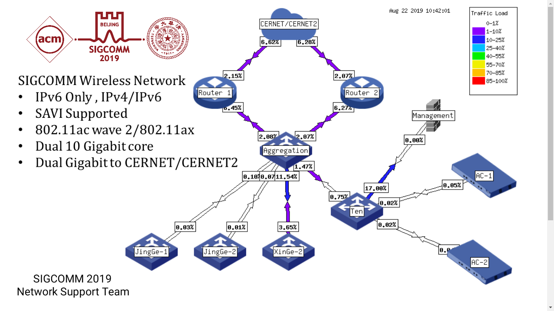
SIGCOMM’19 Wireless Network
Uplink
1Gbps to CERNET for IPv4
1Gbps to CERNET2 for IPv6
Devices
2 Routers
2 Core Switches + 14 PoE Switches
72 APs (802.11ax/802.11ac)
5 Servers
1 UPS (2KVA)
NOC
28 Staffs from Tsinghua Univ., H3C, SRUN, CERNET
Valley Wing Sapphire Room, 3rd floor
Notes:
For the wireless networks, we provide 2 Gbps for IPv4 CERNET and IPv6 CERNET2 totally.
We settled over 70 APs with a few servers and even a UPS.
We have staff engineers and a Noc center upstairs.

Slide 12
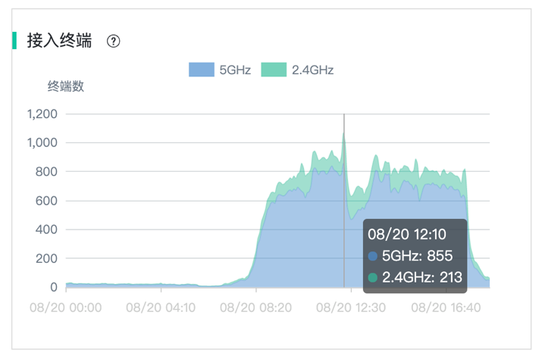
SIGCOMM’19 Wireless Network
Statistics: (8.19-8.21)
Total Number of Users : 1128
Total Number of Devices: 1760
Total Traffic: 724.1GB
Peak Online Users: 671
Peak Online Devices: 1068
Peak Associated Devices Number per AP: 116
Notes:
Here are some Statistics for the past 3 days on Number of Users and Devices. The Total Traffic is over 700 GB.
We have around 700 Users and over 1000 Devices at the peak time.

Slide 13
SIGCOMM’19 Wireless Network
TOP 5 Users of inbound traffic
Sig1827 (10.7GB)
Sig1982 (9.8GB)
Sig1079 (7.3GB)
Sig0082 (6.6GB)
Sig0207 (6.0GB)
TOP 5 Users of outbound traffic
Sig0786 (11.0GB)
Sig1451 (5.5GB)
Sig0287 (4.7GB)
Sig0117 (4.5GB)
Sig1963 (4.4GB)
Notes:
This is the list of top users of the traffic consumption.
Maybe you can Check your badge to see if you are list here☺
An elephant user consumed more than 10 GB.

Slide 14
SIGCOMM’19 Wireless Network
TOP 5 Applications (Traffic)
SSL (60.8GB)
Web Browsing (26.2GB)
Apple APPStore (20.6GB)
DTLS (11GB)
MS-Update (8.3GB)
TOP 5 Applications (Session)
DNS (2.4M)
SIP (633.5K)
SSL (594.7K)
Web Browsing (244.0K)
WeChat-Base (195.6K)
Notes:
The top applications according to the traffic volumn are SSL, web, appStore and so on.
While if we see from the session number, then we have different answers: top applications are DNS, SIP, SSL, web and even WeChat.

Slide 15
SIGCOMM’19 Wireless Network
Top User Devices
APPLE: 879 (36.5%)
HUAWEI: 627 (26.1%)
XIAOMI: 101 (4.2%)
SUMSUNG: 70 (2.9%)
OPPO: 12 (0.5%)
VIVO: 11 (0.4%)
OTHER: 704 (29.3%)
Notes:
Top User Devices include APPLE, HUAWEI, XIAOMI, and Sumsung.
The fifth is only 0.5%.

Slide 16
SIGCOMM’19 Wireless Network
User Distribution
Wireless Frequency
2.4G: 1878
5G: 1994
SSIDs
SIGCOMM: 857
SIGCOMM-1X: 1163
Eduroam: 308

Slide 17
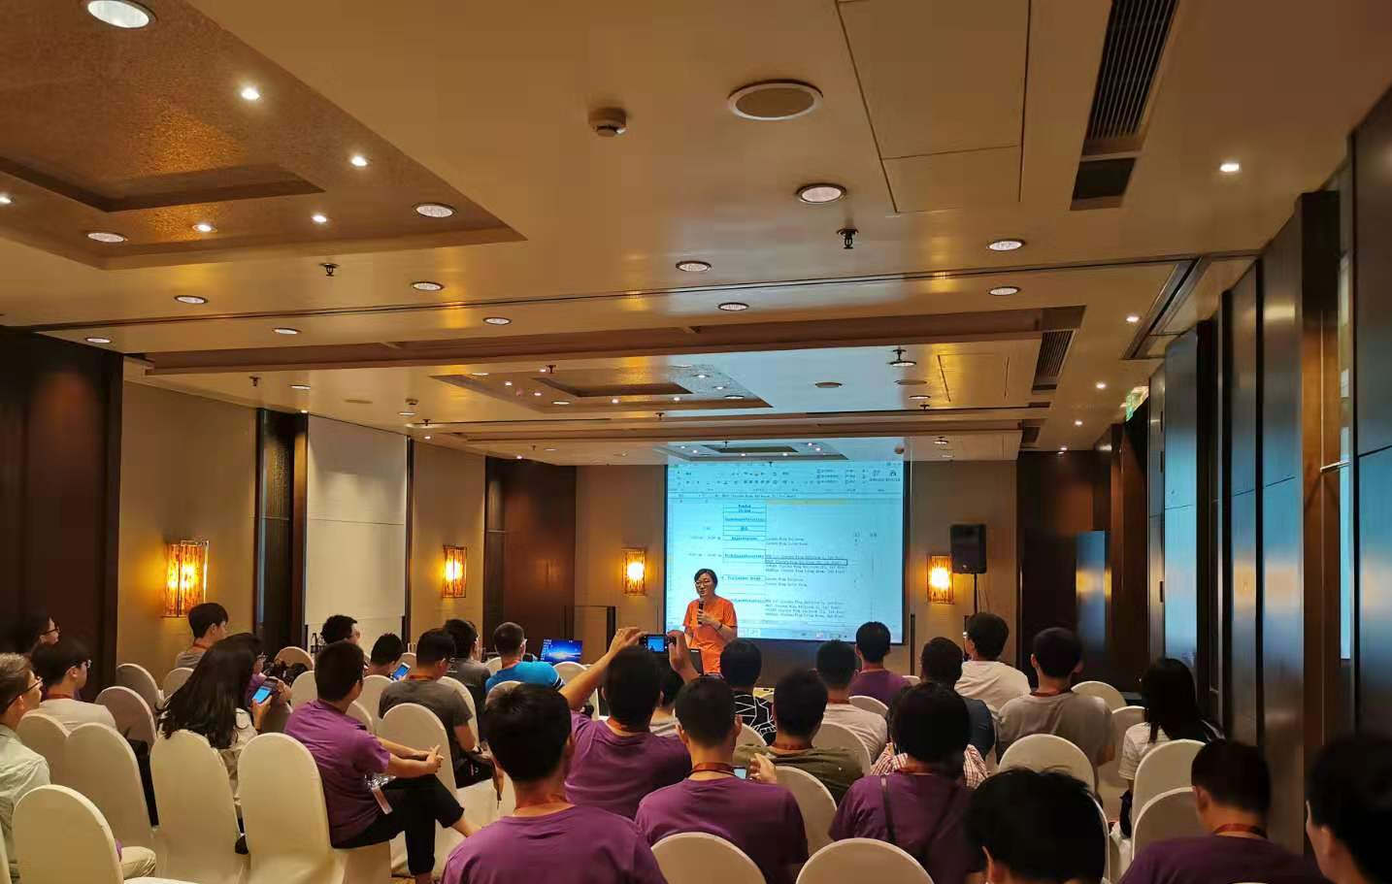
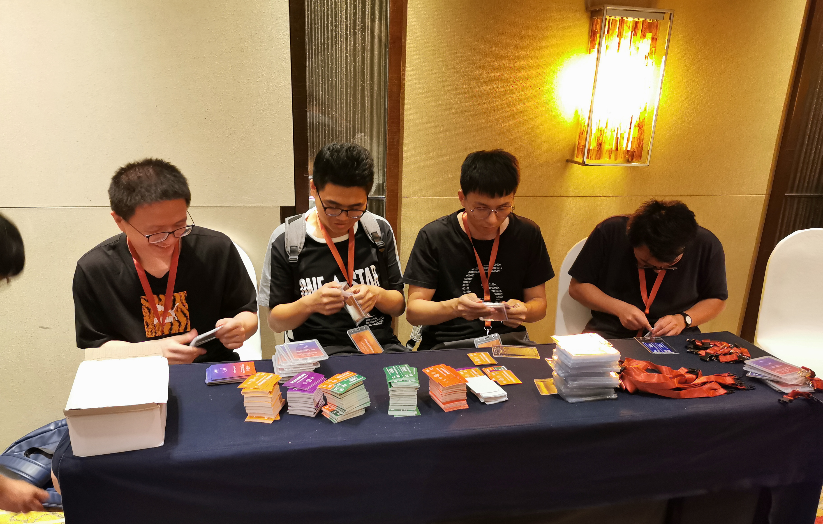
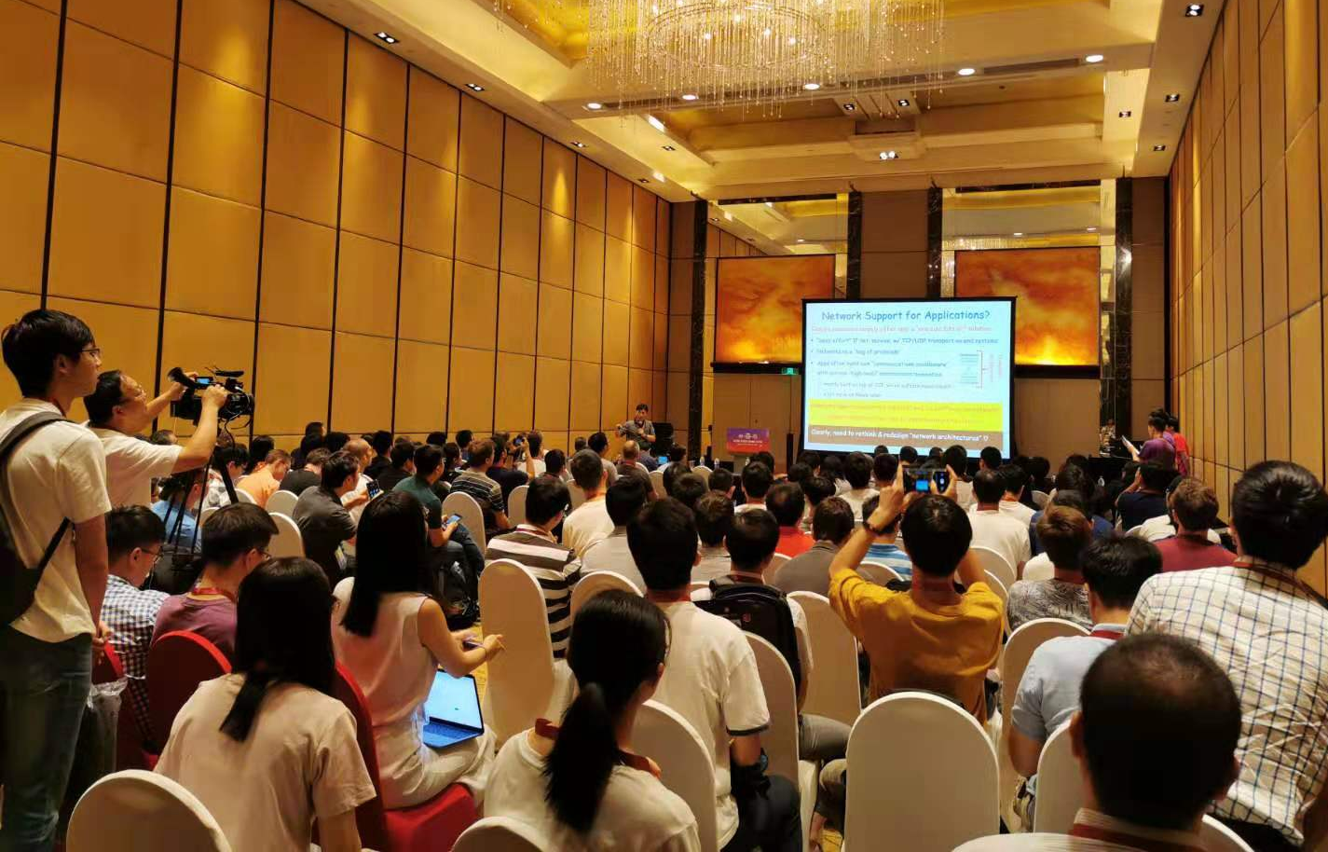
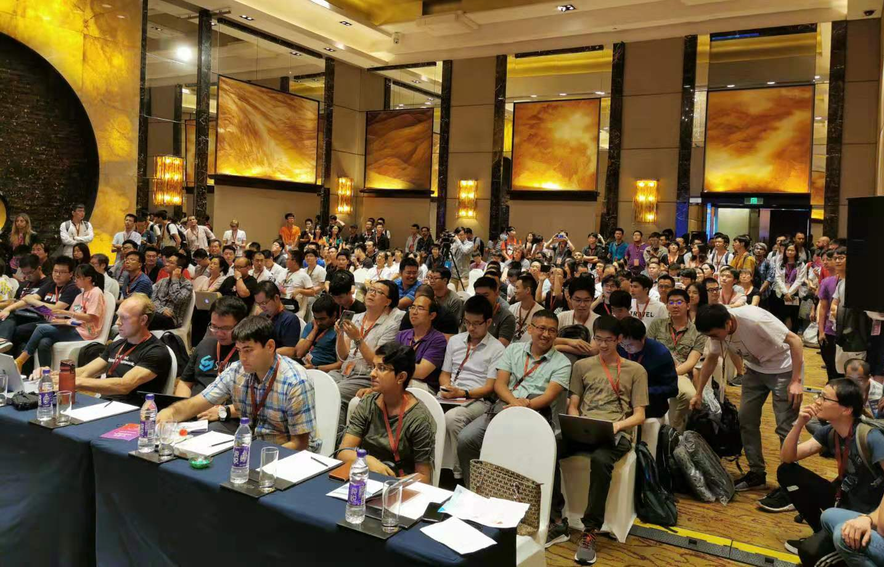
Day 0: Warm up
Day 1: WS…
Notes:
Let’s go quickly with review of the past days and events.
Actually, we organized several meetings for volunteer training last week, and here they prepared the badge for everyone of you on Sunday.
Monday is our first day with workshop and tutorials. The left one is our workshop, NEAT, while the right one is the topic preview session. Many people there, right?

Slide 18
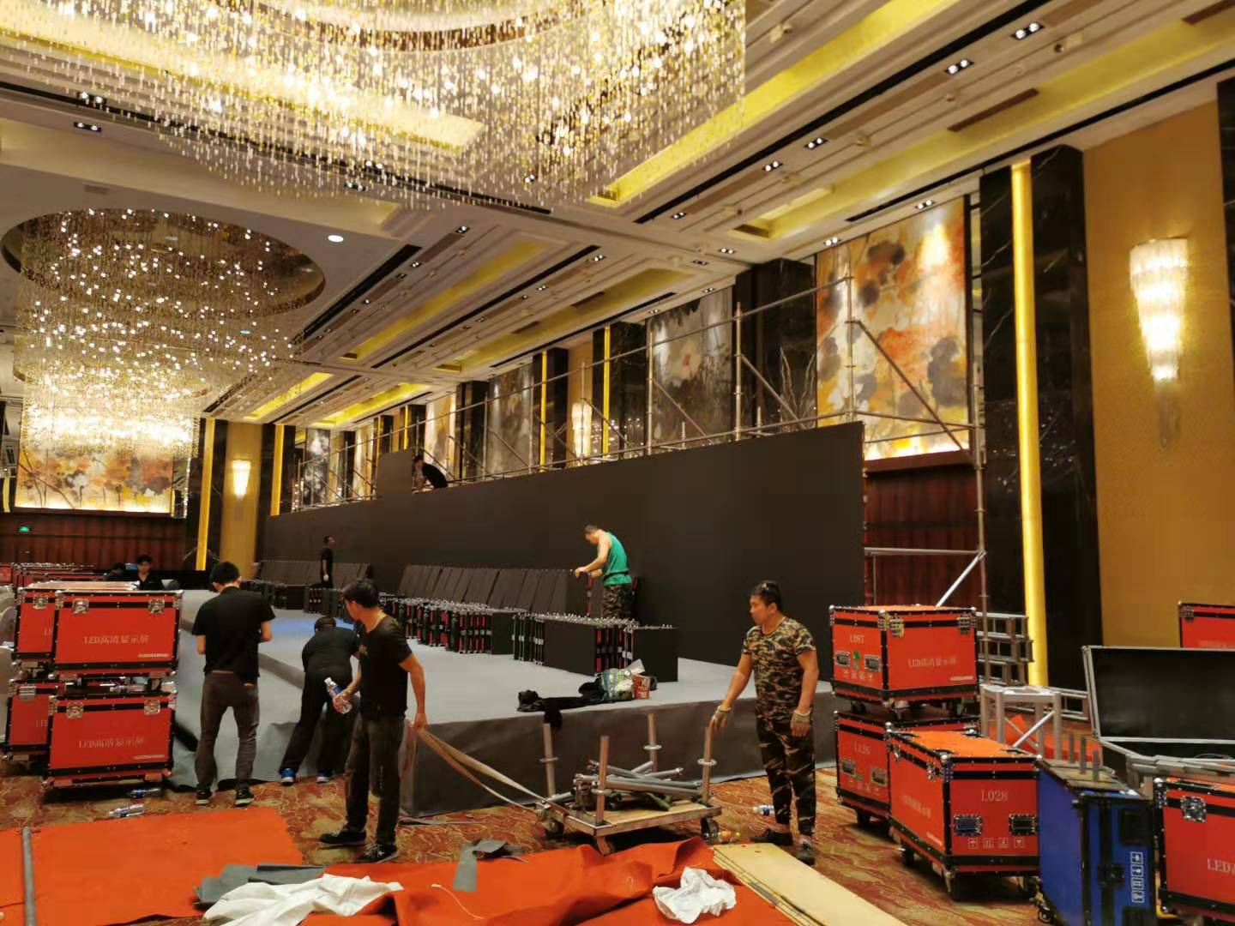
Monday 2:00 a.m.
Notes:
Oh, I took this picture on Monday midnight, 2am.
Guess, where did I take this picture?
Yes, after their overnight working, we have the big screen.

Slide 19
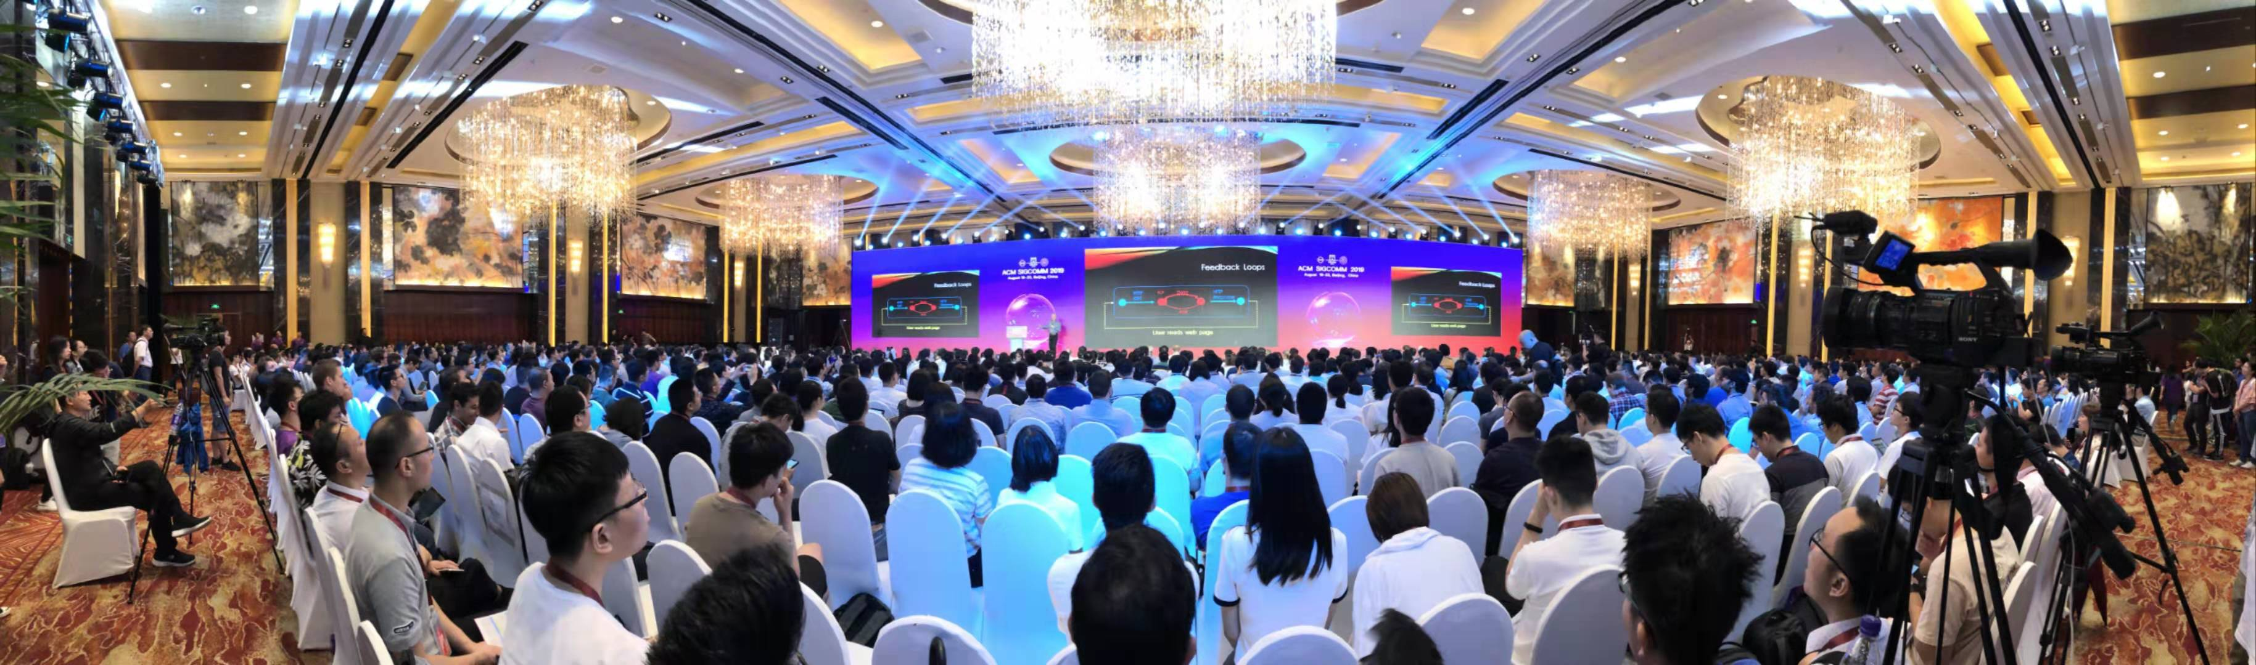
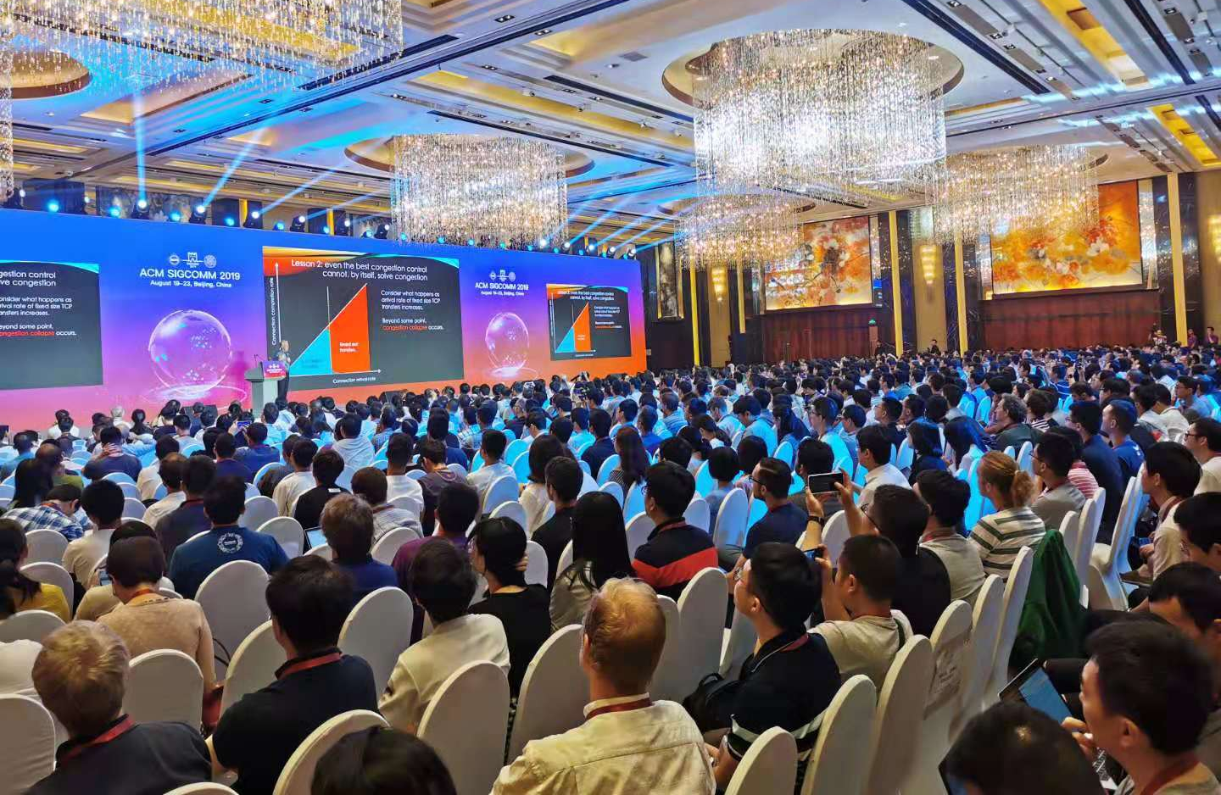
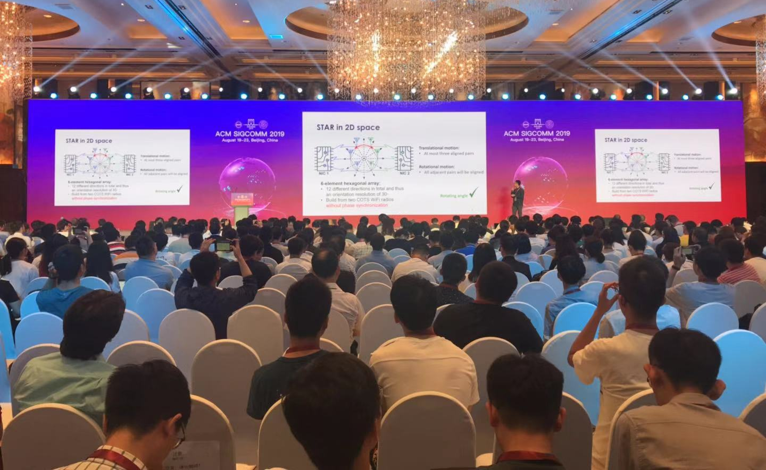
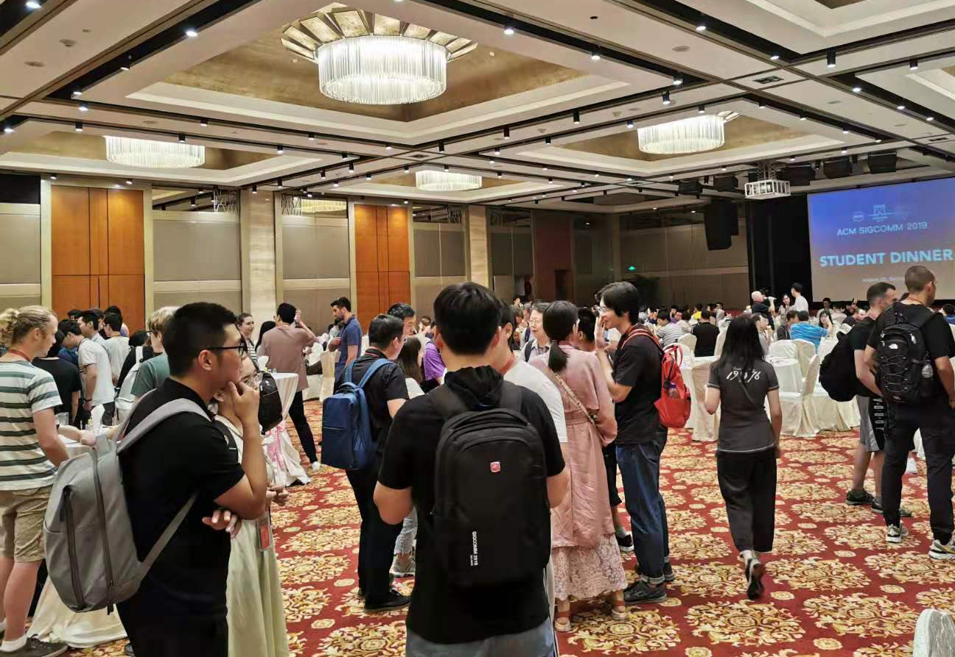
The Opening Day
Notes:
So we have a successful opening day. After a short opening session, Prof. Mark Handley delivered a insightful keynote speech. After that, we had technical session and student dinner in the evening.

Slide 20
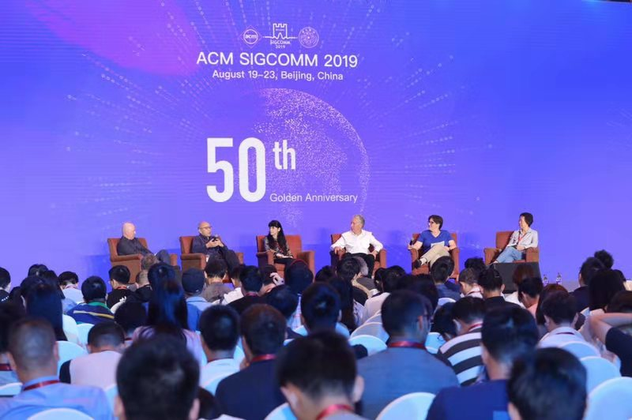
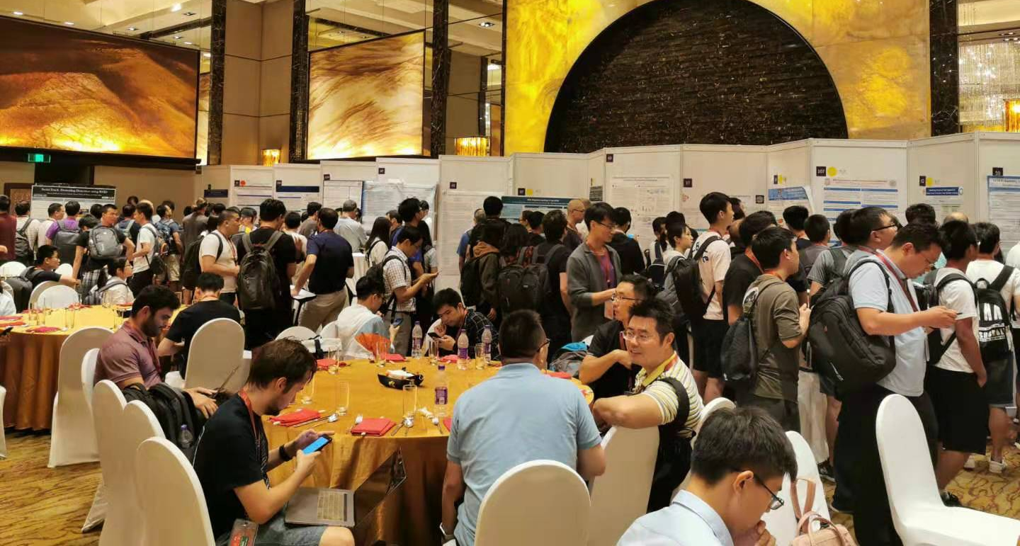
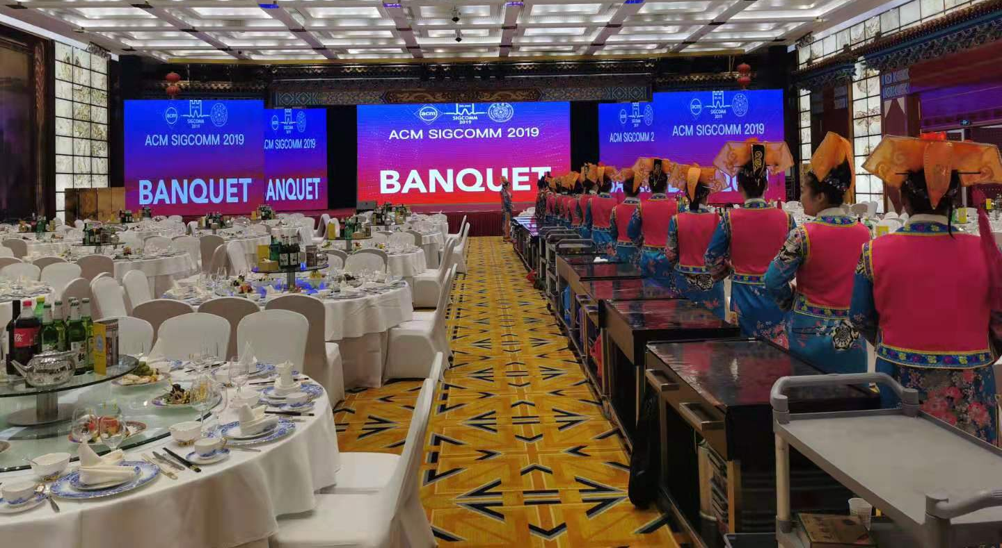
Notes:
Yesterday, we had the celebration for the 50 year anniversary.
/////We also enjoyed the posters and demos with a lot of interaction with the presenters.
/////Last night we had a banquet with the performance showing the history with the dishes.

Slide 21
Attendance Stat.
Attendance Rate
Attendance Number
300
905
796
786
Notes:
Here is the statistics of the Attendance.
The peak is 83% for the Attendance Rate with over 900 people.
To my surprise, the number today is almost the same with that on Wed.

Slide 22
Friday Program
Workshops
NetPL: Workshop on Networking and Programming Languages
NetAI: Workshop on Network Meets AI & ML
Tutorials
P4: Tutorial on Programming the Network Data Plane (P4)
CPS: Tutorial on Modeling and Analysis of Network Infrastructure in Cyber-Physical Systems
Videos will be available at ACM DL next week
Notes:
I would like to remind you that we will have 2 workshops and 2 tutorials tomorrow. Please look at your conference book for details.
Additionally, some people asked me about the pictures and videoes. We are uploading the video to the ACM Digital Lib and you should be able to download them next week.

Slide 23
Acknowledgements
SIGCOMM Executive Committee
Organization Committee (44 members)
Program Committee (61 members)
Poster/Demo Committee (47 members)
Student Research Competition Committee (18 members)
Notes:
At this closing, I would like to Acknowledge the help from different committees. SIGCOMM Executive Committee,
Organization Committee with 44 members, Program Committee with over 60 member, Poster/Demo Committee, Student, Research Competition Committee.
Based on the hard working of all these committee members, we could have today’s conference.

Slide 24

















Thanks to Supporters
Notes:
At the same time, we appreciate the support from all of the sponsors. Without your generous support, we could never have this conference at this topmost hotel.

Slide 25

Special Thanks to Local Team
Total Number : 89 people
Tsinghua Faculty : 16 people
Volunteers : 45 people
Network engineers : 28 people
Tsinghua University
Welcome to the Stage!
Notes:
To ensure the smooth running of the conference, we organized a local team with around 90 persons, including our faculty member, student volunteers and staff engineers.
Without their hard working behind us, we could never have this conference.
So may I have this chance to invite all of them from behind to the front?
Let’s give the warmest applause to thank our local team!

Slide 26
ACM SIGCOMM 2019 CLOSING
August 22, Beijing, CHINA
Notes:
Thank you for your coming to this sigcomm conference.
See you tomorrow on workshops and tutorials. See you next year in New York.

