Slide 1
Unmasking Vulnerabilities of HyperLogLog: Security via Parameter Extraction
Shishi Zhang Ning Wang Lu Tang

Slide 2





1
Background — Software-based network monitoring
The execution of network telemetry and analytics tasks in software, enabling real-time traffic analysis under high-speed constraints.
1）Cardinality estimation
2）Resource optimization
3）Anomaly detection
Challenges
1）Deploy fine-grained telemetry at high speeds
2）Resource limitation
High-speed traffic
Software processor
Security analytics

Slide 3





1
Background — Outline of HLL
HLL is one of the most important cardinality estimation methods.
Google counts the number of different search queries
Facebook calculates the number of distinct people
HLL is vulnerable to attacks that manipulate cardinality estimates.
Overestimation: misjudge network activity
Underestimation: miss critical threats
Process fake traffic
Network scans
DDoS attacks

Slide 4
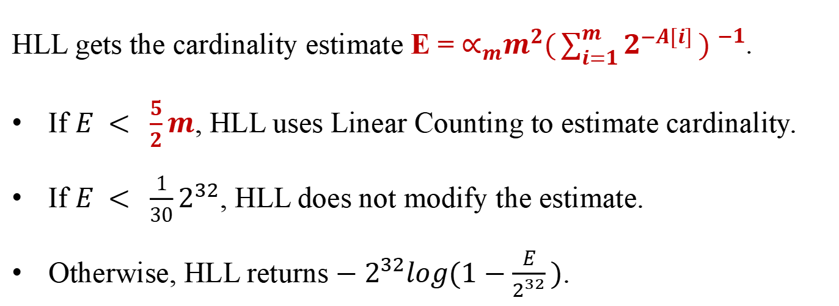
1
Background — Data structure of HLL
m registers
Data structure of HLL
1 2 3 ··· m
Array A Storage the maximum value of leading zeros
Hash functions h Which register to update
Hash functions s How to update each register
Function p(str) The position of the leftmost '1' in the binary string str
0
h(f) = 3
h
f
flow key
s(f) = 001
p(s(f)) = 2
2 > 0
Estimate formula of HLL
HLL gets the cardinality estimate E = $∝_{m}m^{2}{(\sum_{i=1}^{m}{2^{−A[i]}}) }^{−1}$.
If $E < \frac{5}{2}m$, HLL uses Linear Counting to estimate cardinality.
If $E < \frac{1}{30}2^{32}$, HLL does not modify the estimate.
Otherwise, HLL returns $−2^{32}log(1−\frac{E}{2^{32}})$.
1 2 3 ··· m
2
A(i) = max(p(s(f)),A(i))

Slide 5
1
Background — Limitations of existing work vs. our approach
Existing Work: overlooking security threats in adversarial settings
Accuracy / Memory optimization[1][2][3][4]
Naive attack methods[5][6][7][8]
Our Research: exploiting HLL's structural vulnerability via parameter extraction
Novel parameter inference
Parameter-driven black-box attacks
 | Existing Work | Our Work
Focus | Accuracy optimization Memory optimization | Security vulnerability Parameter extraction
Attacks | Ignorant of ‘m’ Limited impact | ‘m’-aware Magnitude or exponential level
[1] Otmar Ertl. 2024. UltraLogLog: A Practical and More Space-Efficient Alternative to HyperLogLog for Approximate Distinct Counting. In Proceedings of the 2024 ACMVLDB. 1655–1668.
[2] Stefan Heule, Marc Nunkesser, and Alexander Hall. 2013. Hyperloglog in practice: Algorithmic engineering of a state of the art cardinality estimation algorithm. In Proceedings of the 2013 ACM EDBT/ICDT. 683–692.
[3] Matti Karppa and Rasmus Pagh. 2022. Hyperlogloglog: Cardinality estimation with one log more. In Proceedings of the 2022 ACM SIGKDD. 753–761.
[4] Qingjun Xiao, You Zhou, and Shigang Chen. 2017. Better with fewer bits: Improving the performance of cardinality estimation of large data streams. In Proceedings of the 2017 IEEE INFOCOM. 1–9.
[5] Sara Ahmadian and Edith Cohen. 2024. Unmasking vulnerabilities: cardinalit sketches under adaptive inputs. In Proceedings of the 2024 ICML.
[6] Damu Ding. 2024. CARBINE: Exploring Additional Properties of HyperLogLog for Secure and Robust Flow Cardinality Estimation. In Proceedings of the 2024 IEEE INFOCOM. 471–480.
[7] Kenneth G Paterson and Mathilde Raynal. 2022. Hyperloglog: Exponentially bad in adversarial settings. In Proceedings of the 2022 IEEE EuroS&P. 154–170.
[8] Pedro Reviriego and Daniel Ting. 2020. Security of HyperLogLog (HLL) cardinality estimation: Vulnerabilities and protection. IEEE Communications Letters 24, 5 (2020), 976–980.

Slide 6


1
Background — Adversarial scenario
In the distributed counting scenario, the black box S1 is more realistic than the white-box S2-S4.
S1:
  The details of the HLL
  A shadow copy of the HLL via its API
S2:
  The details of the HLL implementation
  Interact with the HLL via its API
S3:
  The details of the HLL implementation
  The individual bucket contents
S4:
  Has direct access to the HLL and full knowledge of its internal contents
more realistic

Slide 7






1
Background — Adversarial scenario
To support merging, all HLL instances need to use the same hash functions.
HLL uses the same hash functions.
Different instances will yield the same cardinality estimate for a given input set.
purchase
same
inpute
same
estimate
The shadow device

Slide 8
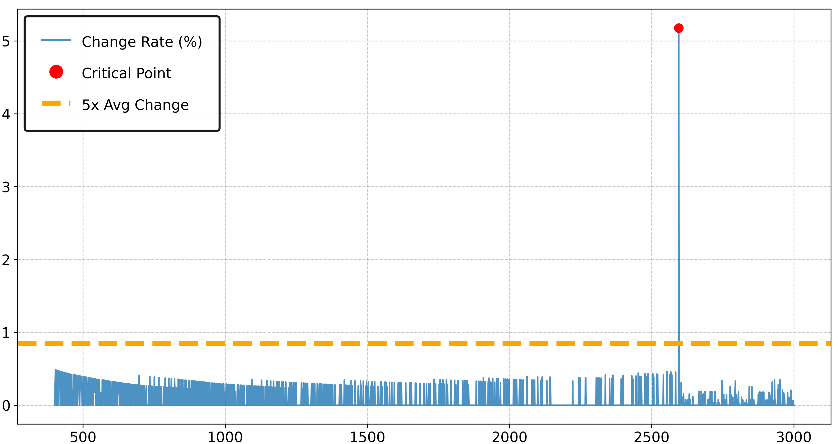
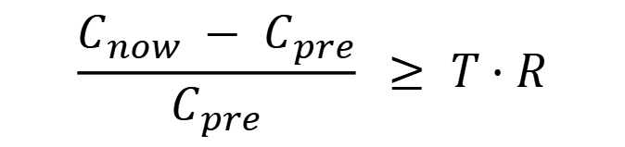

2
Design — Parameter inference technology
Source of thought: the observation of the critical value in the error correction of HLL.
At the critical point, the rate of change in cardinality estimates experiences a sharp jump.
Change Rate of Cardinality Estimation during Insertions
The critical point
$$C_{now} < C_{pre}$$
Change Rate (%)
sharp jump
$$\frac{C_{now} − C_{pre}}{C_{pre}} ≥ T · R$$
Setting:
Ubuntu 20.04.6
HLL:
m = 1024
Insertion Index (j)

Slide 9
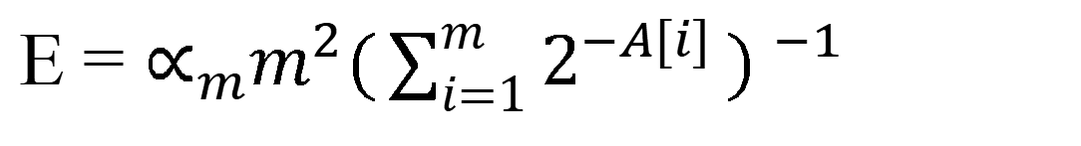
2
Design — Outline of two black-box attack methods
Correction
coefficient
The max leading zeros of element mapped to the i-th register
Cardinality estimate
A[i] Leading zeros E
E = $∝_{m}m^{2}{(\sum_{i=1}^{m}{2^{−A[i]}}) }^{−1}$
A[i] Leading zeros E
The cardinality estimation formula of HLL
Inflation Attack
Overestimate the base value
The estimated value ＞ the true value
Deflation Attack
Underestimate the base value
The estimated value ＜ the true value
Inflation
large
cardinality
small set
HLL
large
set
HLL
small cardinality
Deflation

Slide 10






2
Design — Inflation attack
We construct an attack set of size m:
the hash value of each element fall into different registers
the leading zeros of each hash value is large enough for A[i] to increase
elements
elements
fall into different registers
...
concentrated in few registers
 |  |  |  |  |  | i
$$A[i]$$
large enough
smaller $A[i]$ and $E$
m registers
$$E$$
m registers
S
Forward
Screening
I
R
Forward
Screening
A
Attack Set Reduction
minimum A
Reverse
insert element
retain
element
insert
element
$$E_{after} =$$
$$E_{before}$$
remove
element
E
$$E_{before}$$
$$E_{after}$$

Slide 11


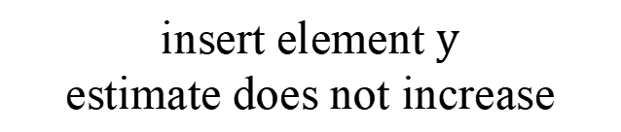
2
Design — Deflation attack
finding a large number of elements with at most two leading zeros
use these elements to construct the deflation attack set
Elements (leading zeros ≤ 2)
...
Deflation attack set
The steps of finding element(leading zeros ≤ 2)
The steps of construct the deflation attack set
...
$$E$$
insert element $y$
estimate does not increase
x
...
leading zeros of element x
$$E_{1}$$
S
x
leading zeros of x ≤ 2
y
leading zeros of y ≤ 2
F
F involves elements with no more than 2 leading zeros.
y
attack set A
HLL

Slide 12
3
Evaluation — Setting
Setting:
Ubuntu 20.04.6
8-core Intel Gen i7-11700 2.50GHz CPU and 31GB RAM
384KB L1 data cache, 256KB L1 instruction cache and 4MB L2 cache
16MB of shared L3 cache
HLL:
m = 1024
S: The initial set
A: The attack set

Slide 13
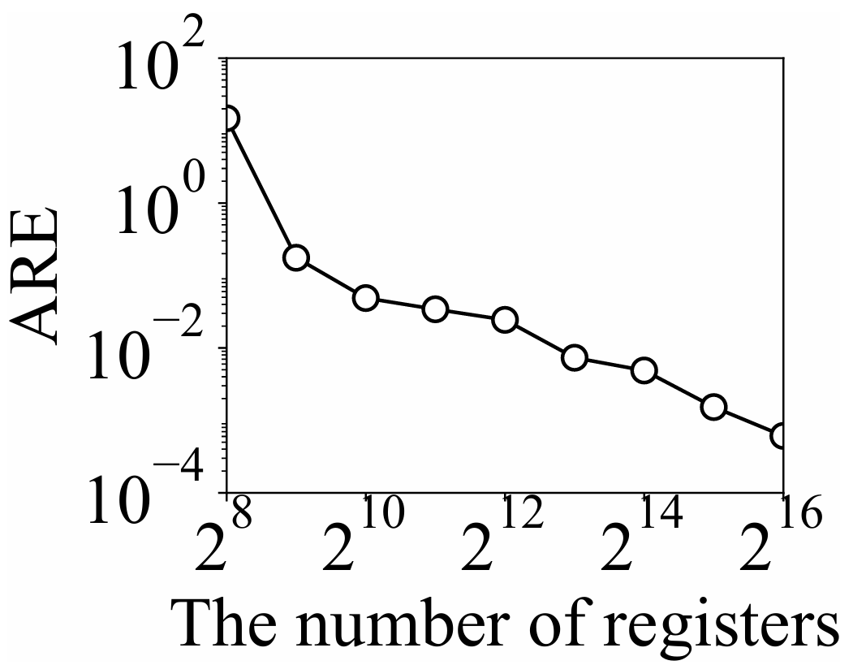

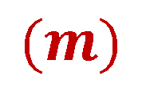
3
Evaluation — Parameter inference
$$1\%$$
$$(m)$$
When $m ≥ 512$, the average relative error is within $1\%$.

Slide 14
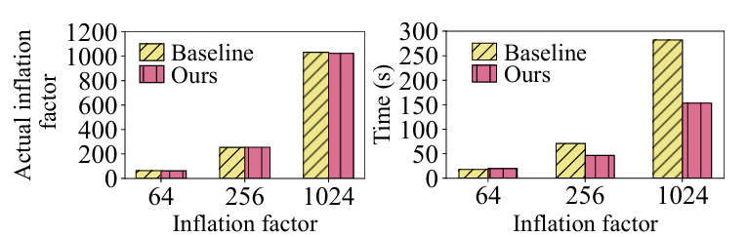

3
Evaluation — Inflation attack
$$45.64\%$$
In actual inflation effect, our method achieves comparable effectiveness to the baseline[1].
In time usage, out method reducing the attack set construction time by up to 45.64%.
[1] Pedro Reviriego, Pablo Adell, and Daniel Ting. 2020. Hyperloglog (hll) security: Inflating cardinality estimates. arXiv preprint arXiv:2011.10355 (2020).

Slide 15
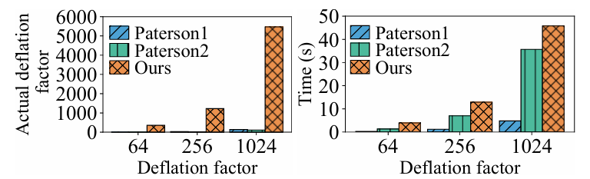



3
Evaluation — Deflation attack
$$3×$$
$$40×$$
$$10×$$
In actual deflation effect, our method is about 40 times better than that of Paterson’s methods[1].
In time usage, our attack consumes up to 10× and 3× more time than Paterson1 and Paterson2.
[1] Kenneth G Paterson and Mathilde Raynal. 2022. Hyperloglog: Exponentially bad in adversarial settings. In Proceedings of the 2022 IEEE EuroS&P. 154–170.

Slide 16
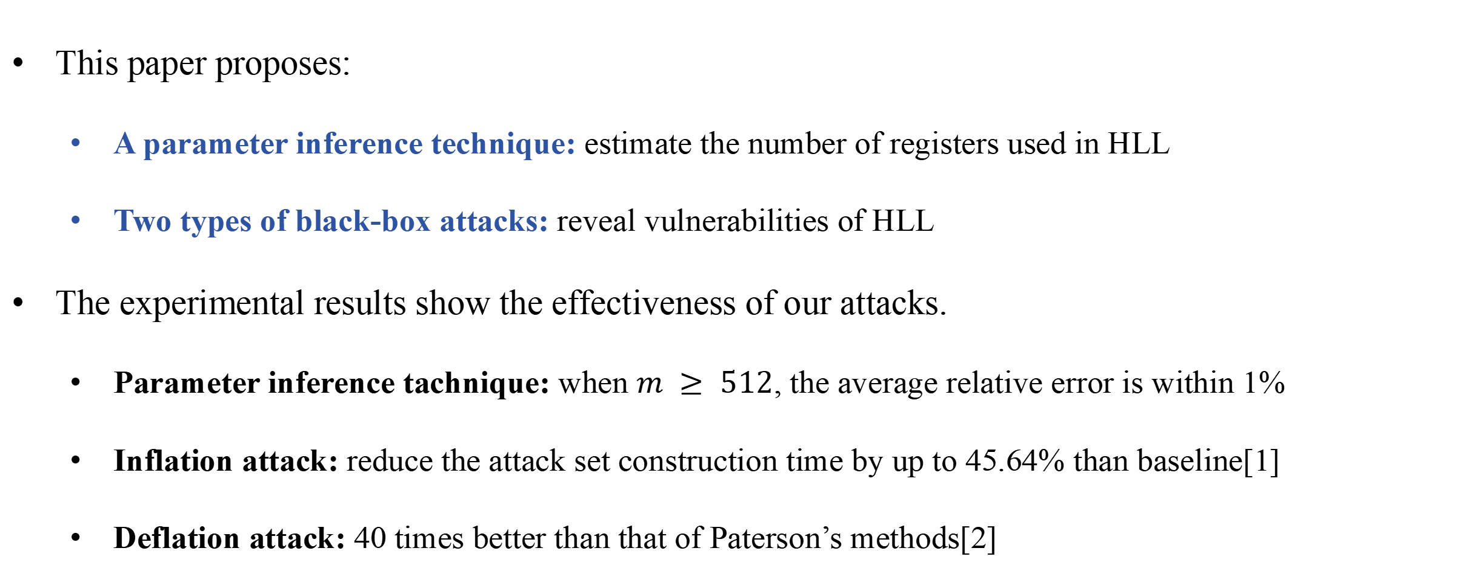
4
Conclusion
This paper proposes:
  A parameter inference technique: estimate the number of registers used in HLL
  Two types of black-box attacks: reveal vulnerabilities of HLL
The experimental results show the effectiveness of our attacks.
  Parameter inference tachnique: when $m ≥ 512$, the average relative error is within 1%
  Inflation attack: reduce the attack set construction time by up to 45.64% than baseline[1]
  Deflation attack: 40 times better than that of Paterson’s methods[2]
[1] Pedro Reviriego, Pablo Adell, and Daniel Ting. 2020. Hyperloglog (hll) security: Inflating cardinality estimates. arXiv preprint arXiv:2011.10355 (2020).
[2] Kenneth G Paterson and Mathilde Raynal. 2022. Hyperloglog: Exponentially bad in adversarial settings. In Proceedings of the 2022 IEEE EuroS&P. 154–170.

Slide 17
Thank you
Q & A

