Slide 1
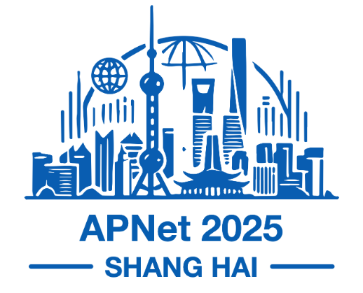


Toward Scalable Learning-Based Optical Restoration
Siyong Huang¹, Qingyu Song², Kexin Yu¹, Zhaoning Wang³, Qiao Xiang¹, Jiwu Shu^{6,1}
¹Xiamen Key Laboratory of Intelligent Storage and Computing, Xiamen University, ²The Chinese University of Hong Kong, ³China Unicom, ⁴Minjiang University
August 2025, Shanghai, China,
ACM APNET’25
Notes:
Hi, I’m Siyong from Xiamen University.
Today I‘m going to talk about a learning-based algorithm that accelerates optical restoration
This is joint work with Qingyu Song from Chinese University of Hong Kong,
Kexin Yu from Xiamen University, Zhaoning Wang from China Unicom,
as well as my advisor Qiao Xiang and Jiwu Shu.

Slide 2
Optical transmission system
IP link
router
router
ROADM
MUX
router
MUX
ROADM
router
transponder
amplifier
Notes:
Optical transmission system transport traffic through fiber. We have an IP link between two router and let us zoom into one end of the ip link. We see that right after the router ports, a device called optical transponder converts the signal from electrical domain to optical wavelength. A mux subsequently combines these wavelengths, which are then routed through a ROADM. On the fiber, amplifier is placed to compensate power attenuation during signal propagation. Therefore, an ip link is actually a logical connection supported by provisioned wavelengths.

Slide 3
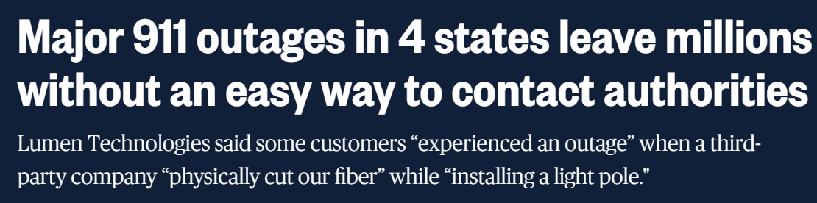
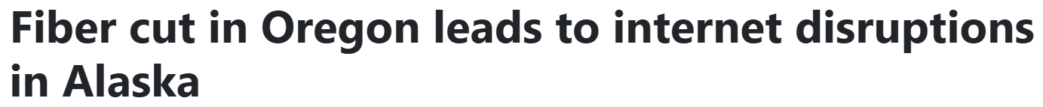

The Hazards of Fiber cuts
Source:
Update: Fiber cut causes Verizon network outage that impacts customers across county; service restored | SkyHiNews.com
911 outages in 4 states leave millions without way to call authorities
Fiber cut in Oregon leads to internet disruptions in Alaska
Severe social and financial consequences
Notes:
Operating a global-scale wan while maintaining availability is challenging, mostly because of unexpected failures, especially fiber cuts.
Historical fiber cuts have triggered severe internet disruptions, causing significant societal and economic damage.
The question is: how do we solve this problem?

Slide 4







State-of-the-art approach^{[1]} to cope with fiber cuts
Optical layer
Lottery Tickets
IP layer
…
$$\left[\begin{matrix}1 & 1.2 & 3.4 \\ … & … & … \\ 4.5 & 2.3 & 1\end{matrix}\right]$$
Optical topology
Restoration candidate 1
Restoration candidate m
Traffic demand
IP topology
Offline
Failure scenario 1
…
Online
Random rounding
LP solver
Failure scenario 1
…
…
Restoration candidate 1
Restoration candidate m
Failure scenario n
Restoration plan
Failure scenario n
[1] ARROW: Restoration-Aware Traffic Engineering [SIGCOMM’21]
Traffic splitting ratio
Notes:
The state-of-the-art approach published in sigcomm21proposes a two-stage TE model that generates multiple candidate optical restorations offline using random rounding techniques for high-probability failure scenarios and computes the optimal traffic allocation from the candidates for each traffic demand online using LP solver.

Slide 5
Motivation
  Problem 1: Low Scalability.
    2.3 hours to compute the recovery solution on an optical topology with 70 nodes
Notes:
However, we find three limitations of arrow.
First problem is low scalability. When low-probability failures arise, ARROW requires up to 2.3 hours to compute the recovery solution on an optical topology consisting of 70 nodes.

Slide 6



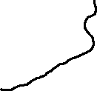



Motivation
A
$$λ_{1}$$
$$λ_{1}$$ | $$λ_{2}$$ | $$λ_{3}$$ | $$λ_{4}$$
  Problem 1: Low Scalability.
    2.3 hours to compute the recovery solution on an optical topology with 70 nodes.
  Problem 2: Implicit Optical Restoration.
B
D
C
 |  | $$λ_{3}$$ | $$λ_{4}$$
  Example
    Fiber AD is cut.
    Number of restorable wavelengths per IP link
Notes:
Second problems is implicit optical restoration. Let me take an example. There is a failure scenario in which fiber AD is cut, disrupting two IP links: AC with two wavelengths and AD with two wavelengths. One of ARROW’s candidate solutions assigns two wavelengths to AC and only one wavelength to AD. However, the specific wavelength assignment to which path and which lambda remains unspecified.

Slide 7
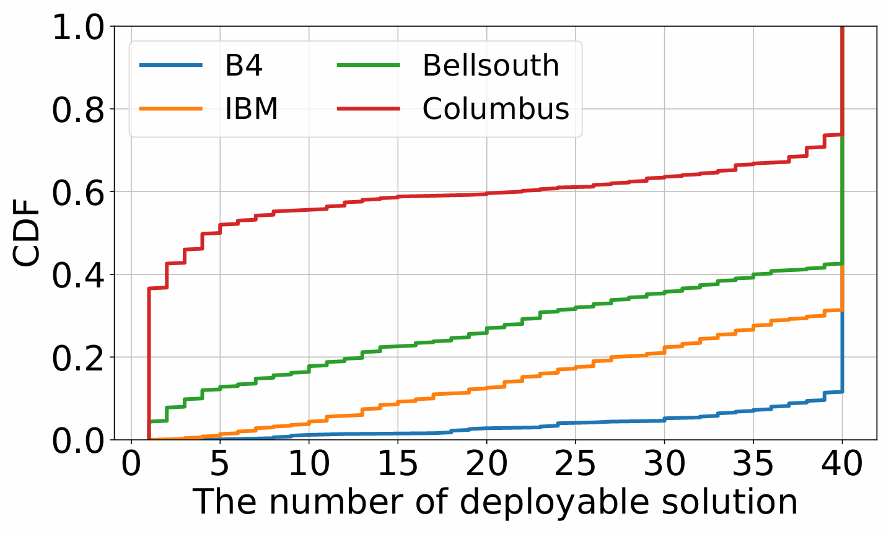
Motivation
  Problem 1: Low Scalability.
    2.3 hours to compute the recovery solution on an optical topology with 70 nodes.
  Problem 2: Implicit Optical Restoration.
  Problem 3: Limitation of Candidate Solutions.
  Fewer than 20/40 candidate solutions could deploy on Columbus’ optical layer in ~60% of scenarios.
Notes:
Third problem is limitation of candidate solutions. We derive a practical restoration strategy using an ILP model to get a specific solution based on the results of arrow. And we found in approximately 60% of the evaluated scenarios, fewer than 20 of the 40 candidate solutions could be translated into practical optical-layer configurations on Columbus.

Slide 8
Motivation
  Problem 1: Low Scalability.
    2.3 hours to compute the recovery solution on an optical topology with 70 nodes.
  Problem 2: Implicit Optical Restoration.
  Problem 3: Limitation of Candidate Solutions.
  Limitation: Dependency on the ILP solver
Notes:
And all the three limitations is due to the dependence on the accuracy and efficiency of the ILP solver.

Slide 9
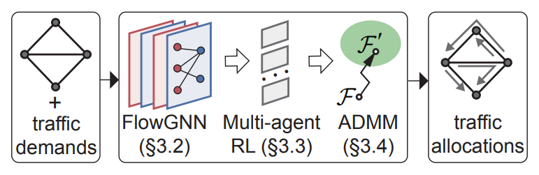
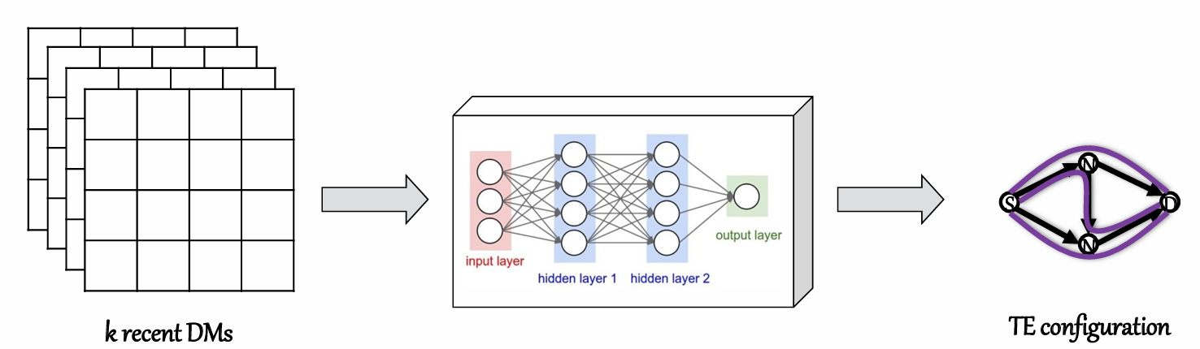
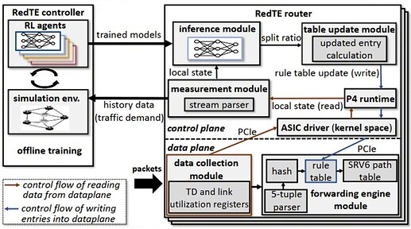
Key Insight:
Neural network inference has recently advanced the scalability of traffic engineering.
TEAL [SIGCOMM’23]
DOTE [NSDI’23]
RedTE [SIGCOMM’24]
Notes:
To avoid reallocation the traffic using ilp solver, we think ML is a good choice. And in the past two years, ml is applied to traffic engineering for multiple scenarios. In addition, based on the learning algorithm, we can further accelerates optical restorations.

Slide 10
Workflow
Pre-Training Module
Online Inference Module
Model
Online Training Module
Model
Optical Restoration
Failure Scenario
SDN Gateway
Optical Restoration
Traffic Demand
TE controller
Optical Topology
IP-layer Topology
Traffic Split Ratio
Notes:
Let me introduce the workflow of our system.
The SDN controller first collects network states. Then, we generates various fiber failure scenarios to generate a training dataset and pre-trains the model. Each time a fiber cut happens, the model computes a restoration plan based on the current network state and delivers the updated ip link configurations to the SDN controller, followed by TE controller to generate the final traffic split ratio using a gurobi solver.
To further make sure the availability of the model, LBOR periodically retrain the model using the actual fiber cut scenarios.

Slide 11
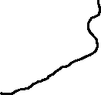



Example
Three IP links: A -> B (one wavelength), A -> C (two wavelengths), and A -> D (one wavelength).
Fiber (A, D) is cut.
Goal: restore the failed IP link as much as possible.
A
B
D
C
Notes:
Let me give an example to introduce the training process of our model. There are three ip links, ab with one wavelength, ac with two wavelengths and ad with one wavelength. And fiber ad is cut. Our goal is to restore the failed ip link as much as possible.

Slide 12





Combine Reinforcement Learning with Optical Restoration
A
B
D
C
A
C
D
wavelength usage
B
C
D
selected path
A
path agent
A
C
D
candidate path
Notes:
At first, we compute the candidate restoration path for ad based on the k shortest path algorithm. Then we feed the wavelength usage and candidate path as state. The path agent map the network state to the probability of the paths and selects an available path to restore one of the wavelengths of ip link ad.

Slide 13
Combine Reinforcement Learning with Optical Restoration
A
B
D
A
C
B
D
wavelength usage
C
wavelength agent
A
C
D
restoration
configuration
selected path
Notes:
And then the selected path is used as state observed by the wavelength agent. And the wavelength agent selects a wavelength to restore capacity for ip link ad.
This separation makes it convenient to replace the fix-path-set agent with an agent which can dynamically generates more optimal routing strategies in the future.

Slide 14
Combine Reinforcement Learning with Optical Restoration
update the wavelength usage
A
B
D
C
A
path agent
B
D
wavelength usage
A
B
C
D
C
A
C
D
restoration
configuration
wavelength agent
candidate path
Notes:
And then the wavelength usage is updated based on the selected path and wavelength to make sure two agent know the first wavelength of path a-c-d is unavailable.

Slide 15
Combine Reinforcement Learning with Optical Restoration
A
B
D
A
C
path agent
B
D
wavelength usage
C
A
B
C
D
wavelength agent
restoration
configuration
A
C
D
candidate path
Notes:
We iteratively restore all wavelengths for all failed IP links. After that, we get an episode as training data, which also is a restoration configuration. And the return is the number of wavelengths that have been successfully restored.

Slide 16


Design 1: Random Allocation Order
First episode
A
A
A
D
B
D
D
B
B
C
C
C
Second episode
A
A
A
D
B
D
D
B
B
C
C
C
Advantage: mitigate premature convergence to local optima
Notes:
However, we found that in the training process, the model is hard to find the optimal solution due to invalid exploration. We propose a randomized assignment order for agents, designed to promote more extensive exploration.

Slide 17
Design 2: Action Masking
A
D
0.2
0.0
B
0.3
0.375
0.3
0.375
0.2
0.25
C
Wavelength agent
Advantage: prune the MARL search space
Notes:
Another techniques is action masking to reduce the search space. We prune the invalid path and invalid wavelength to avoid invalid exploration.

Slide 18
Experiment Setup
Baseline:
  Two-phase solver. This method first maximizes wavelength restoration on candidate optical paths, then re-optimizes traffic allocation ratios across predefined IP-layer paths to maximize overall network recovery.
  Arrow. [SIGCOMM ‘21]:one of the state-of-the-art optical restoration system.
Topology and Traffic Matrix:
  Optical topology: four topologies from the Internet Topology Zoo.
  IP-layer topology: wavelength distribution based on Arrow.
  Traffic Matrix: Yate
Metric:
  maximize total flow normalized into satisfied demand
Notes:
Our evaluation setup is as follows.
As for baselines, we adopt two-phase solver as solutions from the ILP solver and arrow.
We used four topologies from the internet topology zoo as optical topology and wavelength distribution from arrow to generate ip-layer topology.
We use 15000 dataset for training and another 15000 for test.
As for the metric, our objective is to maximize total flow and we normalized our results into satisfied demands.

Slide 19
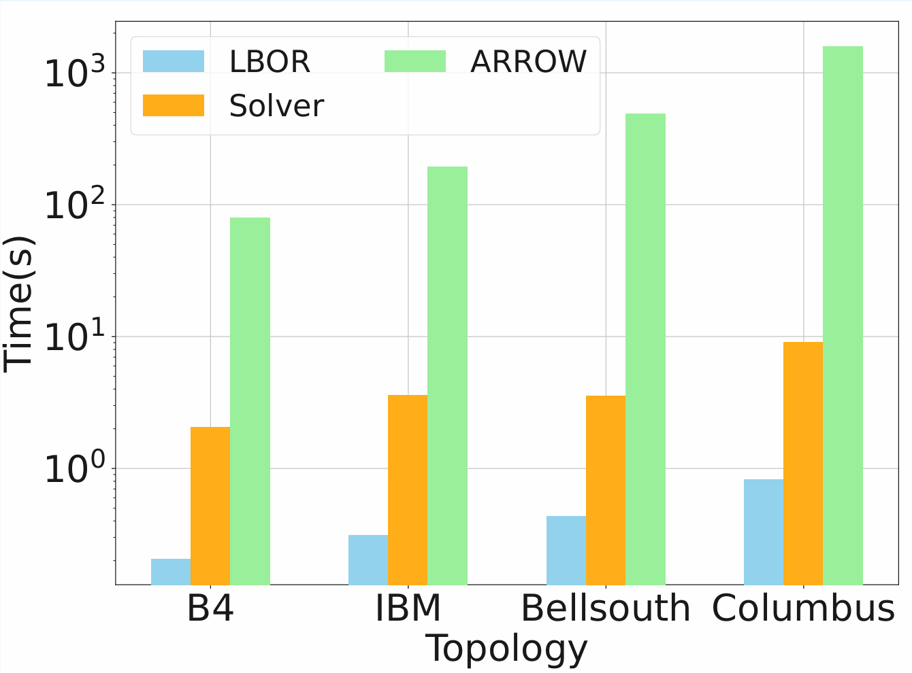
LBOR significantly accelerates optical restoration
LBOR gets the restoration within 1s:
  Two-phase solver: 10× slower in Columbus.
  Arrow: 1000× slower in Columbus.
Regardless of the topology size or failure pattern, LBOR maintains inference latency within 0.82s,with its primary computational bottleneck stemming from the LP solver in the larger topologies.
Notes:
Our evaluation shows that LBOR significantly accelerates optical restoration
LBOR reallocates traffic within 1 s in larger networks, with its primary computational bottleneck stemming from the LP solver in the larger topologies.
We gain 10x speedup compared with two-phase solver on average, and solving ILPs directly is computationally expensive.
[删掉]In addition, Significant variability exists in per-scenario computation times when solving ILPs directly, differing by up to 50x even in the smallest network topologies
ARROW further intensifys this issue as it requires multiple rounding and feasibility checks to generate 40candidate solutions, followed by solving 40 parallelizable ILPs.

Slide 20
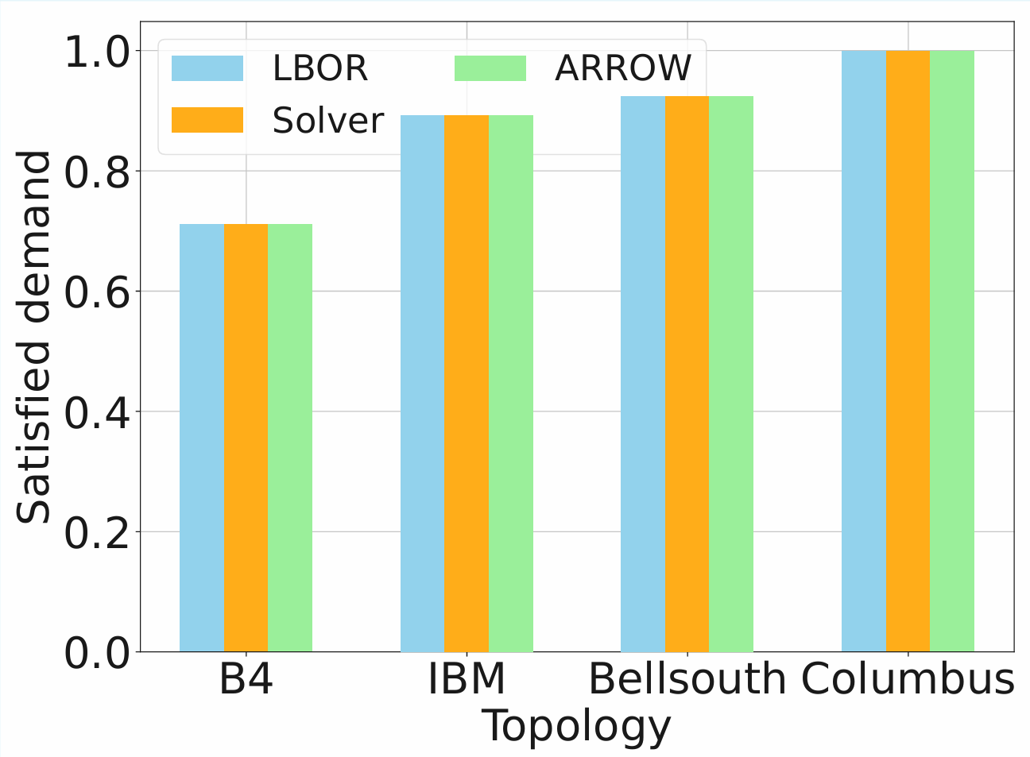
LBOR generates near-optimal traffic allocations
LBOR exhibits only a slight reduction compared to both Solver and ARROW.
LBOR outperforms ARROW in 60 failure scenarios on Columbus, achieving a better traffic allocation.
Notes:
Apart from being fast, LBOR generates near-optimal traffic allocations
LBOR exhibits only a slight reduction compared to both Solver and ARROW.
And it outperforms ARROW in 60 failure scenarios on Columbus with 70 nodes, achieving a better traffic allocation.

Slide 21
Summary
Contribution:
  We designed a learning-based optical restoration and traffic reallocation framework to accelerate optical restoration.
  We develop a randomized assignment ordering strategy to mitigate premature convergence to local optima and an action masking mechanism to prune the MARL search space.
Future work:
  Learning-based joint routing and wavelength allocation.
  Learning-based joint Optical/IP Formulation.
  Larger-scale experiments.
Notes:
【】In conclusion, LBOR demonstrates the ability to substantially accelerate optical restoration using reinforcement learning, while also achieving near-optimal traffic allocation.
【】With these encouraging results, we believe LBOR opens the door to a new paradigm for applying ML in networking: not only for optimization, but also for dramatically accelerating the solution of complex network problems.
Looking ahead, we plan to explore extending this approach to more challenging scenarios, such as joint routing and wavelength allocation, as well as joint optical and IP network optimization. We look forward to sharing these future results in upcoming publications.
Thank you for your attention.

