Slide 1

﻿Rethinking Dynamic Networks and Heterogeneous Computing with Automatic Parallelization
Ruilong WU, Xinjiao LI, Yisu Wang, Xinyu Chen, ﻿Dirk Kutscher
August 8,2025
IOT Thrust of HKUST(GZ)

Slide 2

Background
Challenge
Heterogenous Computation
How to get computational time?
HexGen[ICML’24], HexGen-2[ICLR’25], Helix[ASPLOS’25], LLM-PQ[PPoPP]
Dynamic Bandwidth
OptiReduce[NSDI’25], Themis[ISCA’22],
CASSINI[NSDI’24]
Flow scheduling and congestion control
Classic cloud-base environment
Node failure and slows down
How to recovery and adjust tasks?
Recycle[SOSP’24], Gemini[SOSP’23],
Oobleck[SOSP’23], DropCompute[NIPS’23]
﻿Insight: computation can be viewed as mapping data and algorithms onto computational devices, while communication corresponds to data transmission tasks across network links

Slide 3


Heterogenous Computation
B
A
﻿Attention Throughput: H100 vs V100
Heterogenous computation for one operator
Point A: limited by memory bandwidth
Point B: limited by computational performance
FLOP_{s} :the peak floating-point operations per second
memBW_{𝑝}: the peak memory bandwidth of the GPU
K: arithmetic intensity

Slide 4
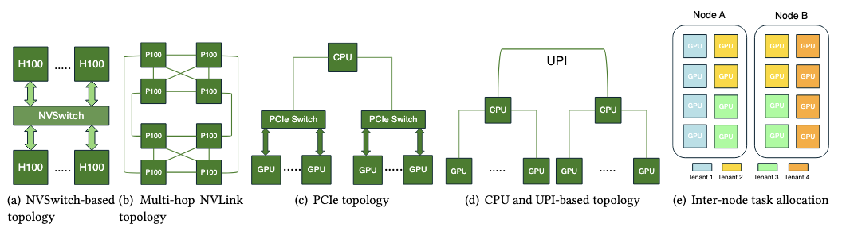
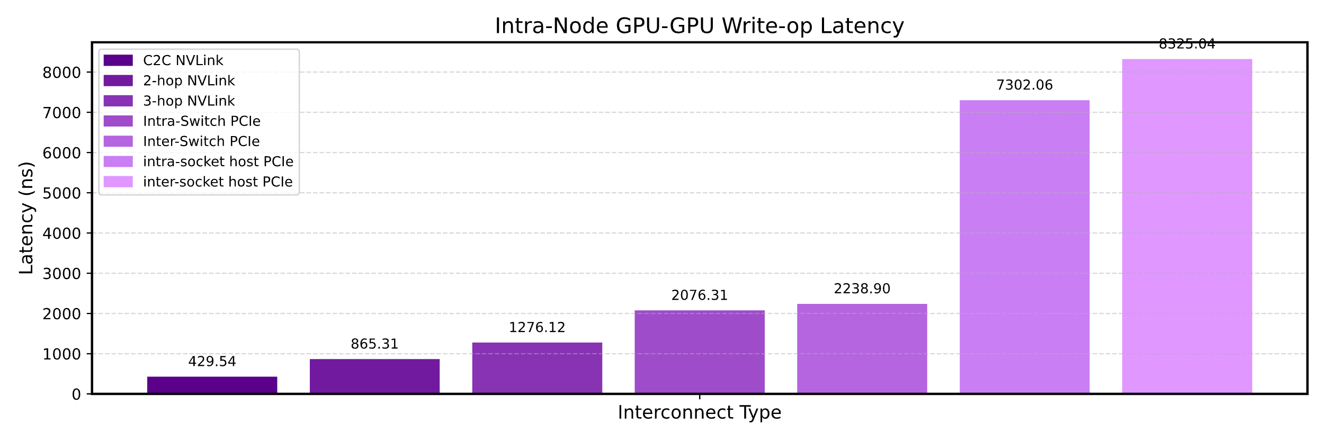
Dynamic Bandwidth
Intra-node Topology
Inter-node Topology
Intra-node GPU-to-GPU write-operation la-
tency under different interconnect types

Slide 5
Operation Fusion and Split
Hierarchy of GPU memory bandwidth optimization levels.
Example of op fusion: GEMM+Reduce scatter

Slide 6
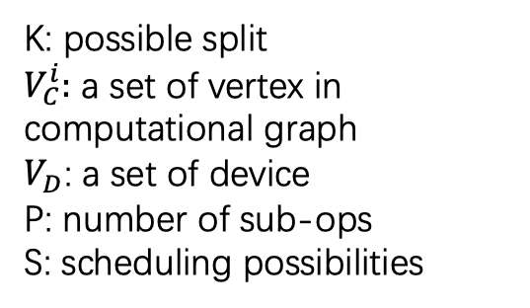

Design
Multi-edge Assumption
K: possible split
$V_{C}^{i}:$ a set of vertex in computational graph
$V_{D}$: a set of device
P: number of sub-ops
S: scheduling possibilities
Search space
$$O(K^{\left|V_{C}^{i}\right|}×{\left|V_{D}\right|}^{p}×S)$$
Edge conflict

Slide 7
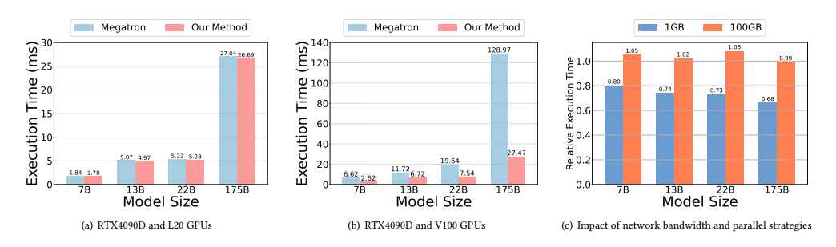
Evaluation
Environment Setup
Using SimAI to invoke execution time on RTX4090D, L20 and V100
Model: LLaMA_7B, GPT_13B, GPT_22B, and GPT_175B.
﻿Scenario 2: Dynamic Network Conditions.
﻿Scenario 1: Heterogeneous Computation

Slide 8
Conclusion and future work
conclusion
A common abstract for distributed complier for LLM tasks on heterogenous computing and dynamic network
Preliminary validation on parallel strategies change on different environments because of variable operators on computation and network
To do
﻿First, due to simulator constraints, we are currently limited to parallel strategies defined by the Megatron-LM. In future work, we plan to implement a native operator-level simulator rather than relying on coarse-grained model-level task assignments.
Second, to accommodate variable-length operators, the search space grows exponentially. Even with multithreading, it is difficult for the CPU to match the search efficiency of existing methods. We plan to leverage FPGA-based acceleration for simulations in future work.

Slide 9
Thanks for listening

