Slide 1
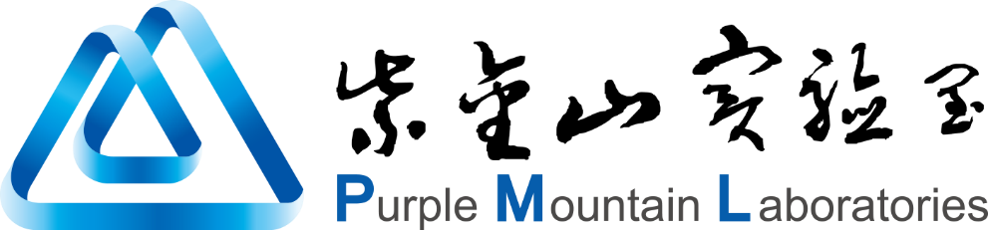

Topology-Adaptive LEO Satellite Network Telemetry via Graph Isomorphism and Topology Partitioning
Yan Zhang, Tian Pan, Yan Zheng, Guohao Ruan, Haonan Li, Yi Liu, Jiang Liu, Huang Tao

Slide 2
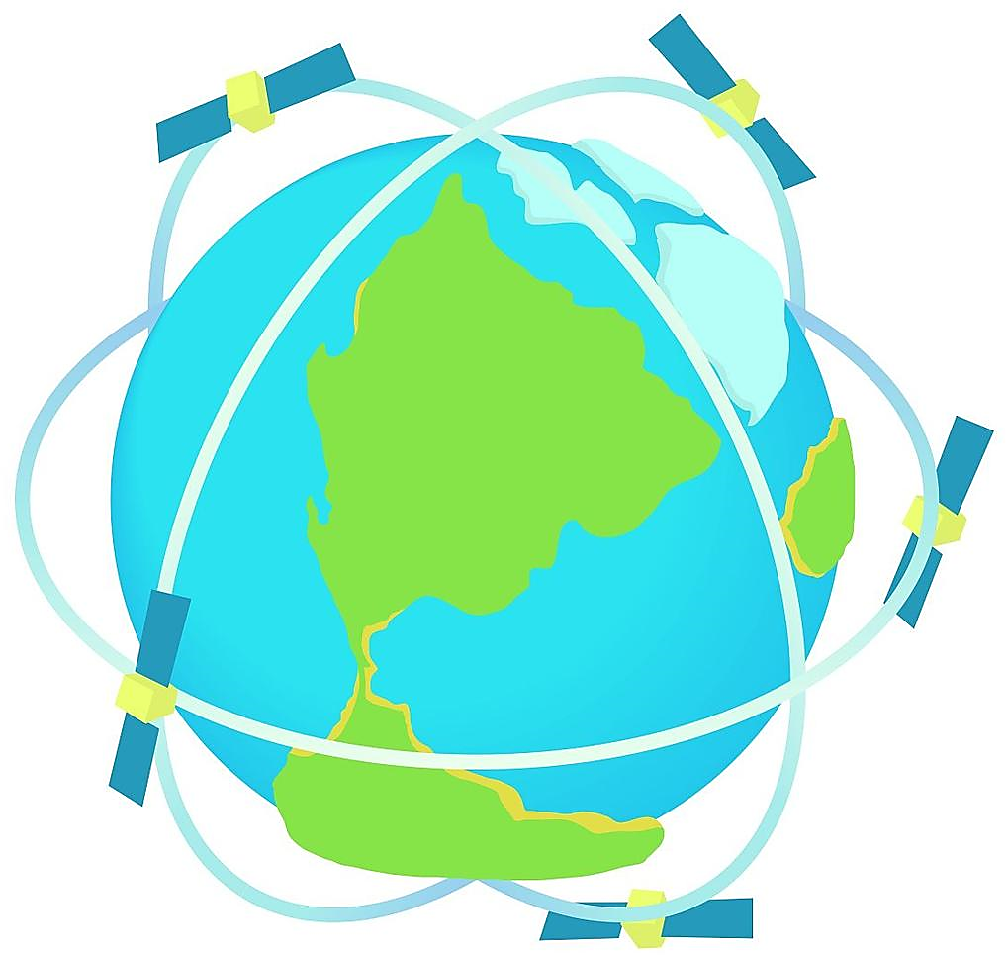
Introduction of LEO satellite networks
Applications
Global internet,
Remote connectivity,
Emergency comms,
IoT connections,
Earth monitoring…
Advantages
Global coverage,
Low latency,
Fast deployment,
Cost efficiency…
🌍
🚀
Low Earth Orbit (LEO) satellite networks
Measurement
High requirements for QoS,
Latency tracking,
Signal stability,
Interference detection…
Challenges
High dynamic nature,
Satellite motion,
Link on/off,
Topology change,
Frequent and Periodic…
📏
⚠️
Starlink: topology changes reach 10 times per second.
2

Slide 3
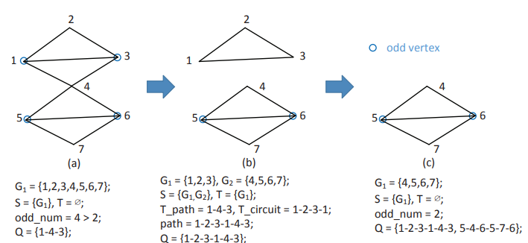
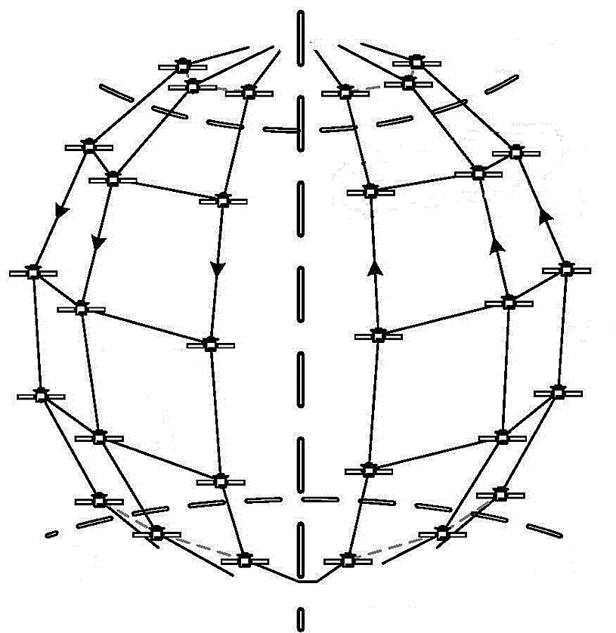
Network-wide measurement
Terrestrial network measurement:
SNMP, ping and traceroute.
Pingmesh and NetBouncer.
VNet Pingmesh and Zoonet.
In-band Network Telemetry (INT)…
Example: path planning in INT-path
Network-wide measurement requires topology-aware path planning.
Frequent and periodic topology changes may result in repeated execution of path planning, increasing overhead.
3

Slide 4
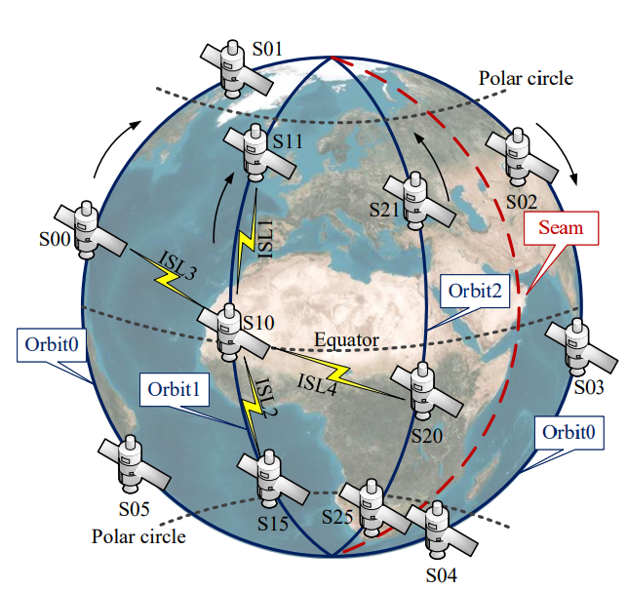

LEO Satellite Link Characteristics
Walker constellation:
Uniformly distributed orbits and satellites.
Intra-orbit ISLs: remain always connected.
Inter-orbit ISLs: break or reconnect as satellites enter or exit the polar regions.
SGL
ISL: Inter-Satellite Link
SGL: Satellite-to-Ground Link
Planar Projection of a 6*8 Constellation Topology
4

Slide 5
LEO Satellite Topology Dynamics
Are there underlying patterns in the frequent topology changes?
The regularity of satellite motion often results in similar graph structures among different topologies.
satellites moved 22.5◦
satellites moved 45◦
An example: LEO48 constellation (N = 6, M = 8, F = 3, β = 66◦).
5

Slide 6
LEO Satellite Topology Dynamics
Time A
Time B
Time C
Different topology snapshots may have same structure.
When performing network-wide measurement, we only need to plan probing paths for different-structure topologies, reducing the computation and overhead.
6

Slide 7
LEO Satellite Topology Dynamics
LEO48 constellation (the west part of the non-polar region):
A cyclic pattern of 4 different-structure topology graphs appearing in a fixed order.
Different-structure topologies occur in a continuous sequence.
It is straightforward to extract them from network topology sequences.
7

Slide 8
Our Solution
Graph Isomorphism
We “find the constant in the change” and configure full topologies using measurement plans generated for only a small set of representative topologies.
We investigate this self-similarity of the dynamic topologies using graph isomorphism theory.
Topology Partitioning
Satellite network topology changes have regional differences.
We apply a divide-and-conquer measurement method, monitoring non-polar region with INT-based path planning and polar regions with probe flooding.
8

Slide 9
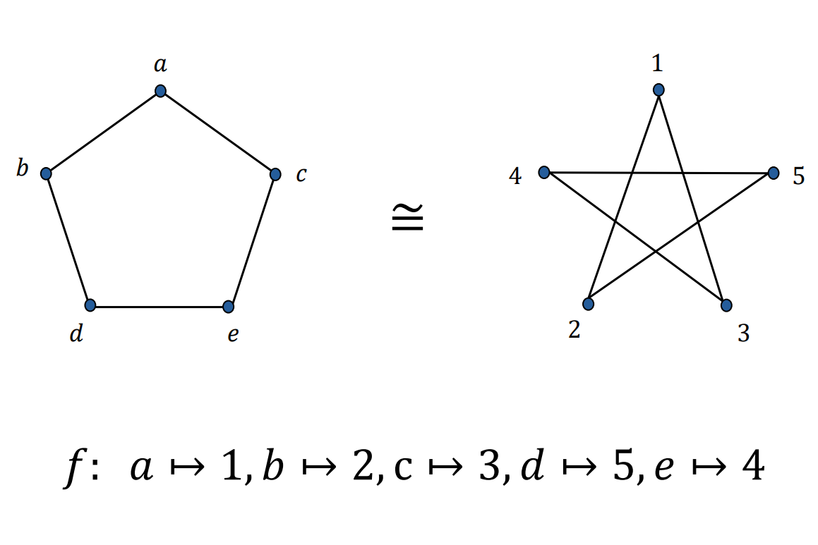
Satellite Topology Self-Similarity
What is Graph isomorphism?
A concept in graph theory that captures when two graphs are identical in structure, even if they appear different due to vertex labeling.
Non-isomorphic
Non-isomorphic
Topology A
Topology B
Topology C
Same number of vertices and edges, and same pattern of connectivity.
Isomorphic
9

Slide 10
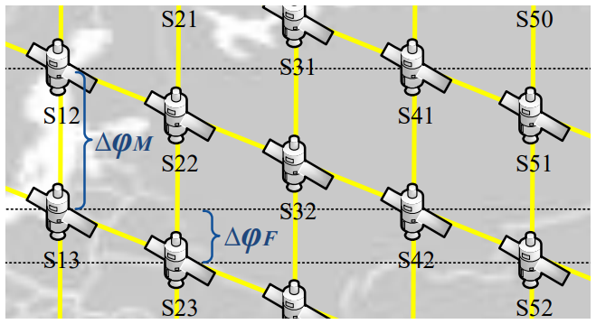
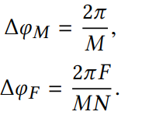

Non-Isomorphic Topology Extraction
The number of topology changes and the number of non-isomorphic topologies.
∆φM: In-Orbit Phase Difference.
∆φF: Cross-Orbit Phase Difference.
(1)
(2)
When F = 0, ∆φF = 0.
When F ≠ 0, the ratio of the above two phase differences:
Constellation parameters:
N: number of orbit planes
M: number of satellites per plane
F: phase factor
(3)
10

Slide 11
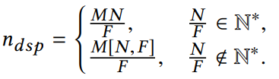
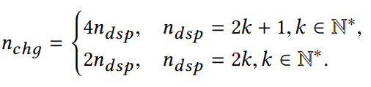
Non-Isomorphic Topology Extraction
1. Number of Topology Changes (n_chg)
n_dsp is the number of different satellite phases in a period.
When F ≠ 0:
(4)
(1) When n_dsp is odd, whenever a satellite crosses a polar circle, it causes a topology change. A satellite is known to cross the polar circles 4 times during one orbit around the Earth.
(2) When n_dsp is even, whenever a satellite crosses a polar circle, there must be another satellite crossing the other polar circle at the same time.
(5)
11

Slide 12
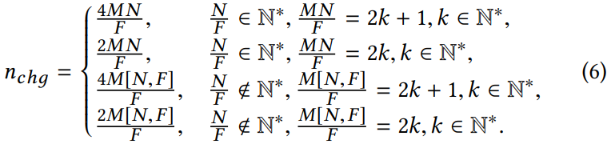
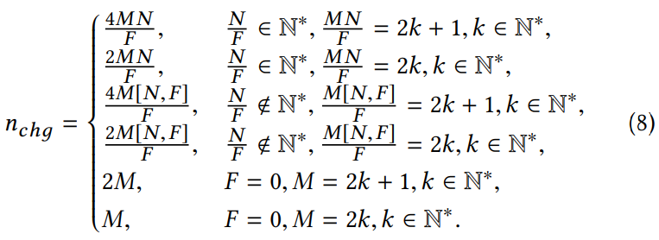
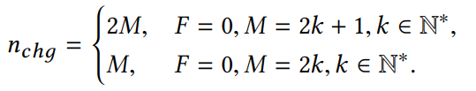
Non-Isomorphic Topology Extraction
With Equation (4) and (5), n_chg can be expressed as:
Number of Topology Changes (n_chg):
(6)
When F = 0, n_dsp = M, since adjacent satellites in neighbor orbits have the same phase.
(8)
(7)
12

Slide 13

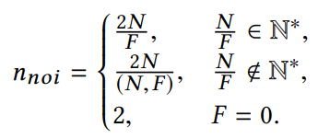
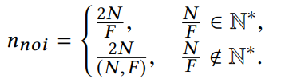
Non-Isomorphic Topology Extraction
2. Number of Non-Isomorphic Topologies (n_noi)
When F ≠ 0:
When F = 0, n_ssp = N. That is, N same-phase satellites in all orbits cross the polar circle at the same time, and n_noi = 2, considering two polar circles.
(9)
n_ssp is the number of same-phase satellites.
(1) When r ∈ N∗, n_ssp = F;
(2) When r ∉ N∗, n_ssp = (N, F).
Thus, n_noi can be expressed as:
Number of Non-Isomorphic Topologies (n_noi):
(11)
(10)
13

Slide 14
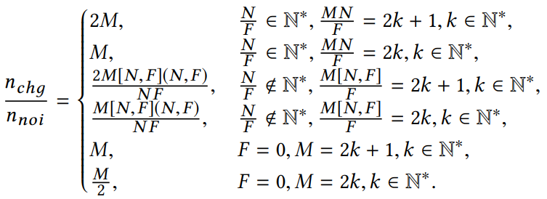
Non-Isomorphic Topology Extraction
Number of Topology Changes (n_chg):
The ratio of n_chg to n_noi:
Number of Non-Isomorphic Topologies (n_noi):
The number of non-isomorphic topologies is much smaller than the number of topology changes.
We can then determine the number of non-isomorphic topologies and extract them based on equations.
14

Slide 15
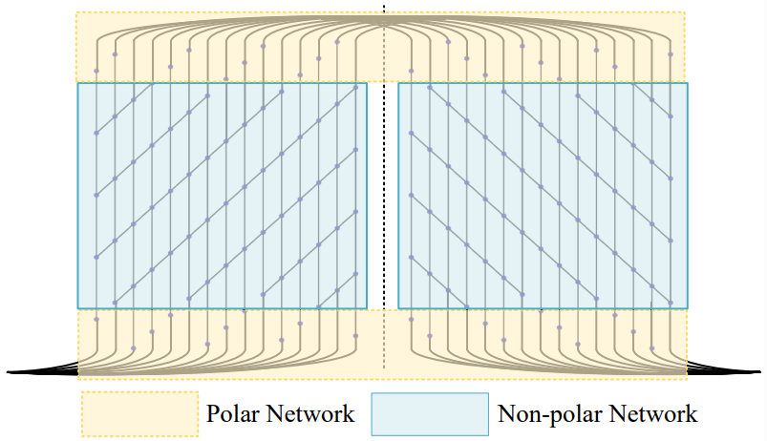
Measurement with Topology Partitioning
Satellite topology changes generally have regional differences.
We adopt a divide-and-conquer measurement strategy.
Divide the satellite network into non-polar network and polar network by the polar region boundary.
Use different monitoring methods for different regions.
15

Slide 16
Non-Polar Region Monitoring
We adopt a network-wide telemetry approach by INT-based path planning.
Extract the non-isomorphic topologies.
Generate monitoring paths by INT-path.
Install the measurement plan into the data plane.
Activate the INT logic on node satellites.
Non-overlapping, network-wide monitoring paths with the minimum path number, reducing measurement overhead.
The plan can be reused across the remaining isomorphic topologies.
Our measurement plans can be reused across the remaining isomorphic topologies.
Since non-isomorphic topologies appear periodically and continuously, we only need to activate in each time slice.
16

Slide 17
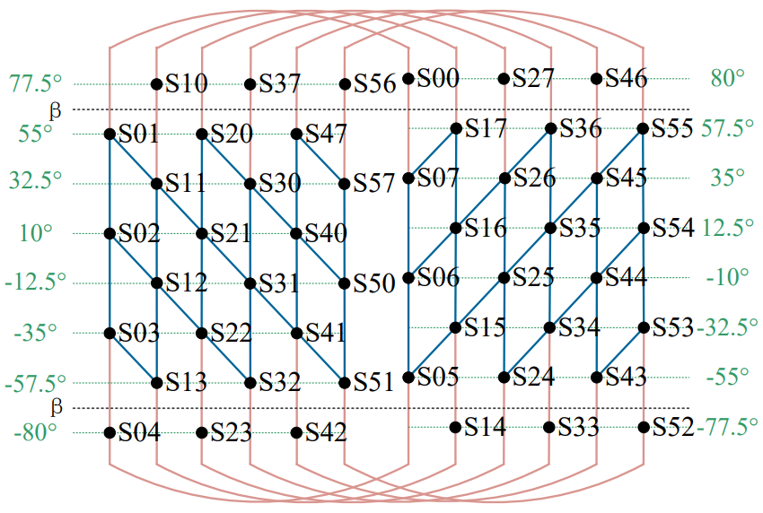
Polar Region Monitoring
We adopt a flooding-based probing approach to simplify measurement.
In the polar regions, inter-orbit ISLs are already disconnected, so flooding does not incur significant overhead.
An example:
Satellite S10 floods probe packets to S11 and S17. After receiving the probe packets, S11 and S17 bounce them back to S10.
17

Slide 18
Telemetry Data Landing
How to deliver the telemetry data to the ground?
Relay-based data landing method: INT sink satellite → Direct-link satellite → Ground station
An example:
If S16 is the INT sink and S34 is the direct-link satellite, the tunnel path can be “S16-S26-S36-S35-S34”.
18

Slide 19
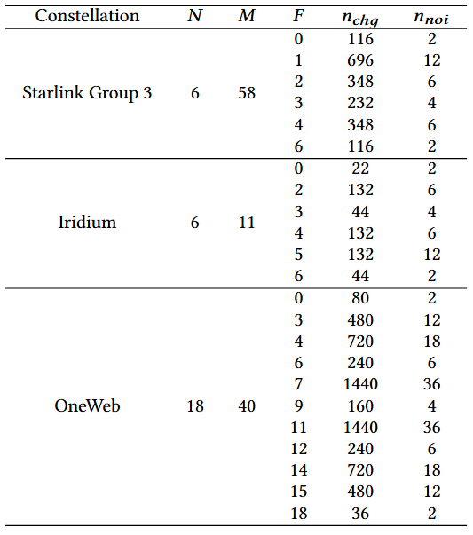
Evaluation
Constellations and their non-isomorphic topologies
We verify the equations by performing experiments on different satellite constellations.
The number of non-isomorphic topologies (n_noi) is much smaller than the number of topology changes (n_chg).
19

Slide 20
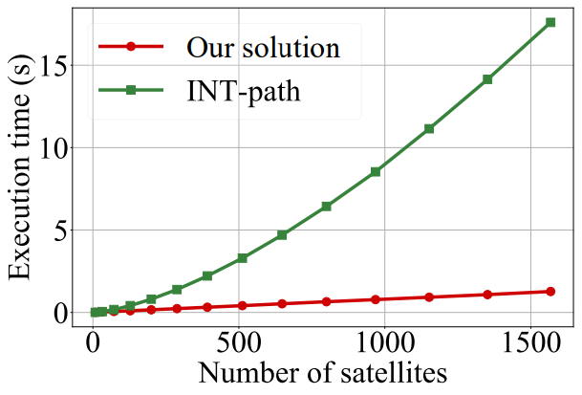
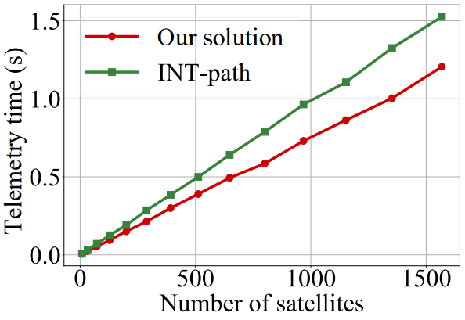
Evaluation
Path planning execution time
Our solution significantly reduces this time compared to directly using INT-path.
Time for one round of telemetry
The telemetry time of our solution with topology partitioning is lower than that of INT-path.
20

Slide 21
Conclusion
We present a topology-adaptive telemetry approach for LEO satellite networks, reducing monitoring overhead while ensuring fine-grained network visibility.
We observe self-similarity in topology changes based on graph isomorphism, which allows us to represent the full topology sequence using a small set of distinct topologies.
We apply a divide-and-conquer strategy monitoring in both polar and non-polar regions by topology partitioning, enhancing scalability and efficiency.
21

Slide 22
Future Work
Using ground stations as INT source and sink.
Current solution places the INT source and sink on satellites, and reserve additional direct-link satellites for interacting with ground stations. This may result in a suboptimal overall path planning and imposes high requirements on satellites.
Virtualized satellite network measurement.
As LEO satellites increasingly integrate with terrestrial public clouds, their infrastructure is expected to be virtualized to carry multi-tenant traffic. Due to limited satellite bandwidth, active measurement may lead to overlapping probe traffic and bandwidth exhaustion.
Monitoring with topology-agnostic distributed labeling.
Our approach reduces the number of distinct topologies, thereby lowering the overhead of path planning. If network measurement is entirely independent of topology-based path planning, it would not be affected by the dynamic nature of satellite topologies at all.
22

Slide 23
Thank you!

