Slide 1
Maat: A Fair Layer-4 Load Balancer With Per-Connection Consistency
Ju Huang, Lu Tang

Slide 2








1
Background
Layer-4 Load balancer (L4 LB): Distribute incoming connection requests to a group of servers running the same service.
  1) F5 (F5 Networks)
  2) A10 (A10 Networks)
  3) LVS (Linux Virtual Server)
  4) ATS (Apache Traffic server)
Requirements：
  1) Fairness
  2) Per-connection consistency(PCC)
  3) Deployability
Server1
Server2
L4 LB
(VIP)
Server3
DIP Pool
（DIPs）
Server4

Slide 3


1
Background
1) Fairness: Evenly distribute incoming connection requests
Increased Response Time
  Traditional network: Over-provisioning [1]
    High operating costs;
    Performance bottleneck;
  Cloud network: Orchestration tools (K8S) adjust network resources
    Operational overhead (auto-scaling mechanism);
    Service disruption (eviction mechanism);
Server1
Server2
L4 LB
(VIP)
Server3
DIP Pool
(DIPs)
Server4
Resource Waste
[1] Barbette T, Wu E, Kostić D, et al. Cheetah: A high-speed programmable load-balancer framework with guaranteed per-connection-consistency[J]. IEEE/ACM Transactions on Networking, 2021, 30(1): 354-367.

Slide 4

1
Background
  2） PCC: Ensures that all packets from a connection are sent to the same server.
flow1
flow2
Server 1
flow3
Server 2
L4 LB
(VIP)
Server 3
Traditional network: Monolithic architecture
  Limited impact;
Cloud network: Microservices architecture[1]
  Cascading failure;
DIP Pool
(DIPs)
Server 4
[1] Zhang S, Xia S, Fan W, et al. Failure diagnosis in microservice systems: A comprehensive survey and analysis[J]. ACM Transactions on Software Engineering and Methodology, 2024.

Slide 5
1
Background
  3） Deployability: Ensure protocol independence and transparency for host configuration.
Network Protocol
Traditional network: Dedicated resources, complete control[1]
  Small-scale deployment;
Cloud network: Shared resources, centrally manage [2]
  Limited usage scenarios;
  Increased operational cost;
Server 1
Server 2
L4 LB
(VIP)
Server 3
DIP Pool
(DIPs)
Server 4
TCP Options
[1] Zeng C, Luo L, Zhang T, et al. Tiara: A scalable and efficient hardware acceleration architecture for stateful layer-4 load balancing[C]//19th USENIX Symposium on Networked Systems Design and Implementation (NSDI 22). 2022: 1345-1358.
[2] Bello S A, Oyedele L O, Akinade O O, et al. Cloud computing in construction industry: Use cases, benefits and challenges[J]. Automation in Construction, 2021, 122: 103441.

Slide 6


1
Background
Existing Layer-4 load balancing solutions
Hash-based solution
  Maglev[1], Silkroad[2], Concury[3]... (e.g., ECMP hash…)
          PCC Deployability
            Hash algorithm → Maintain the mapping of connections to servers
    Fairness
      Long-tail distribution[4]: A small fraction of flows are elephant flows, while the majority are mice flows;
      Prone to load imbalance with this distribution.
[1] Eisenbud D E, Yi C, Contavalli C, et al. Maglev: A fast and reliable software network load balancer[C]//13th USENIX Symposium on Networked Systems Design and Implementation (NSDI 16). 2016: 523-535.
[2] Miao R, Zeng H, Kim C, et al. Silkroad: Making stateful layer-4 load balancing fast and cheap using switching asics[C]//Proceedings of the Conference of the ACM Special Interest Group on Data Communication. 2017: 15-28.
[3] Shi S, Yu Y, Xie M, et al. Concury: A fast and light-weight software cloud load balancer[C]//Proceedings of the 11th ACM Symposium on Cloud Computing. 2020: 179-192.
[4] Li Y, Miao R, Liu H H, et al. HPCC: High precision congestion control[M]//Proceedings of the ACM special interest group on data communication. 2019: 44-58.

Slide 7
1
Background
Existing Layer-4 load balancing solutions
Non-Hash-based solution
  1）6LB[1], Cheetah[2]…(e.g., RR/Power of two[3]…)
    Fairness PCC
      Non-hash algorithms perform better than hash-based algorithms[1]
      Header field → Maintain the mapping of connections to servers
    Deployability
      Dependent on specific network protocols (e.g., IPv6,GRE)
      Modify server configuration (e.g., TCP Options)
[1] Desmouceaux Y, Pfister P, Tollet J, et al. 6lb: Scalable and application-aware load balancing with segment routing[J]. IEEE/ACM Transactions on Networking, 2018, 26(2): 819-834.
[2] Barbette T, Wu E, Kostić D, et al. Cheetah: A high-speed programmable load-balancer framework with guaranteed per-connection-consistency[J]. IEEE/ACM Transactions on Networking, 2021, 30(1): 354-367.
[3] Mitzenmacher M. The power of two choices in randomized load balancing[J]. IEEE transactions on parallel and distributed systems, 2002, 12(10): 1094-1104.

Slide 8
2
Design overview
How Maat meet the requirements
PCC
  Using Counting Bloom Filter (CBF) to record existing flow
Fairness
  Providing a backup server for each server
Deployability
  No reliance on any specific protocol
  No modification of server configuration

Slide 9

2
Design
Design Goal: To improve the fairness of the L4 LBs, while ensuring both PCC and deployability.
1) Framework
Update the data plane when network changes occur
Control Plane
DIP Pool
construct entries
record the mapping
ASCP
Flow table
update entries
Counting bloom filter(CBF)
query…
ASDP
Index table
DIP table
query
query
forward
Data Plane
Selecting an appropriate server for incoming traffic

Slide 10
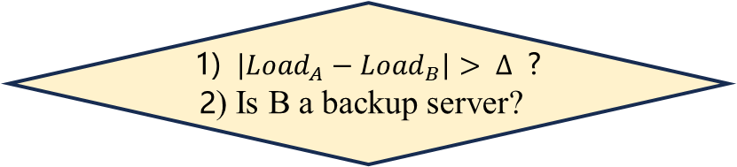
2
Design — Data plane
1) Select a suitable server for the first packet of each flow (i.e., the SYN packet) to enhance fairness;
Hash Selection: Server A(Scenario 1: Server A has no backup server)
server B shares the load from server A.
set Server B as the backup for Server A.
record the flow in a CBF [1].
Yes; No
Differentiate the selected server(A or B)
Check whether Server A is overloaded.
select Server B
1) $\left|{Load}_{A}−{Load}_{B}\right|> ∆$ ?
2) Is B a backup server?
1) Hash Selection: Server A
2) Random Selection: Server B
Check whether Server B is at risk of being overloaded.
Other cases
select Server A
[1] Bonomi F, Mitzenmacher M, Panigrahy R, et al. An improved construction for counting bloom filters[C]//Algorithms–ESA 2006: 14th Annual European Symposium, Zurich, Switzerland, September 11-13, 2006. Proceedings 14. Springer Berlin Heidelberg, 2006: 684-695.

Slide 11

2
Design — Data plane
1) Select a suitable server for the first packet of each flow (i.e., the SYN packet) to enhance fairness;
Hash Selection: Serve r A(Scenario 2: Server A has backup server)
record the flow in a CBF [1].
Differentiate the selected server(A or B)
Select Server B
Yes
1) Hash Selection: Server A
2) Random Selection: Server B
1) $\left|{Load}_{A}−{Load}_{B}\right|> ∆$ ?
No
Select Server A
[1] Bonomi F, Mitzenmacher M, Panigrahy R, et al. An improved construction for counting bloom filters[C]//Algorithms–ESA 2006: 14th Annual European Symposium, Zurich, Switzerland, September 11-13, 2006. Proceedings 14. Springer Berlin Heidelberg, 2006: 684-695.

Slide 12
2
Design — Data plane
2) For the subsequent packets of each flow, maintain the connection state using CBF [1].
Server A is operating normally.
Select Server A
No
No
Server B is the backup for Server A?
Check if the CBF contains the flow?.
Hash Selection: Server A
Yes
Yes
Select Server B
[1] Bonomi F, Mitzenmacher M, Panigrahy R, et al. An improved construction for counting bloom filters[C]//Algorithms–ESA 2006: 14th Annual European Symposium, Zurich, Switzerland, September 11-13, 2006. Proceedings 14. Springer Berlin Heidelberg, 2006: 684-695.

Slide 13
2
Design — Control plane
1) Ensure the data plane maintains the up-to-date mapping of connections to servers.
  Step 1: Aggregate the current state of connection mappings.
Step 2: When the network changes, update the data plane with the entry corresponding to the latest mappings.
flow_id | server_id
3 | 2
5 | 4
Flow table
Control Plane
Step 1
hash_id | server_id
8 | 2
5 | 4
Step 2
ASCP
Data Plane

Slide 14
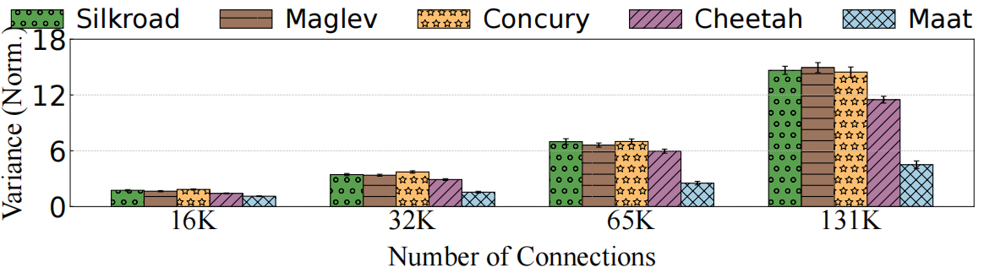
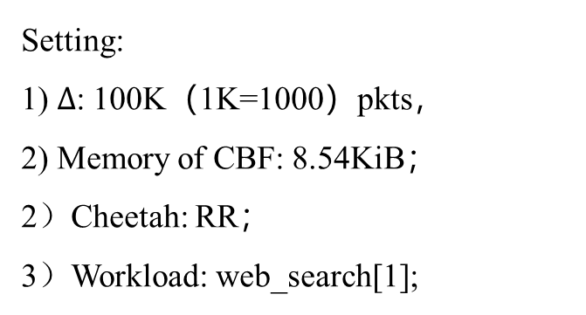
3
Evaluation — Fairness: Average variance
Setting:
1) $∆$: 100K（1K=1000）pkts，
2) Memory of CBF: 8.54KiB；
2）Cheetah: RR；
3）Workload: web_search[1];
63.64%
72.13%
Average Variance vs. Number of Connections
Maat reduces the average variance by 60% to 70%
[1] Alizadeh M, Greenberg A, Maltz D A, et al. Data center tcp (dctcp)[C]//Proceedings of the ACM SIGCOMM 2010 Conference. 2010: 63-74.

Slide 15
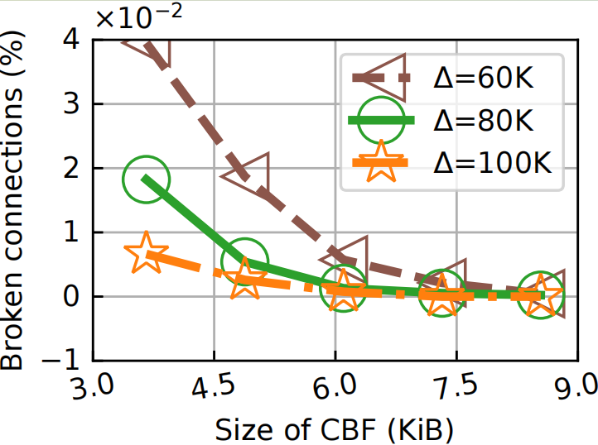
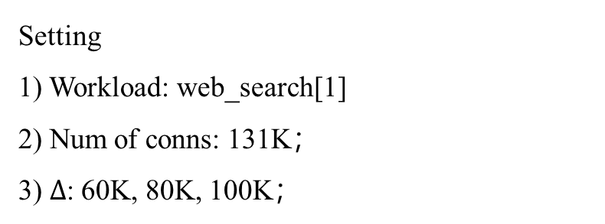
3
Evaluation — PCC: Broken connections ratio
Setting
1) Workload: web_search[1]
2) Num of conns: 131K；
3) $∆$: 60K, 80K, 100K；
Broken connections ratio vs. Memory Overhead
The CBF in Maat requires 8.54 KiB of memory to guarantee 100% PCC
[1] Alizadeh M, Greenberg A, Maltz D A, et al. Data center tcp (dctcp)[C]//Proceedings of the ACM SIGCOMM 2010 Conference. 2010: 63-74.

Slide 16
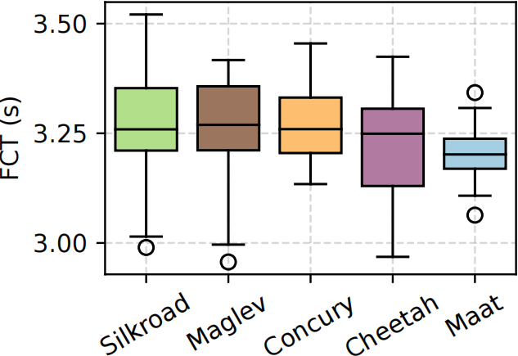
3
Evaluation — Deployability: FCT distribution in the testbed
Setting:
1）Topo：
One server acts as the client sending HTT requests; One server acts as the DIP pool;
The Tofino switch acts as the L4 LB.
2) Request: 131K；
Maat shows an improvement of up to 6.25% in max FCT

Slide 17
4
Conclusion
This paper proposes a novel load-balancing strategy
  Maintains PCC and deployability using hash selection and CBF.
  Improves fairness by utilizing random selection.
Evaluations on real-world workloads show that Maat
  keeps fairness by reducing the average variance by 60% to 70%
  keeps PCC with 8.54 KiB
  keeps deployability by deploying on Tofino

Slide 18
Thank you
Q & A

